Slide 1
GM Report John Viola

Slide 2
GM REPORT
June 3, 2020
John Viola
Initiatives | Construction Status | Projects Completion Date | Budget Cost | As of 5/31/20 Paid YTD
Clubhouse | Completed | *May 2020 | $1.6 mil | ***$1,483,562
Cart Barn | Completed | CO received | $430,000 | $312,121
Police Building | Green | September 2020 | $1.276 mil | $764,613
Northstar (Software Project) | Green/Yellow | **December 2020 | $400,000 | $437,671
Admin. Renovation | Green | September 2020 | $220,000 | $101,319
* Certificate of Occupancy received Friday, May 22, 2020
**Extended
*** Amount includes payment on full to Whayland of approx. $1.395M

Slide 3
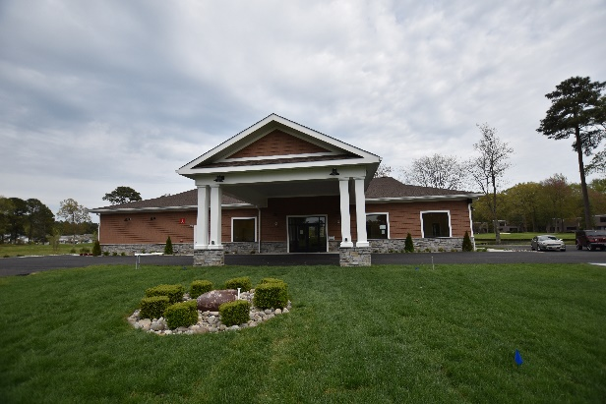
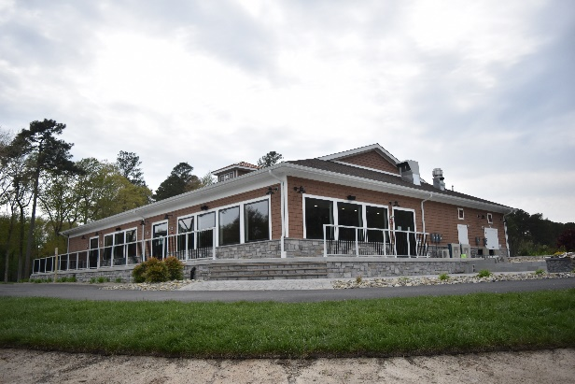
Golf
Opened for play on Saturday, May 9th
Restrictions:
Clubhouse and golf shops were to remain closed – we did not have CO at that time – moved check-in to starters shed
1 person per cart unless they reside in same household
No bunker rakes
No touching flagsticks – blocked bottom of hole so ball will not go all the way down
No beverage cart was allowed at beginning but has since been allowed
Cleaning:
Carts are sanitized and cleaned after each use
Range balls are cleaned and sanitized
Staff wears protective gloves and masks when engaging with golfers
Where are we:
Golf shop fixtures currently expected around end of June as factory reopens
Merchandise starting to ship as factories are being reopened
Date for clubhouse being open to public?
Depends on when Governor Hogan will allow indoor dining. Best guess is between June 5 – 15th.

Slide 4
Bulkheads
Wood Duck
Front end of Ocean Parkway to be completed – June 12th (original date May 1) COVID-19 – materials were delayed.
Residents’ 15 ft. easements will be completed by Friday, June 5th
Front end of Ocean Parkway between entrance of Wood Duck 1 and Wood Duck II will be sodded 6 ft. out to stabilize and seeding
North Pintail -
1 lot to be completed around June 22nd, 51 Pintail Dr.
New Season – 1st Week of September

Slide 5
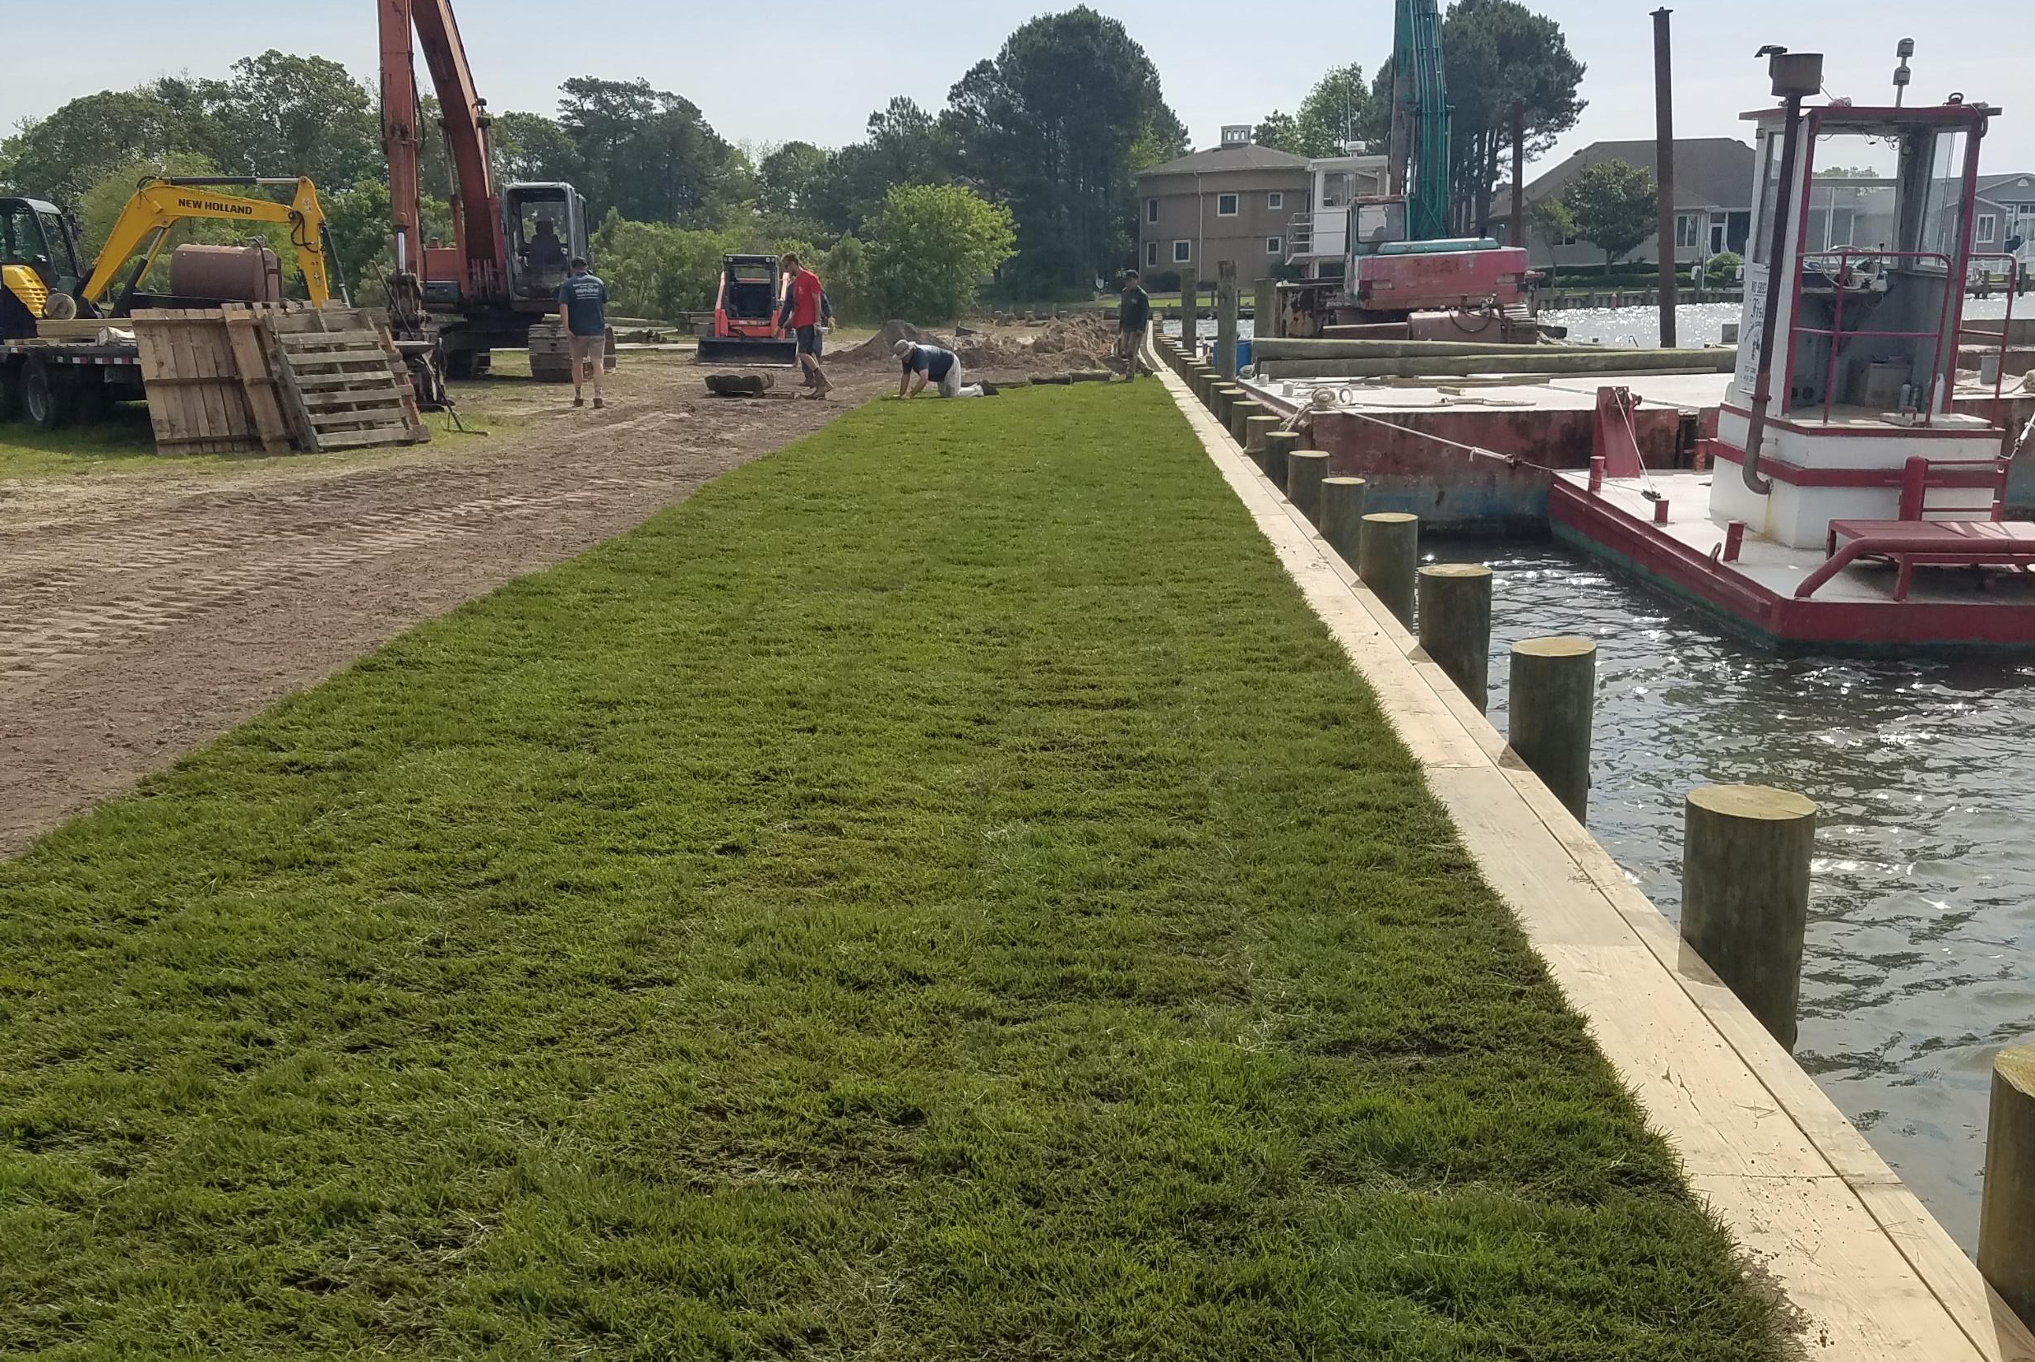

Slide 6
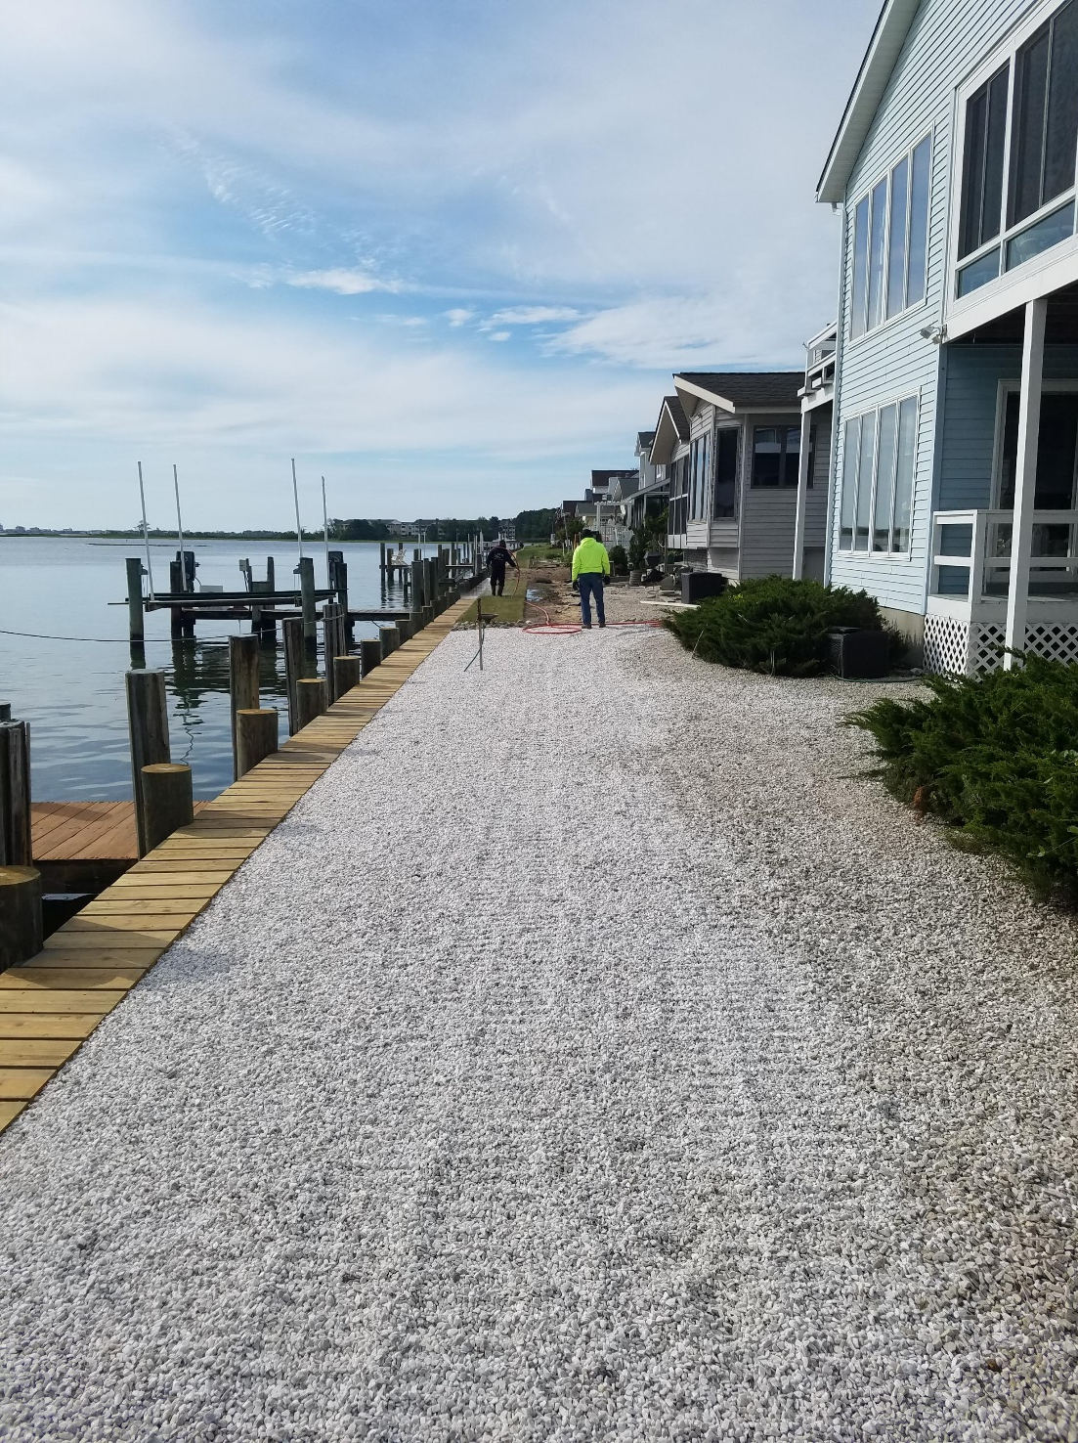
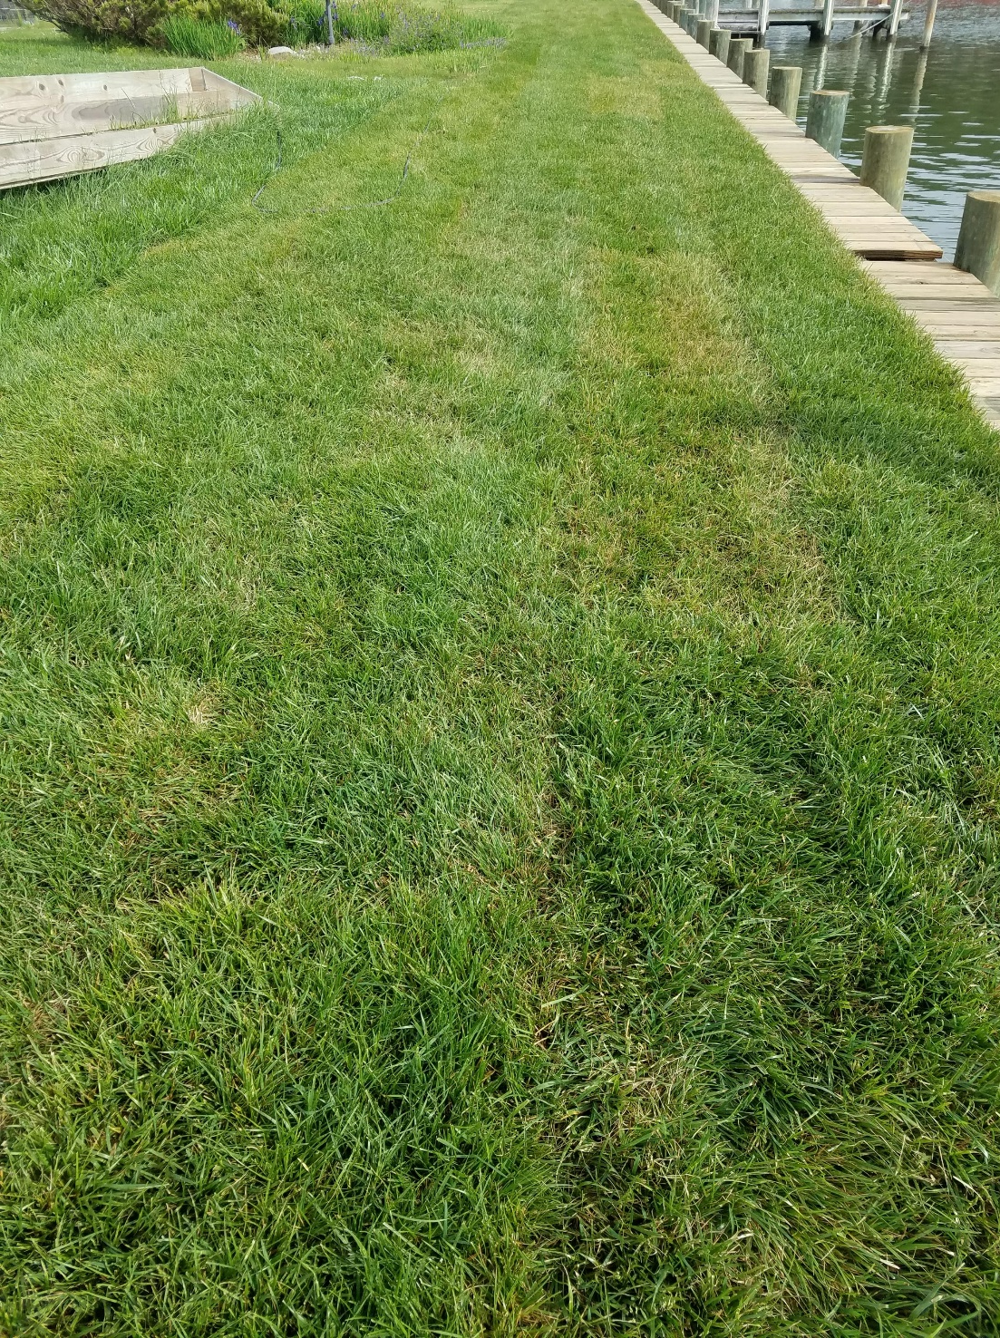

Slide 7
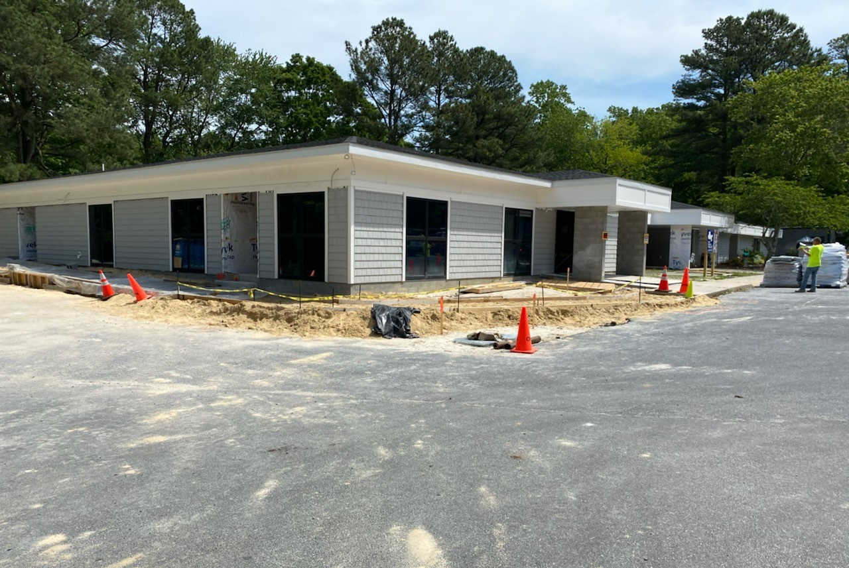

Slide 8
ESTIMATE OF Financial Change for the MONTH OF APRIL 2020 (UNAUDITED)
April
 | Budget | Current Year | Favor/ (Unfavor) vs. Budget
Revenues | $297,612 | $161,627 | ($135,985)
Expenses | 1,140,176 | 1,098,521 | 41,655
Net Operating | $(842,564) | $(936,894) | ($94,330)

Slide 9
ESTIMATE OF Financial Change Year to Date 5/1/19 – 4/30/20 (12 months) - UNAUDITED
YTD
 | Budget | Current Year | Favor/ (Unfavor) vs. Budget
Revenues | $12,487,366 | $12,750,556 | $263,190
Expenses | 12,487,366 | 12,178,644 | 308,722
Net Operating | $0 | $571,912 | $571,912

Slide 10
Treasurer’s Report - Larry Perrone

Slide 11
Cash & Short-Term Investments
Activity for Month of April
Overall Laddered Investment Rate of Return on CDAR’s for April Approx. 1.9%
At April 30, 2020, the Association had approx. $12.3 million in cash
Approx. $6.1 million invested in CDAR’s fully FDIC insured
Approx. $6.2 million in Money Market and other operating accounts, fully insured

Slide 12
Estimate (unaudited) Reserves april 2020 ($Millions)
 | Replacement | Bulkheads | Roads | Total
4/30/19 Balance | $5.2 | $2.5 | $1.1 | $8.8
Assessments/Interest | 2.0 | 0.7 | - | 2.7
Casino Funds | - | - | 0.3 | 0.3
Transfer (Spend) | (3.8) | (1.5) | (0.9) | (6.2)
4/30/20 Balance | $3.4 | $1.7 | $0.5 | $5.6

