Slide 1
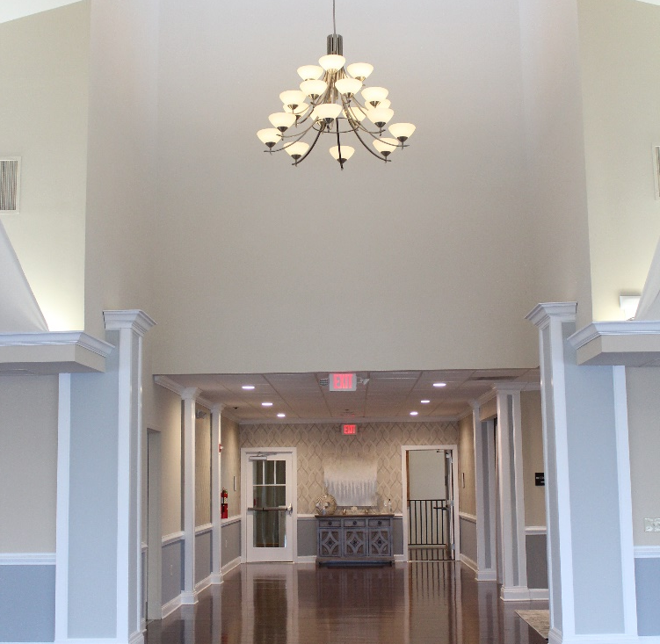
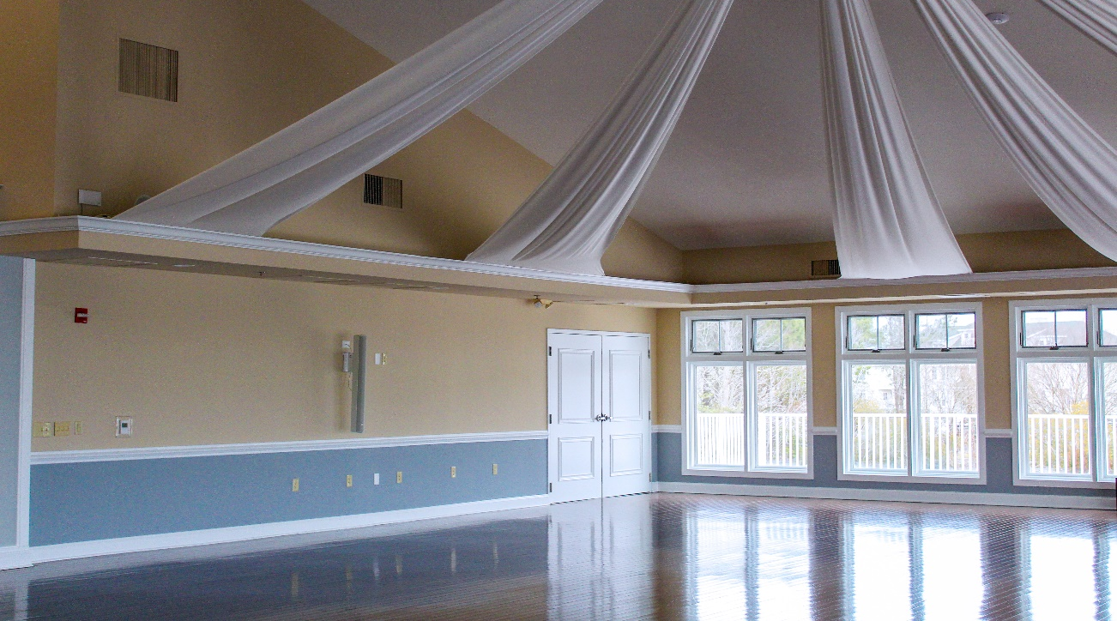
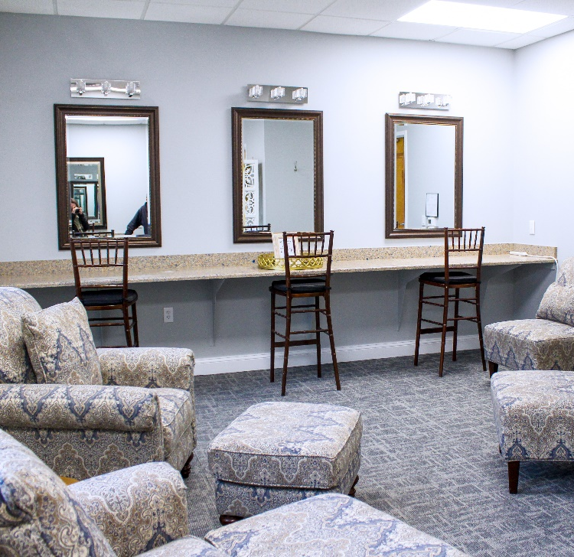
GM Leadership Report John Viola

Slide 2
Your assessment
dollars at work

Slide 3
GM LEADERSHIP REPORT (continued)
Racquet Sports Update
Normal maintenance of the courts has been scheduled
The repairs to the Har-Tru courts will be scheduled based on today’s approval
Recreation & Parks (Beautification)
Robinhood demolition has taken place, replacement of the playground will start on March 22nd
Marina
New boards on the docks will be completed by May 1st opening – project cost $11,800
Ocean Pines Academy - Update
Description of Project - A virtual, self-paced civic education course about the Ocean Pines Association. The Academy includes an overview of the different facets of the Association, presented by the those who are responsible for fulfilling its vision and mission on a daily basis. Also included are printable "quick facts" about the amenities, departments and services that make Ocean Pines a vibrant and well-rounded community. The Academy will be especially useful for those seeking Board and advisory committee positions but is geared toward anyone seeking to learn more about the Association.
Timeline: December 2020-March 2021
Rollout : TBD
Project Lead - Julie Malinowski
Video - Josh Davis
Project Status - Green

Slide 4
GM LEADERSHIP REPORT (continued)
Northstar
Website - Northstar moved the entire site to a new, dedicated server on Wednesday. The hope is that the site will now be more stable. We're also working with Northstar to speed up the homepage, which has been a frequent cause of complaints. Northstar said they should be able to better monitor any service outages on the new server, which will hopefully cut down on the length of time if and when the site goes down.
Point of Sale
Northstar Team
Road Closure
High Sheriff pipe replacement
Road blocked March 22 and reopen March 26 – weather permitting
Mailboxes will temporarily be located on the side of High Sheriff
Drainage - Special Project Bainbridge Update
Project approved by Board
Funding - Grant and OP (Budget $800,000)
Contract signed 1st week of March
Work to begin week of March 15th - Projected Completion Date - End of June
Bi-Weekly Communication Planned (or as deemed needed)
Project to be overseen by Nobie Violante and Justin Reimer
Eddie Wells to coordinate with County, Vista and Contractor EQR
Project Status – Green

Slide 5
GM LEADERSHIP REPORT (continued)
Maintenance to the Yacht Club
Ball room:
Removed wallpaper and painted
Removed wallpaper and painted in the second floor Hallway
Changed all bulbs to LED
Bridal Suite:
Replaced the carpet
Painted
Changed all bulbs to LED
Installed new outlet covers and switch.
Mop closet:
Repaired the floor
Repaired the sink
We had budgeted $14,500; these maintenance items were completed in 3 weeks and under budget for the work.

Slide 6
GM LEADERSHIP REPORT (continued)
Drainage - Pipe Replacement Update
(Budget FY - 2020/2021 $500,000)
Board Approved Contract for $207,167.47 Staff recommended Contractor Pelican Underground LLC
Work to begin beginning of April on 12 pipes at the following locations:
o Under Ocean Parkway by RT 90 - 4 pipes
o 215 Ocean Parkway
o 159 Ocean Parkway
o 736 Ocean Parkway
o 30 Offshore
o 102 Robinhood
o Fosse Grange
o Four Way intersection South Gate
Staging will be at the Public Works Yard
Nobie Violante/Justin Riner to oversee work. Eddie Wells will interact with county for support
Project Status - Green

Slide 7
GM LEADERSHIP REPORT (continued)
Customer Service
General questions, complaints, or concerns should be sent to info@oceanpines.org, or contact 410-641-7717 during business hours, or 410-641-7747 after business hours and on weekends.
Level 1 - Marketing Coordinator Julie Malinowski and Public Works Office Manager Linda Martin will handle questions sent to that email address and redirect them to the proper person or department, if needed.
Level 2 – Department Heads
Level 3 – General Manager

Slide 8
GM LEADERSHIP REPORT (continued)
Organizational Updates
Aquatics Director Kathleen Cook is now responsible for Beach Parking, in addition to the Aquatics Department. She will now report directly to General Manager John Viola.
Recreation and Parks Director Debbie Donahue is now responsible for Racquet Sports, in addition to the Recreation and Parks Department and the Marinas. She also is now leading the beautification projects. Racquet Sports Manager and Tennis Pro Terry Underkoffler, and Racquet Sports Program Coordinator Tim McMullen, will report directly to Donahue. Donahue will continue to report to Viola.
Public Works Director Eddie Wells and Public Works Manager Nobie Violante are now responsible for the oversight and coordination of the Bainbridge Pond drainage project, of which they were already key team members. That is in addition to their existing responsibilities running the Public Works Department. Wells will report to Viola, and Violante will report to Wells.
Director of Finance/Controller Steve Phillips will lead the strategic planning effort, in addition to his existing responsibilities of Finance, Membership, IT and Human Resources. Phillips will continue to report to Viola.

Slide 9
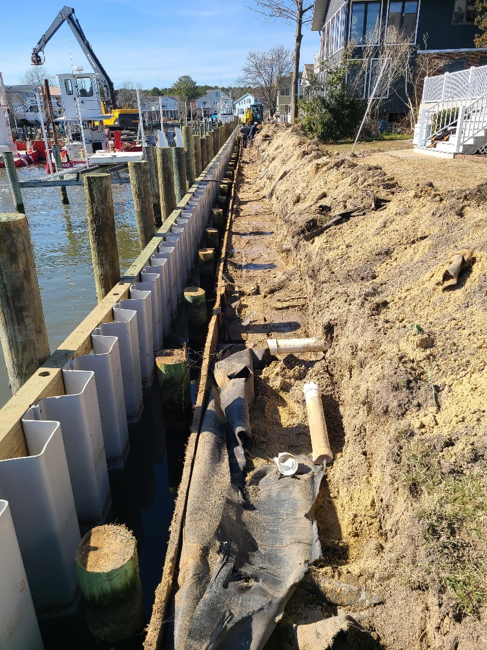
PHASE II BULKHEAD PROJECT: PINTAIL DRIVE AND NORTH PINTAIL DRIVE
Addresses:
19, 21, 23, 25, 27, 29, 31, 33, 35, 37, 39, 41, 43, 45, 47, 49 Pintail Drive
4, 8, 12, 16, 18, 20, 22, 24, 26, 28, 39, 30, 32, 33, 34, 35, 36, 37, 38 North Pintail Drive
Pintail Drive Canal (corner of Pintail Drive and Ocean Parkway)
Current Project Status:
Sheeting, tie backs, and pilings installed at all properties except:
29, 32, 33, 34, 35, 36, 37, 38 (to be completed within the next few weeks)
Once completed, all new bulkheads will be backfilled/sodded
Contract Terms:
March 15, 2020 – April 30, 2021
$1,182,150.00
3,330 linear feet of bulkhead
Budgeted Amount:
$1,192,500.00
Contract Amount: | $ 1,182,150.00
Payment - processed 10/5/2020 | $ 147,768.74
Payment - processed 11/5/2021 | $ 73,884.38
Payment - processed 1/8/2021 | $ 147,768.74
Payment - processed 2/17/2021 | $ 147,768.75
Payment - processed 3/5/2021 | $ 147,768.75
Balance: | $ 517,190.64

Slide 10
Financial Change Month of February 2021
February (In Thousands)
 | Budget | Current Year | Favor/ (Unfavor) vs. Budget
Net Revenues | $205 | $100 | ($105)
Expenses | 849 | 761 | 88
Net Operating | ($644) | ($661) | ($17)

Slide 11
Financial Change YTD February 2021
February YTD (In Thousands)
 | Budget | Current Year | Favor/ (Unfavor) vs. Budget
Net Revenues | $12,545 | $12,669 | $124
Expenses | 10,943 | 9,937 | 1,006
Net Operating | $1,602 | $2,732 | $1,130

Slide 12
Detail for the Month of February Favor/(Unfavorable) Vs. Budget
(In Thousands)
Department/Amenity | Favorable/(Unfavorable)
Recreation & Parks | $17.0
General Maintenance | 13.9
Police | 8.9
Public Works | (23.3)
General Administration | (22.4)
Yacht Club | (11.1)
Other | (0.3)
TOTAL | ($16.7)

Slide 13
Detail for February YTD Favor/(Unfavorable) Vs. Budget
(In Thousands)
General Admin. & Other | $1,086.9
Public Works/Gen Maintenance/CPI | 246.7
Finance | 88.7
Marinas | 65.4
Public Relations | 48.1
Recreation & Parks | 49.7
Police | 26.6
Clubhouse Grille | 19.7
Aquatics | (204.0)
Beach Parking | (178.4)
Yacht Club | (80.2)
Racquet Sports Golf Ops & Maintenance | (29.8) (9.1)
Net Operating | $1,130.3

Slide 14
Treasurer’s Report - Doug Parks

Slide 15
Cash & Short-Term Investments
Activity for Month of February
Overall Laddered Investment Rate of Return on CDAR’s for February Approx. 1.0%
As of February 28, 2021, the Association had approx. $9.9 million in cash
Approx. $6.1 million invested in CDAR’s, fully FDIC insured
Approx. $3.8 million in Money Market and other operating accounts, fully insured

Slide 16
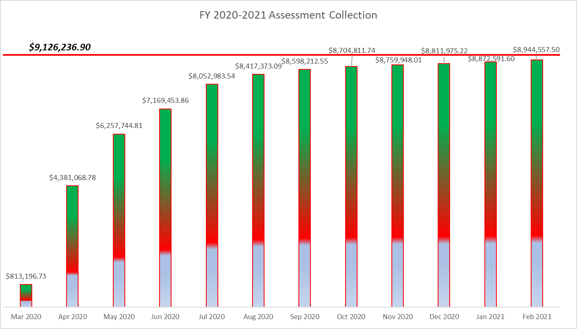

Slide 17
Unaudited Reserves February 2021 ($Millions)
 | GeneralReplace | Bulkheads | Roads | Drainage | New Capital | Total
4/30/20 Balance | $3.5 | $1.6 | $0 | $0.5 | $0 | $5.6
Contributions/ Interest | 1.8 | 0.9 | - | 0.3 | 0.2 | 3.2
Casino Funds | - | - | 0.3 | - | - | 0.3
Transfer (Spend) | (1.3) | (1.0) | (0.1) | (0.1) | (0.1) | (2.6)
2/28/21 Balance | $4.0 | $1.5 | $0.2 | $0.7 | $0.1 | $6.5

Slide 18
Reserves 4/30/21 unaudited estimate (in thousands)
 | Beginning Balance |  |  | Projected Balance
 | 4/30/2020 | Additions | Expenditures | 4/30/2021
Major Maintenance & Replacement:
Police Renovation |  |  | (608)
Northstar |  |  | (75)
Admin Siding-Roof |  |  | (73)
Aquatics (Splash Pads, etc) |  |  | (50)
Yacht Club + Beach Club |  |  | (40)
Racquet Sports Sidewalks |  |  | (65)
Tractor for Ditch Maintenance |  |  | (150)
Rough Mower |  |  | (67)
Police Vehicles |  |  | (90)
Playground Equipment/Other |  |  | (250)
Total | 3,481 | 1,840 | (1,468) | 3,853
Bulkheads & Waterways | 1,653 | 920 | (1,400) | 1,173
Roads | 0 | 330 | (110) | 220
Drainage | 506 | 260 | (511) | 255
New Capital | 0 | 167 | (82) | 85
TOTAL 4/30/21 | 5,640 | 3,517 | (3,571) | 5,586

Slide 19
Public Comments

Slide 20
Bid Request Approvals over $15,000 Public Works / Racquet Sports – Court Crack repair Administration - Level II Capital Reserve Study

Slide 21
Public Works / Racquet Sports
Court Crack repair
Requesting Authorization to go forward with Staff Recommendation of $35,738.83 for Terra Firma
Multiple Contractors were contacted, only 2 responded

Slide 22
Administration
Level II Capital Reserve Study
Requesting Authorization to go forward with Staff Recommendation of $16,590 for DMA Reserves
DMA conducted the prior Level 1 Reserve Study - their proprietary software was utilized in the previous study.
Level II Study is needed due to significant changes to facilities (new Country Club, new Craft Building, Police Department addition).
Level II Study will also review the stormwater system, which was excluded from the previous study.
Existing facility information review is still being conducted in-house; changes will be reviewed with DMA upon their arrival (tentatively scheduled the week of April 12th).
Final analysis from DMA Reserve Study will be presented to the Budget & Finance Committee and the Board in May or June (depending upon receiving the documents from DMA).

Slide 23
CPI Violations- 4 Raft Road – Roof Maintenance 18 King Richard Rd. – Roof Maintenance 19 King Richard Rd. - Roof Maintenance 9 Camelot Circle - Roof Maintenance
As discussed at the January 2021 Board Meeting, violations can be handled by a contractor with a 2/3 vote by the Board (per Resolution M-01 and Declaration of Restrictions).
Contractor hired has completed maintenance violations for Ocean Pines before - contractor is Maryland licensed and insured.
Contractor will spray fungicide to kill the moss/mildew on the roof. He will recheck the roof after spraying the fungicide to see if it is working and if need be, spray again.
Owner will be billed for contractor's fee and a $75 administrative fee.

