Slide 1
Board of Directors Meeting
September 9, 2020

Slide 2
Approval of Agenda

Slide 3
Approval of Minutes June 23, 2020 – Special Meeting July 1, 2020 – Regular Meeting July 10, 2020 – Special Meeting August 12, 2020 – Special Meeting August 12, 2020 – Organization Meeting August 17, 2020 – Special Meeting August 17, 2020 - Closed Meeting

Slide 4
President’s Remarks Larry Perrone

Slide 5
Ocean pines chamber of commerce- kerrie bunting

Slide 6
Bainbridge Pond Project- Colby Phillips & John Viola

Slide 7
BAINBRIDGE POND PROJECT
We will discuss the following-
Original Proposal plan and estimated cost
Where we are today and our position on the project
The cost and budget affect for the current fiscal year
High level explanation of the project sections
Next steps

Slide 8
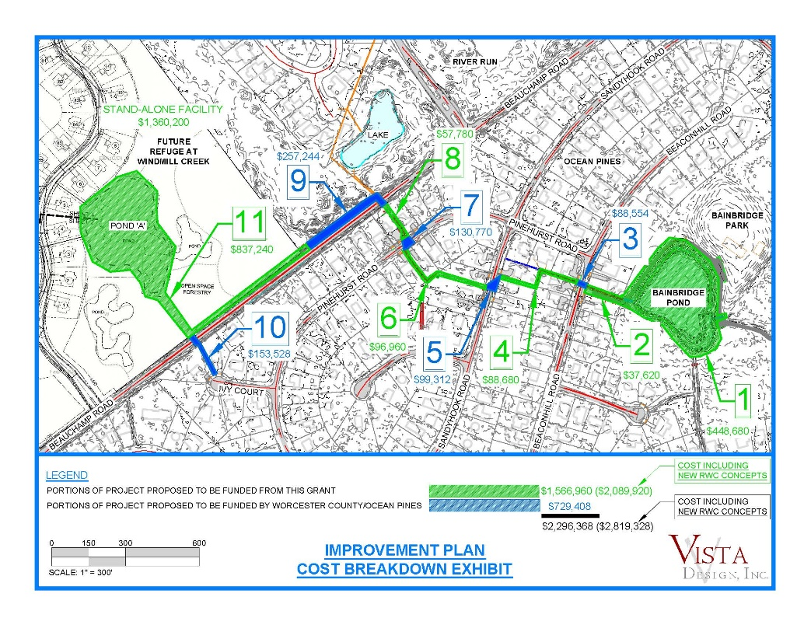
Proposed submitted plan February 2020 to include Evergreen Property with New Outfall

Slide 9
Current Fiscal Year 2020/21
Sections 1-2 of the Project | $486,300
Sections 3-5-7 (pipes) | 318,636
Total | 804,936
Grant | 549,000
OPA Expense FY 2020/21 | $255,936
The estimated $255,936 is available in the drainage reserve.
Sections 4-6-8 could be addressed in FY 2020/21. There is the possibility of future grants.

Slide 10
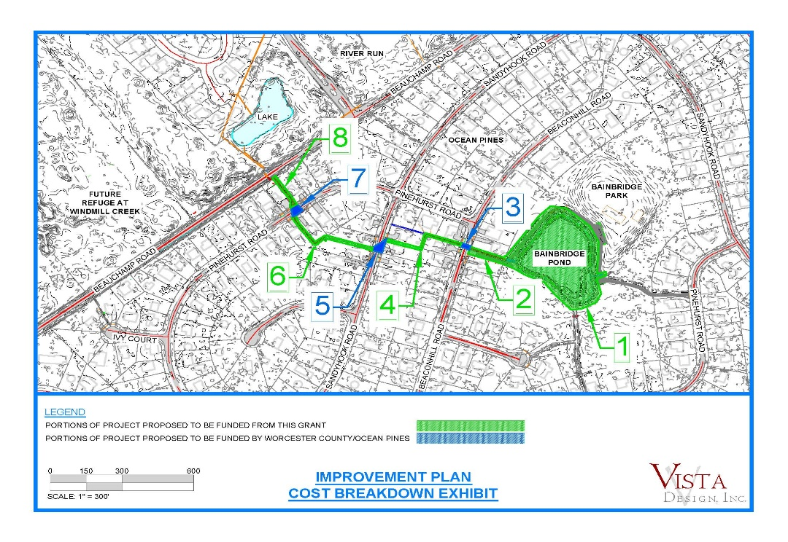
Current Project Scope
Sections 1 & 2 are funded by the current Grant awarded. ($486,300)
Sections 3, 5 & 7 would be estimated costs for OPA to contribute. ($255,936)
Sections 4, 6 & 8 have potential for future grant funding. ($175,180)
Seeking future funding opportunities to continue work throughout OP and current project scope. Ex: MDCB REA Grant

Slide 11
Bainbridge Pond ~ Chesapeake & Coastal Grants Gateway Grant
Project Description:
Grant Funding Improvements: Project Sections 1 & 2
Water quality improvement and improved flood protection resiliency through retrofit of existing Bainbridge Pond.
Retrofit Bainbridge pond to bring up to current MDE wet pond regulations through introduction of forebays, construction of wetland/aquatic benches, a proper outfall structure and improved dam embankment (weir). (Controls water levels and can slow them down with potential larger storms.
Project pollutant reduction values:
Total Nitrogen: 1,535lbs/Year
Total Phosphorus: 174lbs/year
Total Suspended Solids: 90 Tons/Year
OPA Funding Improvements: Project Sections 3, 5 & 7
Improvements to outfall channels: Replace current failing culverts.
Future Grant Funding Improvements: Project Sections 4,6 & 8 plus 2 (included in this current grant scope):
Retrofit the drainage swales to remove the limiting confining layers of silt, leaf & organic material and replace with sand/plant
soil mixture. This will also allow for seasonal infiltration of runoff and provide further resiliency during storm events.

Slide 12
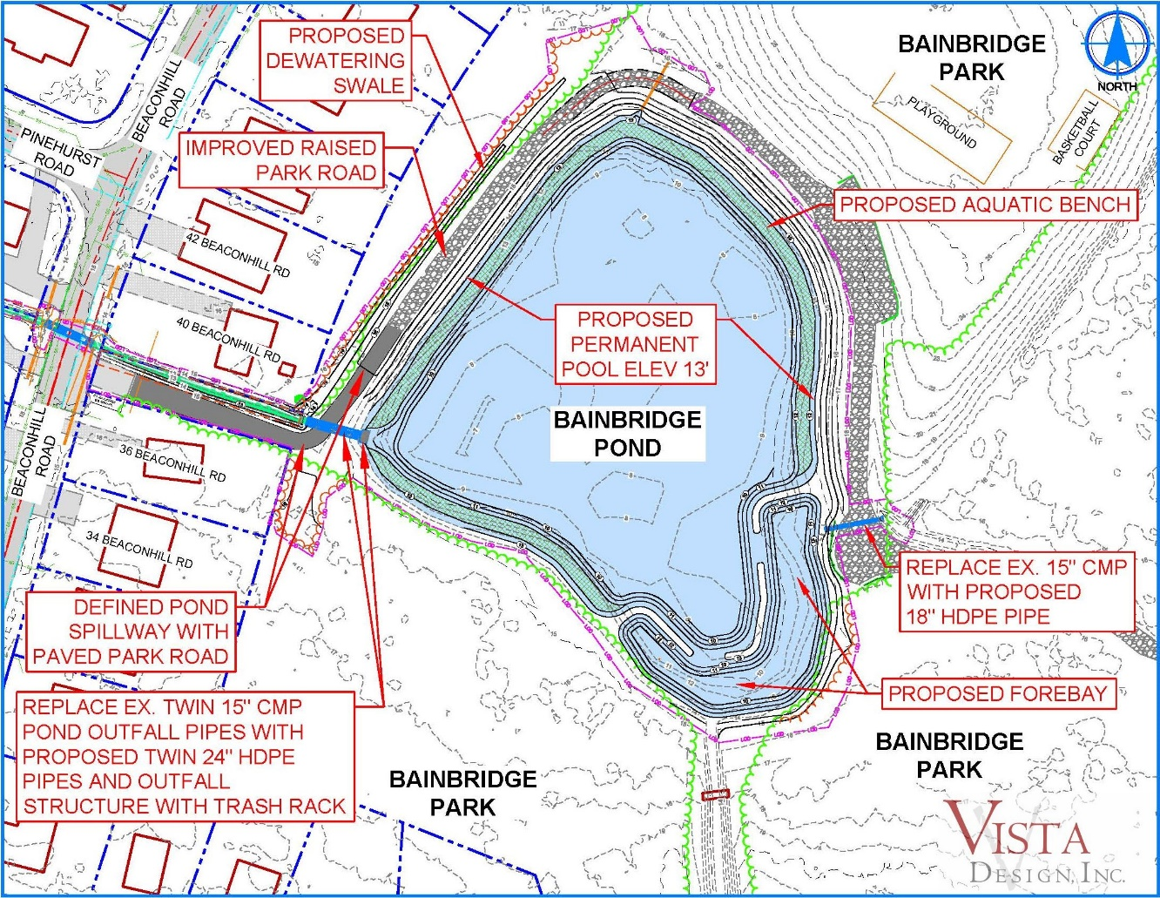
Project Section 1 – Retrofit to Bainbridge Pond
*Currently Grant Funded.

Slide 13
Project Section 2– Improve Pond Outfall Swale
Existing Outfall Swale Leaving Bainbridge Pond
Proposed Water Quality Improvement
*Currently Grant Funded.

Slide 14
Project Section 3 – Beaconhill Road Culvert Improvement
Existing Culverts under Beaconhill Road
Proposed Conveyance Improvement at Beaconhill Road
*OPA Requested Funding.

Slide 15
Project Section 4– Improve Beaconhill to SandyHook Outfall Swale
Existing Outfall Swale at Beaconhill
Proposed Water Quality Improvement
*Future Grant Funding

Slide 16
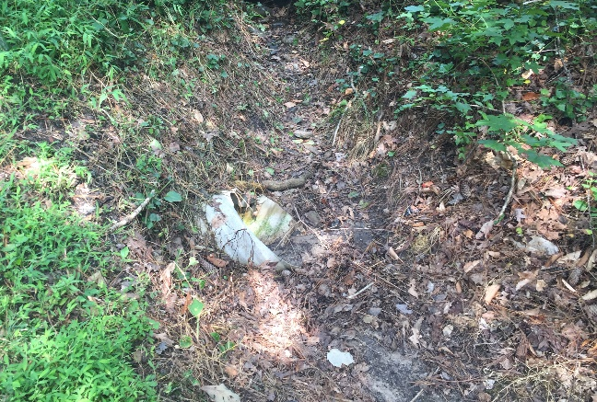
Project Section 5 – Sandyhook Road Culvert Improvement
Existing Culverts under Sandyhook Road
Proposed Conveyance Improvement at Sandyhook Road
Ex. Skewed 15” CMP
Ex. Perpendicular 15” CMP
*OPA Requested Funding

Slide 17
Project Section 6 – Improve SandyHook to Pinehurst Outfall Swale
Existing Outfall Swale at Pinehurst
Proposed Water Quality Improvement
*Future Grant Funding

Slide 18
Project Section 7 – Pinehurst Road Culvert Improvement
Existing Culverts under Pinehurst Road
Proposed Conveyance Improvement at Pinehurst Road
*OPA Requested Funding

Slide 19
Project Section 8 – Improve Pinehurst to Beauchamp Outfall Swale
Existing Outfall Swale at Pinehurst
Proposed Water Quality Improvement
*Future Grant Funding
Updated 9/3

Slide 20
BAINBRIDGE POND PROJECT
Next Steps:
Working on an RFP to begin the bid process
Presentation to MDPW
Approval & acceptance of funds from County Commissioners.

Slide 21
GM team Report John Viola

Slide 22
GM TEAM REPORT
RFP’s to go out for Accounting services and Waste services
Long Range Plan Team in place preparing information for budget process/ Working with B&F and Strategic Planning Committees.
Yearly Golf Maintenance on fairways and greens in progress.
Continue to manage thru the Covid-19 situation. Communication transparency in reporting cases and Josh posted CDC guidelines and talking points.

Slide 23
GM TEAM REPORT (cont’d)
Northstar: | Completion %
Website | 50
R&P | 85
Marina | 100
Membership | 85
Aquatics | 85
Beach Parking | 100
Racquet Sports | 100
Public Works | 75
CPI | 10
POS | 75
Finance | 80
Issues/open item log prepared
CPI was jump started in September, changes made.

Slide 24
Financial Change month of July 2020
July (In Thousands)
 | Budget | Current Year | Favor/ (Unfavor) vs. Budget
Net Revenues | $1,004 | $1,330 | $326
Expenses | 1,318 | 1,326 | (8)
Net Operating | $ (314) | $ 4 | $318

Slide 25
Financial Change ytd July 2020
July YTD (In Thousands)
 | Budget | Current Year | Favor/ (Unfavor) vs. Budget
Net Revenues | $9,332 | $9,430 | $98
Expenses | 3,757 | 2,924 | 833
Net Operating | $5,575 | $6,506 | $931

Slide 26
Detail for the Month of july Favor/(Unfavorable) Vs. Budget
General Admin. | $283.7
Yacht Club | 41.7
Public Works | 32.9
Marinas | 32.8
Golf Ops/Maintenance | 21.2
CPI | 11.2
Clubhouse Grille | 8.9
Finance | 8.2
Aquatics | (78.8)
Beach Club | (26.6)
Rec & Parks | (23.1)
Other | 6.0
Net Operating | $318.1

Slide 27
Detail for July ytd Favor/(Unfavorable) Vs. Budget
General Admin. | $979.9
Public Works/Gen Maintenance/CPI | 201.2
Yacht Club | 104.8
Finance | 31.7
Marinas | 24.5
Police | 23.9
Public Relations | 13.5
Beach Club | 9.0
Other | 11.3
Aquatics | (192.6)
Beach Parking | (189.3)
Golf Operations & Maintenance | (40.1)
Rec & Parks | (38.0)
Racquet Sports | (9.2)
Net Operating | $930.6

Slide 28
Treasurer’s Report - doug parks

Slide 29
Cash & Short-Term Investments
Activity for Month of July
Overall Laddered Investment Rate of Return on CDAR’s for July Approx. 1.9%
At July 31, 2020, the Association had approx. $13.5 million in cash
Approx. $7.1 million invested in CDAR’s, fully FDIC insured
Approx. $6.4 million in Money Market and other operating accounts, fully insured

Slide 31
FY 2020 - 2021 ASSESSMENT COLLECTION
TOTAL ASSESSMENT DUE |  | $9,126,236.90
MONTH | COLLECTED (CURRENT MONTH) | COLLECTED (TOTAL TO DATE) | COLLECTED (PERCENT TO DATE) | OUTSTANDING (TOTAL TO DATE)
Mar 2020 | $813,196.73 | $813,196.73 | 8.91% | $8,313,040.17
Apr 2020 | $3,567,872.05 | $4,381,068.78 | 48.01% | $4,745,168.12
May 2020 | $1,876,676.03 | $6,257,744.81 | 68.57% | $2,868,492.09
Jun 2020 | $911,709.05 | $7,169,453.86 | 78.56% | $1,956,783.04
Jul 2020 | $883,529.68 | $8,052,983.54 | 88.24% | $1,073,253.36
Aug 2020 | $364,389.55 | $8,417,373.09 | 92.23% | $708,863.81
Sep 2020
Oct 2020
Nov 2020
Dec 2020
Jan 2021
Feb 2021
Mar 2021
Apr 2021
(Allowance for doubtful accounts)
TOTAL (through August) |  | $11,725.63
GRAND TOTAL (w/write offs) |  | $8,429,098.72 | 92.36%

Slide 32
Unaudited Reserves july 2020 ($Millions)
 | Replacement | Bulkheads | Roads/ Drainage | New Capital | Total
4/30/20 Balance | $3.5 | $1.6 | $0.5 | $0 | $5.6
Assessments/Interest | 1.8 | 0.9 | - | 0.2 | 2.9
Casino Funds | - | - | 0.3 | - | 0.3
Transfer (Spend) | (0.9) | (0.5) | (0.1) | (0.1) | (1.6)
7/31/20 Balance | $4.4 | $2.0 | $0.7 | $0.1 | $7.2

Slide 33
Reserves 4/30/21 unaudited estimate (in thousands)
 | Beginning Balance |  |  | Projected Balance
 | 4/30/2020 | Additions | Expenditures | 4/30/2021
Major Maintenance & Replacement:
Police Renovation |  |  | (604)
Northstar |  |  | (50)
Admin Siding-Roof |  |  | (72)
Aquatics (Splash Pads, etc) |  |  | (50)
Yacht Club + Beach Club |  |  | (40)
Racquet Sports Sidewalks |  |  | (65)
Tractor for Ditch Maintenance |  |  | (110)
Police Vehicle |  |  | (40)
Other |  |  | (38)
Total | 3,481 | 1,825 | (1,069) | 4,237
Bulkheads & Waterways | 1,653 | 900 | (1,800) | 753
Roads | 0 | 330 | (262) | 68
Drainage | 506 | 5 | (611) | (100)
New Capital | 0 | 167 | (70) | 97
TOTAL 4/30/21 | 5,640 | 3,227 | (3,812) | 5,055

Slide 34
Public Comments

Slide 35
Capital Purchase Requests R&P Department – Cleaning Services

Slide 36
R&P Department – Cleaning Services
In the Budget for 2020/2021 (-$2,000)
Requesting Authorization to go Forward in 2020/2021 with Staff Recommendation of $32,000 from Sands of Time Cleaning.

Slide 37
CPI Violations none

Slide 38
Unfinished Business Second Reading – Resolution C-01 – Colette Horn

Slide 39
New Business First Reading – Resolution C-05 – Tom Janasek Discussion – Succession Planning Update – Frank Daly

Slide 40
Appointments - Rebecca Colt-Ferguson – 1st Term – Strategic Planning Rob Keesling – 1st Term – Strategic Planning Jennifer Cropper-Rines – 1st Term – Strategic Planning Ann Shockley – 3rd Term - ARC

Slide 41
Adjourn TO CLOSED SESSION

