Slide 1
Board of Directors Meeting
September 24, 2022

Slide 2
Approval of Agenda

Slide 3
Approval of Minutes July 27, 2022 – Regular Meeting August 23, 2022 – Special Meeting August 25, 2022 – Organization Meeting

Slide 4
President’s Remarks Doug Parks

Slide 5
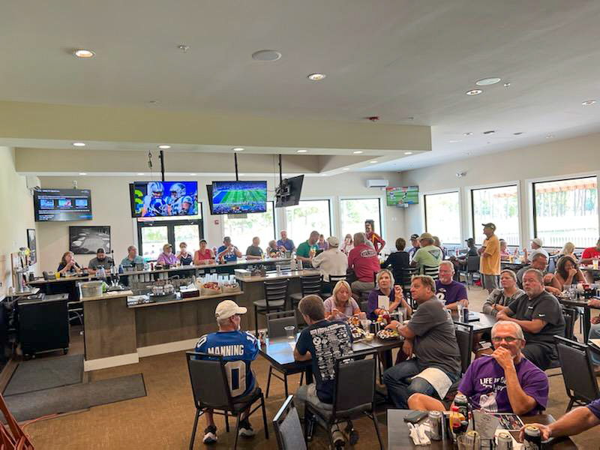
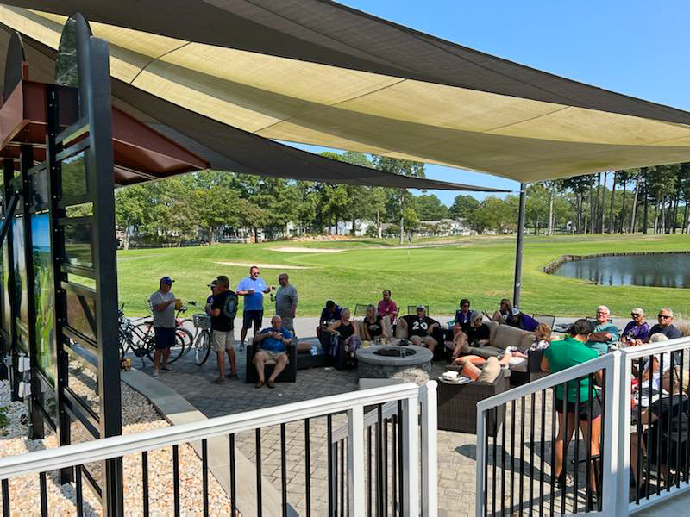
GM Leadership Report – John Viola

Slide 6
Initiatives
Metrics
North Gate Bridge
Administration Building Renovations
Drainage
Fire Department Work Group
Aquatics
Roads
Racquet Sports
Marina Gas Pump Line
Mailboxes

Slide 7
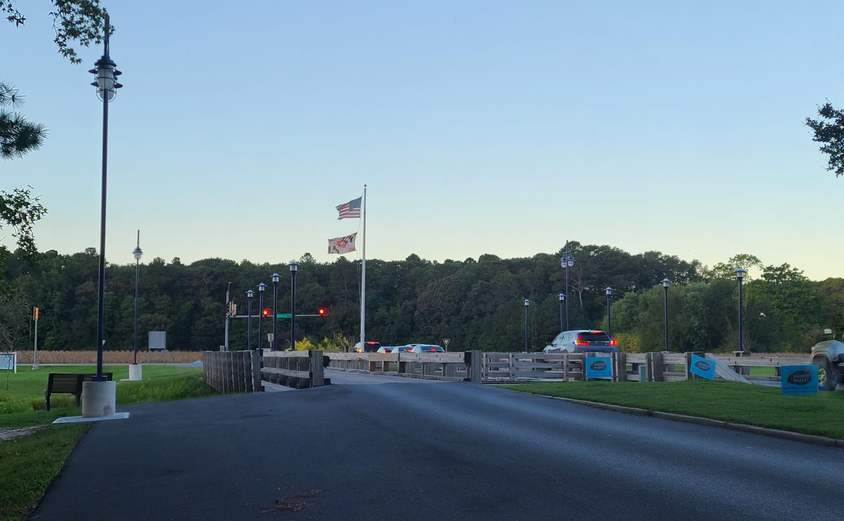
North Gate Bridge
North Gate Bridge Lights:
Approved by Board in March 2022
Total cost: $46,390.65
Work began in early September with pole lights followed by bridge lights
Work completed September 22nd

Slide 8
Roads
Paving
Coming forth today with bids for road paving
Per bid, work to be completed within 90 days after contract signed
Approximately 3 miles of roads to be completed: Barnacle Court, Beach Court, Birdnest Drive, Fosse Grange, Garrett Drive, Ivanhoe Court, Liberty Bell Court, Little John Court, Moonshell Drive, Rabbit Run Lane, Surfers Way, Watergreen Lane, and Willow Way
Striping
Approved by the Board in July
Total cost: $19,398.00
Roads edged to prepared for line striping
Alpha Space Control Co. Inc. to begin work within the next few weeks

Slide 9
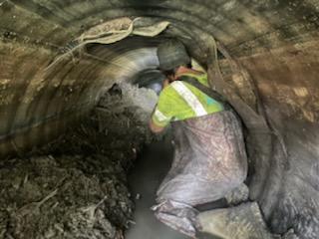
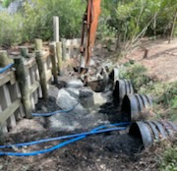
Drainage
CIPP Pipe Lining:
Pelican Underground began pipe lining in August
Phase I: Juneway Lane, Seagrave Lane, Cannon Drive, Southwind Court, Drawbridge Road, and Ocean Parkway: $187,971.92
Phase II: Mumfords Landing Road, Fairway Lane, Whisper Court, Newport Drive, and Beaumont Court: $235,399.50
Total: $423,371.42 (19 pipes)

Slide 10
Aquatics
Communication plan:
Staffing shortages communicated throughout the season through signs, phone messages, weekly e-blast, and posted closures online
57,295 guest in 2022 (21,780 were swim members) (2021 – 58,824; 16,908 were swim members)
Members only time:
Will be reviewed and assessed during the next budget process, along with the memberships and possibility of lifeguard shortages next year

Slide 11
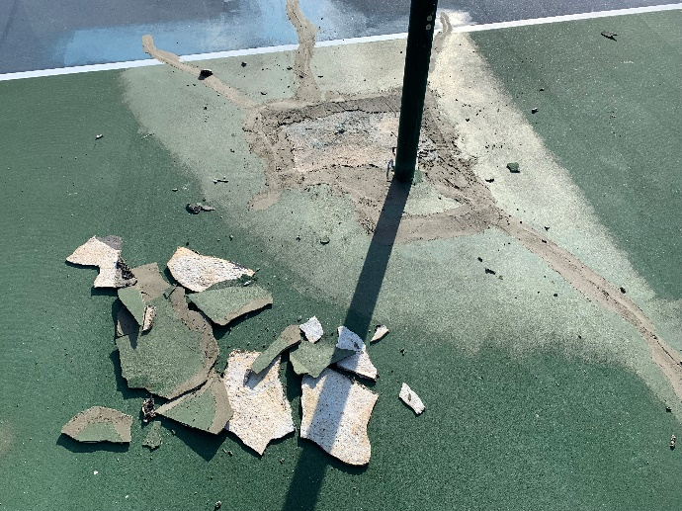
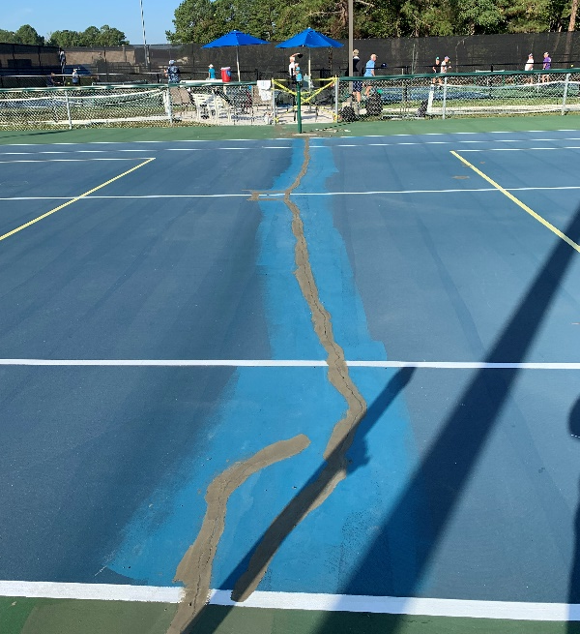
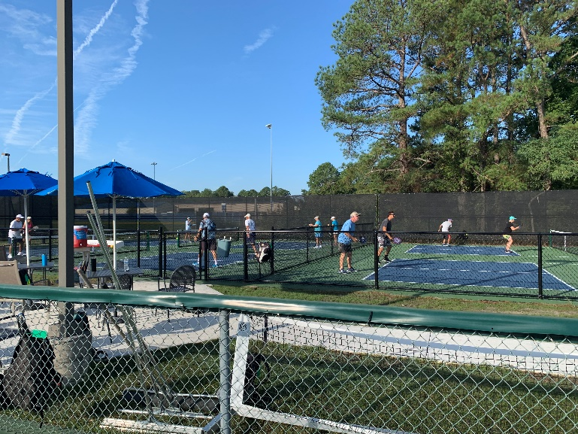
Racquet Sports
New pickleball courts completed in August
Renovation of Existing Courts
ATC power washed courts early this week
Crack repairs began on September 20th
Total time for repairs to be done: approximately 15 days, weather permitting
Due to the court closure, the Recreation Department has made arrangements for the gym at the Community Center to be available from 11-2 on Tuesday’s, or portable nets can be taken to Swim & Racquet for pickleball play (with an attendant)

Slide 12
Marina Gas Pump Line
Met demand all season
Coming forth today with recommendation for replacement of gas pump lines
Gas pump and fuel management system will comply with new MD Comar regulations
Plan will be submitted to MDE 60 days prior to work beginning

Slide 13
Administration Building Renovations
Timeline:
If approved by Board today, work will begin in October and be completed by February
All work to be done in-house (with in-house contractor)
Budget/Forecasted Cost - $125,000.00

Slide 14
OPVFD Work Group
Prepared RFP to hire a consultant
Issue RFP 9/26/22
Respond to questions 10/17/22
Proposal due 10/31/22
Evaluation 11/1/22 – 11/9/22
Update Board with recommendation 11/10/22
Board to review for approval 11/19/22
If approved, consultant begins 11/21/22 – 2/28/23
Team:
John Viola (sponsor)
Ted Maroney (lead)
Dave Van Gasbeck (OPVFD)
Frank Brown
Josh Davis
Pete Gomsack
Marvin Steen
Eddie Wells

Slide 15
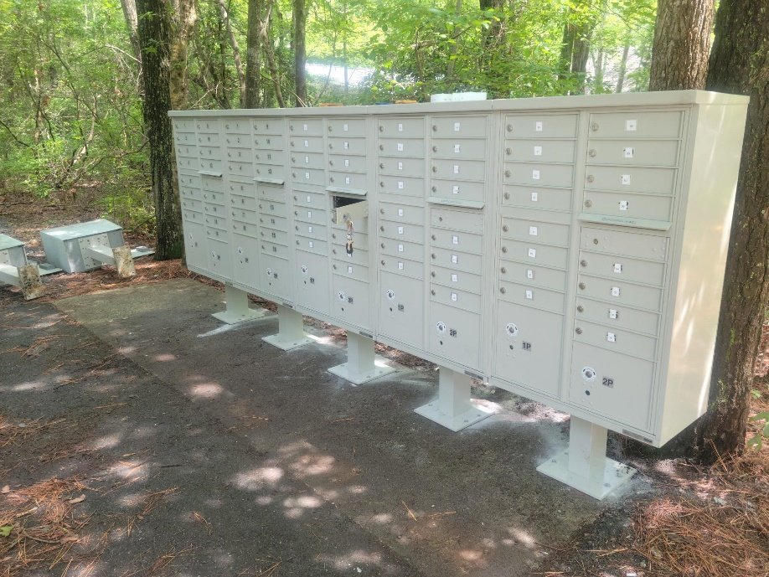
Mailboxes
Pedestal and mailbox replacement began in July:
To date, 31 pedestals and 11 mailbox clusters have been replaced
56 pedestals and 6 mailbox pedestals still to be replaced in high-priority locations
All work being done by Public Works maintenance team
Cleaning of mailbox locations continues

Slide 16
CPI Violation Dashboard August
Violations (includes legal)
As of 7/31/22 | New Violations | Closed Violations | As of 8/31/22
97 | 54 | 46 | 105
Legal Cases
As of 7/31/22 | New Violations to Legal | Closed Violations in Legal | As of 8/31/22
47 | 13 | 4 | 56

Slide 17
Work Orders August
Open Work Orders as of 7/31/22 | New Work Orders | Closed Work Orders | Open Work Orders as of 8/31/22
204 | 112 | 138 | 178
112 work orders initiated in August: 8 bulkhead; 22 drainage; 28 grounds/landscaping; 7 roads; 5 signs; 42 general maintenance
Majority still open in drainage (80) and grounds/landscaping (43)
Drainage (20 – over 30 days; 14 – over 60 days; 24 – over 90 days
Average 1-4 work orders a day to complete depending upon severity

Slide 18
Customer Service Dashboard (from info@oceanpines.org) August
Type | # Received – August
Amenities | 34
CPI | 38
Drainage | 3
General | 59
Public Works | 17
TOTAL | 151

Slide 19
Financials

Slide 20
FINANCIAL CHANGE MONTH OF AUGUST 2022
August (In 000’s)
 | Budget | Current Year | Favor/ (Unfavor) vs. Budget
Net Revenues | $1,525 | $1,756 | $231
Expenses | 1,462 | 1,532 | (70)
Net Operating | $63 | $224 | $161

Slide 21
FINANCIAL CHANGE YEAR-TO-DATE AUGUST 2022
YTD August 2022 (In 000’s)
 | Budget | Current Year | Favor/ (Unfavor) vs. Budget
Net Revenues | $11,255 | $11,983 | $728
Expenses | 5,412 | 5,447 | (35)
Net Operating | $5,843 | $6,536 | $693

Slide 22
MONTH OF AUGUST FAVOR/(UNFAVORABLE) VS. BUDGET (IN 000’s)
Department/Amenity | Favorable/(Unfavorable)
Yacht Club | 35
Golf Ops & Maintenance | 33
Beach Club | 33
Rec & Parks | 21
Aquatics | 16
Public Works | 14
Police | 12
Beach Parking | 9
Admin/GM Office/Finance/PR&Marketing | (17)
Other Net (Racquet Sports, Marinas, Clubhouse Grille, CPI, General Maintenance) | 5
TOTAL | $161

Slide 23
YEAR-TO-DATE AUGUST FAVOR/(UNFAVORABLE) VS. BUDGET (IN 000’s)
Department/Amenity | Favorable/(Unfavorable)
Golf Ops & Maintenance | 160
Aquatics | 115
Yacht Club | 114
Public Works | 89
Beach Club | 74
Rec & Parks | 30
General Maintenance | 30
Racquet Sports | 25
Admin/GM Office/Finance/PR&Marketing | 25
Beach Parking | 18
Marinas | 17
Police | 15
Clubhouse Grille | (14)
Other Net (Police, CPI, Marinas, Clubhouse Grille) | (4)
TOTAL | $694

Slide 24
UNAUDITED RESERVES AUGUST 2022 ($MILLIONS)
 | General Replace | Bulkheads | Roads | Drainage | New Capital | Total
4/30/22 Balance | $4.8 | $0.5 | $0.0 | $0.7 | $0.1 | $6.1
Contributions/ Interest | 1.7 | 1.1 | 0.3 | - | 0.1 | 3.2
Casino Funds | - | - | 0.4 | 0.1 | - | 0.5
Transfer (Spend) | (0.4) | (0.2) | - | (0.5) | (0.2) | (1.3)
8/31/22 Balance | $6.1 | $1.4 | $0.7 | $0.3 | $- | $8.5

Slide 25
Treasurer’s Report Monica Rakowski

Slide 26
Cash & Short-Term Investments
Activity for Month of August
As of August 31, 2022, the Association had approx. $18.0M in cash
Approx. $15.1M in BOC insured cash sweep (ICS) account
Approx. $1.1M invested in CDAR’s
Remaining $1.8M in money market and other operating accounts
Note: With rates increasing, OPA transferred $10M of funds in the ICS account to BOC CDAR’s

Slide 27
Public Comments
Members wishing to make comments must state their name and address. The order for comments will be members in attendance in-person, followed by members attending via MS Teams. Members attending via MS Teams can use the “raise hand” function to be recognized for making a public comment.

Slide 28
Capital Requests
Public Works – 2022 Secondary Road Rehabilitation
Marina – Replacement of gas lines and fuel dispensers to include a fuel management system on C dock
Administration Building - Renovations

Slide 29
Capital Requests
Public Works –
2022 Road Secondary Road Rehabilitation
Requesting authorization to go forward with staff recommendation of $363,122.90 for Asphalt Maintenance LLC

Slide 30
Capital Requests
Marina –
Replacement of gas lines and fuel dispensers to include a fuel management system on C dock
Requesting authorization to go forward with staff recommendation of $169,520.56 for Petrol Supply, Inc.

Slide 31
Capital Requests
Administration – Building
Renovations
Requesting authorization to go forward with completing in-house renovations for $125,000.00

Slide 32
CPI Violations None

Slide 33
Unfinished Business None

Slide 34
New Business
Discussion on Worcester County water and wastewater treatment facility not meeting the state standard for nitrogen content related to bay restoration – Monica Rakowski
Review of proposal to retrofit the north gate sign to become electronic – Steve Jacobs
Motion to authorize a change in contract agreement for purchase of golf carts – Doug Parks
Request for reserve transfer – John Viola

Slide 35
New Business –
Reserve Transfer
Requesting permission for team recommendation to transfer from realized budget favorability for FY 2021/2022 the following:
Mailbox maintenance and replacement: $150,000.00
Pickleball renovation existing courts: $75,000.00
Road reserve: $350,000.00

Slide 36
Appointments
David Allen – 2nd Term & Chair – Marine Activities Committee
Pam Ferinde – 1st Term – By-Laws & Resolutions Committee
Patricia Garcia – 1st Term – Environmental & Natural Assets Committee
Mark Heintz – 1st Term – Elections Committee
Keith Kaiser – 2nd Term – By-Laws & Resolutions Committee
Susan Morris – Chair – Racquet Sports Committee
Lora Pangratz – Chair – By-Laws & Resolutions Committee
Araceli Popen – 1st Term – Racquet Sports Committee
Brian Reynolds – 2nd Term – Budget & Finance Committee
George Solyak – 2nd Term – Budget & Finance Committee

Slide 37
Adjournment

