Slide 1
Board of Directors Meeting
July 21, 2021

Slide 2
Approval of Agenda

Slide 3
Approval of Minutes June 16, 2021 – Regular Meeting

Slide 4
President’s Remarks Larry Perrone

Slide 5
Ocean Pines BOD Strategic Planning Update Strategic Planning Advisory Committee
7/21/22

Slide 6
Ocean Pines Strategic Planning Update Agenda
Committee Members
Strategic Planning Process
Progress To Date/Next Steps
Property Owner/Resident Survey
Q&A/Feedback

Slide 7
Ocean Pines Strategic Planning Update Committee Members
Committee Members:
Helen Johnson
Jenny Cropper-Rines
Wes Blacley
Rob Keesling
Rebecca Colt-Ferguson
Andie Davis
Gary Miller
Morrell (Moe Delcher-Co-Chair
Bernie McGorry-Co-Chair
Staff Liaisons:
Steve Phillips
Julia Johnson
Josh Davis
Board Liaison:
Dr. Colette Horn

Slide 8
Ocean Pines Strategic Planning Update Why Have a Strategic or Long-Range Plan*
Align the board of directors and management
Align the management team on a strategic agenda to move the organization forward
Communicate clarity of direction throughout the organization
Provide clear direction and thereby restore integrity of leadership
Create agreement on core beliefs and principles
Other
*Source: Professional Growth Systems

Slide 9
Where we are today

Slide 10
Ocean Pines Strategic Planning Update Progress To Date
New Committee Kick-Off
Jan/Feb
SWOT Analysis
Exec, Council/OP. Depts.
March-May
Benchmarking Other HOA’s
April-June
Community and Culture
(values)
May/June

Slide 11
Ocean Pines Strategic Planning Update Progress To Date
Property Owner
Survey
Development
Summarize Survey Results*
Property Owner Survey
Summarize Current Situation
TBD**
June-July
Late August-October?
November
* Survey Results will be shared at future Town Hall Meeting
**Timing dependent on survey completion

Slide 12
Ocean Pines Strategic Planning Update Timing/Next Steps
Summarize Current Situation
Develop Conclusions/
Implications
Formulate Recommended OP Key Strategies
*November
*December
*January
*Timing dependent on survey completion

Slide 13
Ocean Pines Strategic Planning Update Property Owner/Resident Survey
Previous Survey
Timing: Summer-November-2018
Execution: Mail only
Estimated Cost: ?? Mailing would have been Min. of $8,000
# of Questions: 32; many with multiple parts and extensive “other” answers
Estimated Time to Complete: ???
# of completed surveys: 1,773; 2% < 39 years old; not enough part time residents
Current Planned Survey
Timing; Late August-Oct./Nov, 2021
Execution: Hybrid-Online, hard copy available at key locations/on request
Estimated Cost: $1,500-$3,000
# of Questions: Currently 15, 7 with multiple parts
Estimated Time to Complete: 15-20 minutes max
# of completed surveys: Will be setting targets by key demographic including full time residents, part time residents, families with children, etc.

Slide 14
Ocean Pines Strategic Planning Update Property Owner/Resident Survey
We welcome any/all property owner/resident, OPA staff/employee and BOD questions for the survey.
Email: bmcgorry1079@gmail.com by 7/28/21
And………..please complete the survey when it is released in mid-late August (aggressive PR plan)

Slide 15
Ocean Pines Strategic Planning Update Questions/Comments/Feedback
??????????????
Thank you!

Slide 16
Appendix

Slide 17
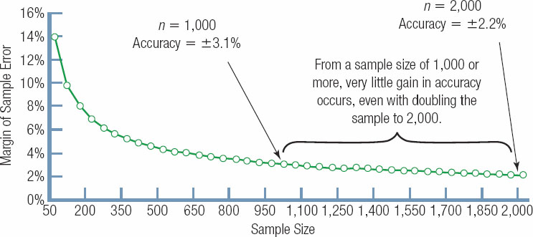
The Relationship Between Sample Size and Sample Error

Slide 18
Sample Sizes and Margin of Sample Error
Sample Size ( n ) | Margin of Sample Error (Accuracy Level)
10 | ±31.0%
50 | ±13.9%
100 | ±9.8%
200 | ±6.9%
400 | ±4.9%
500 | ±4.4%
750 | ±3.6%
1,000 | ±3.1%
1,5000 | ±2.5%
2,000 | ±2.2%
5,000 | ±1.4%
10,000 | ±1.0%

Slide 19
Ocean Pines Strategic Planning Advisory Committee
Community Engagement Plan (updated based on input from 5/27 meeting)
Continue to include minutes on OP website
Continue to provide updates to local publications including Bayside Gazette and others
When survey is finalized and approved; be more proactive:
PR Release to go in all local papers
Link on OP website and OP Social Media
Include in weekly eblast
Follow-up weekly in ALL local papers
If necessary, hard copies with drop off boxes, iPad at busy locations, etc.
Finally, include survey results and preliminary long-range plan via a Town Hall

Slide 20
2019 Artisanal Objective & Plans
We will get here…..be patient
VISION
To be the leading supplier of bakery ingredients and services to the NA artisanal channel
Objective
Strategic Priorities
Strategic Actions
Accelerate Profitable Sales Momentum in the Artisanal Channel
(+6.3%, +$27M)
Grow existing Dawn customers with emphasis on Dawn MFGR
1
Create standard portfolio via Sunrise and deliver digital product catalog to enable sales
Drive activations with ‘always on’ umbrella programs focusing on core categories
Launch regional promos to address specific market needs and increase category penetration
Deliver full value proposition to drive growth in emerging chains and distributor partners (GiGi’s, VooDoo, Hurts)
1.1
1.2
1.3
1.4
2
Aggressively acquire new customers in current and new markets
Improve lead generation and qualification capabilities to drive new customer acquisition
Develop geographic expansion plans
Acquire 2 new emerging chains and execute flawlessly
Identify regional opportunities for expansion (e.g. Latino)
2.1
2.2
2.3
2.4
Deliver Dawn’s full value proposition with a focus on value added services
3
Drive Dawn awareness of our value proposition via the Smile campaign and targeted media
Leverage 2018 learnings to implement customer retention program and reduce churn
Implement TSR service model; develop new service proposition (consult need state) and test launch in 2019
3.1
3.2
3.3
Enablers: Customer/Consumer Insight, Demand/Supply & Service excellence, KAM Model & CRM System

Slide 21
Benchmarked Communities
Bayside
◦ Sea Colony
◦ Broadlands
◦ Leisure World
◦ Crofton
◦ Montgomery Village
◦ Glen Riddle
◦ Kiawah
Villages

Slide 22
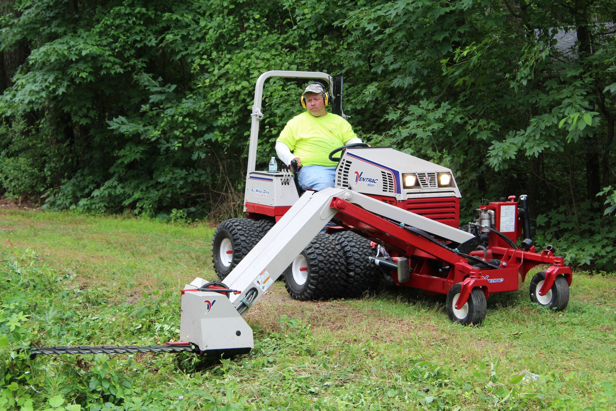
GM Leadership Report John Viola
Ventrac MA900 Boom Mower – Approved at the June16th Board Meeting

Slide 23
info@oceanpines.org
CALL
410.641.7717
After hours, call Ocean Pines Police at 410.641.7747

Slide 24
Your assessment
dollars at work

Slide 25
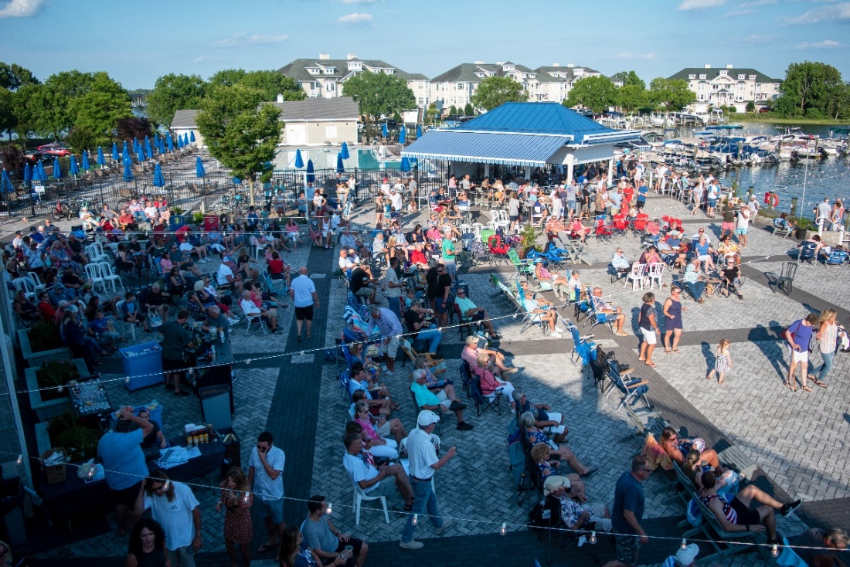
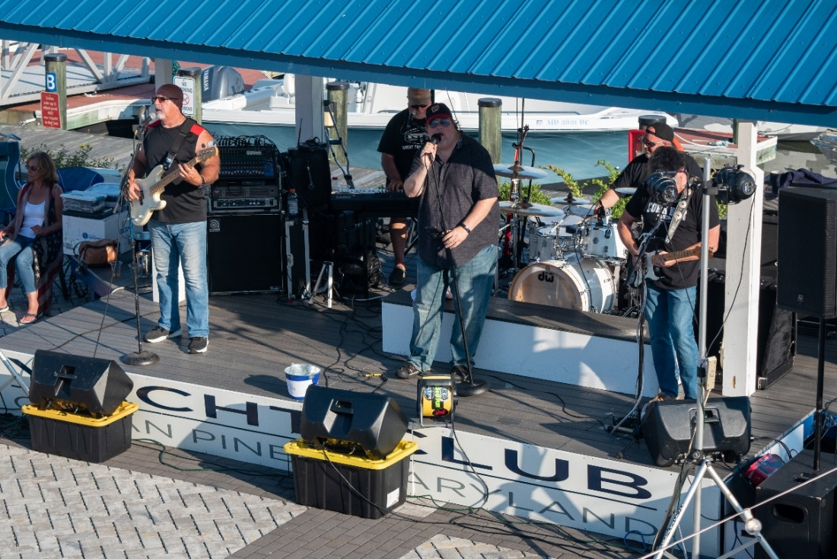
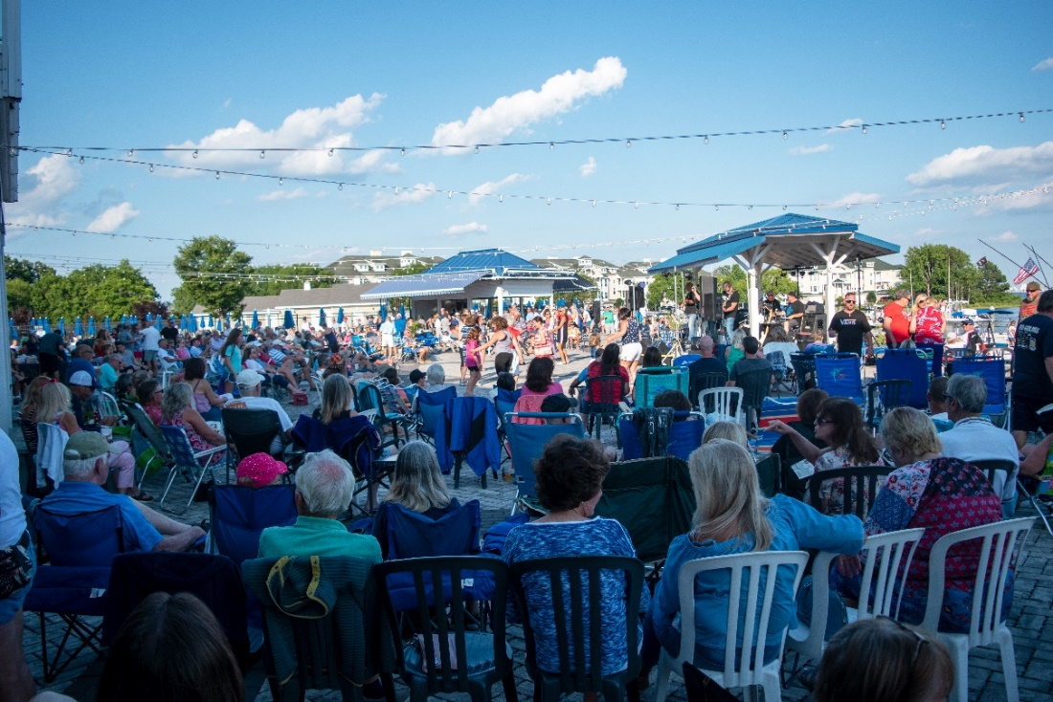
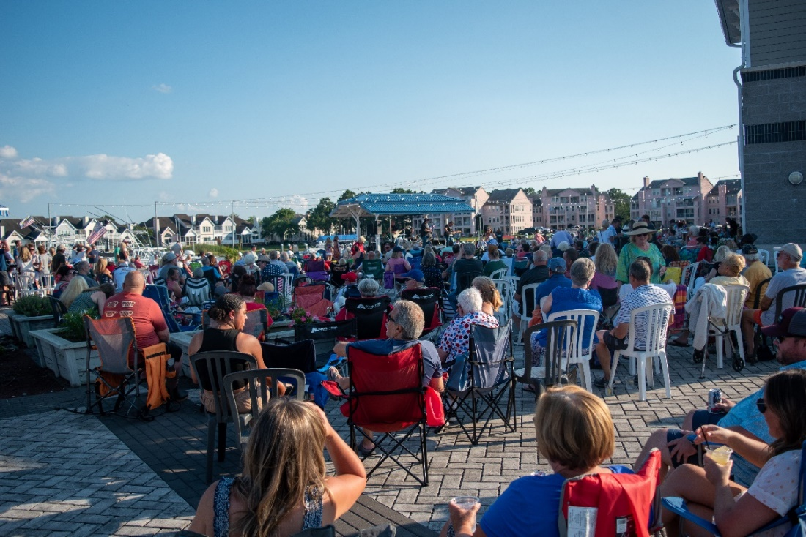
Record Weekend At The Yacht Club
Summer Fun in Ocean Pines
July 4th Weekend
Full Circle ~ Tranzfusion ~ Great Train Robbery

Slide 26
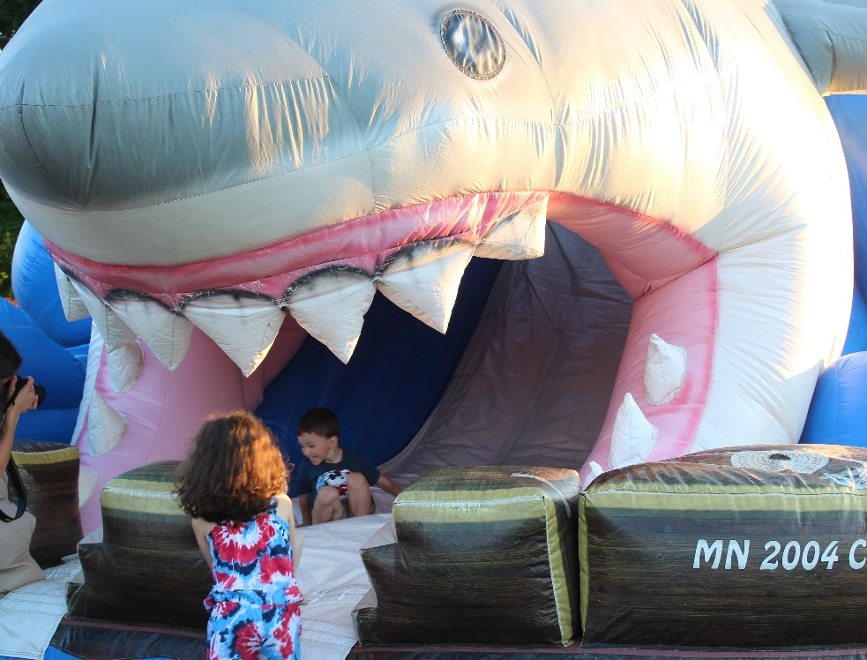
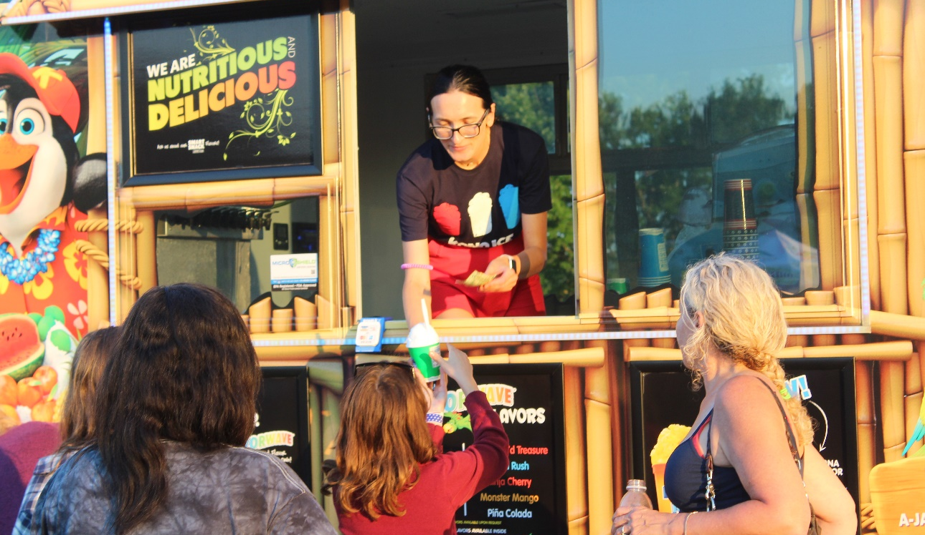
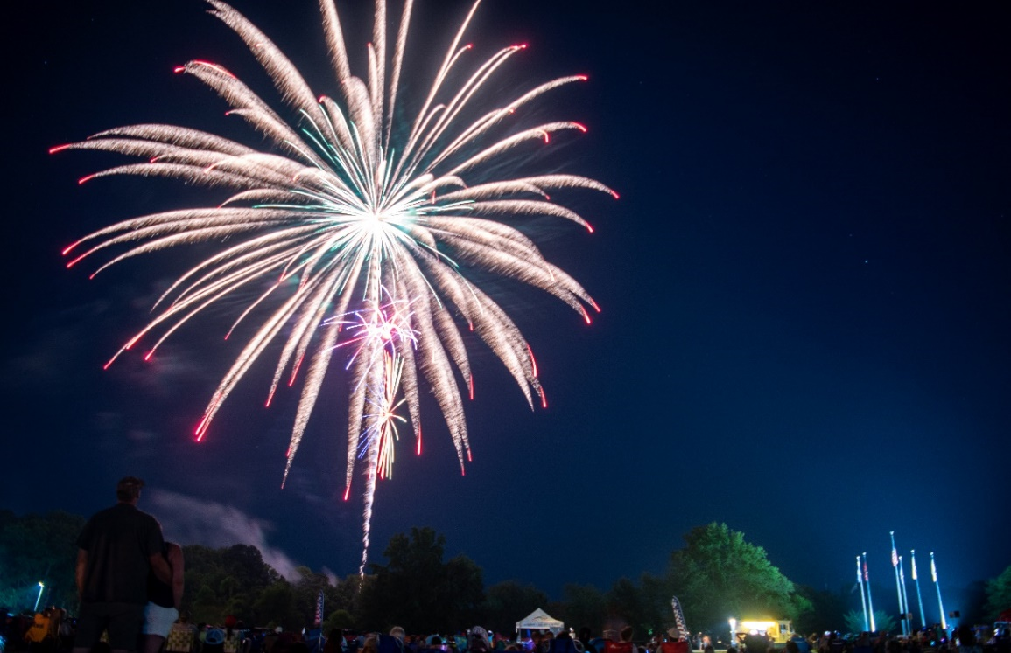
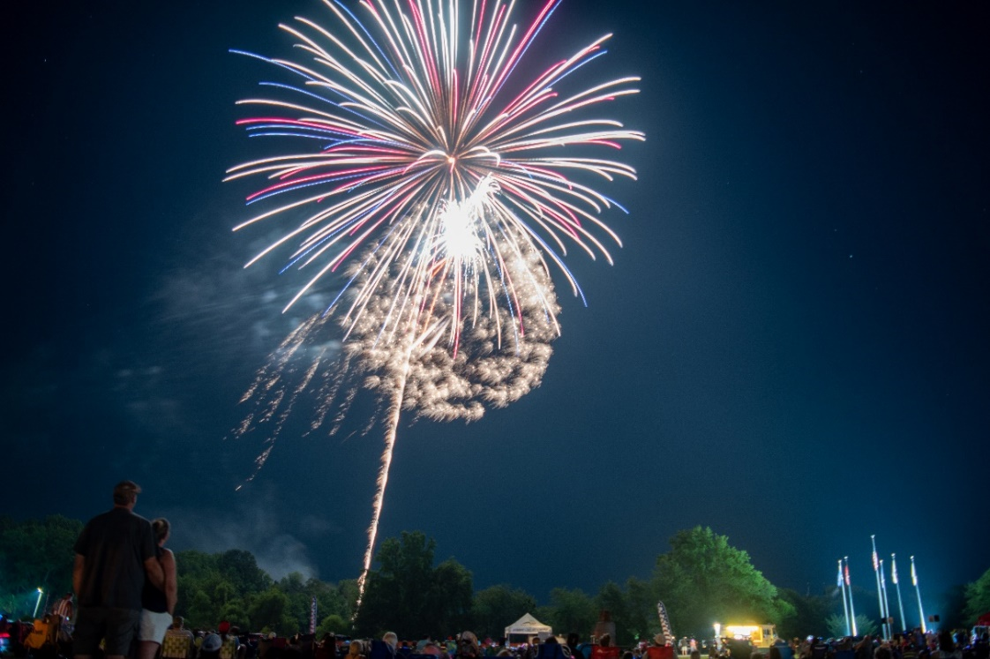
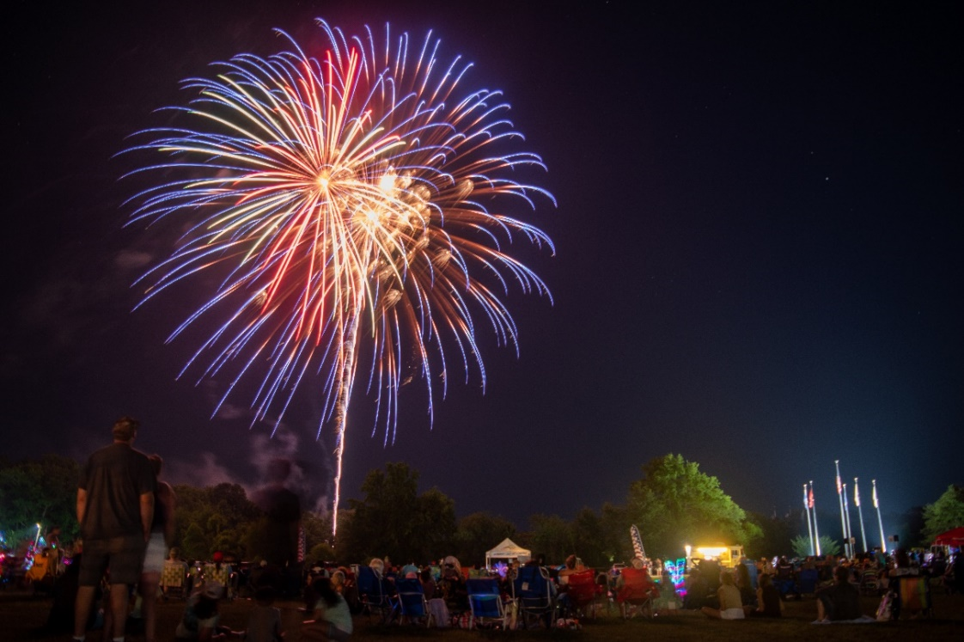
July 4th Carnival & Fireworks
Support of July 4 events broke records on social media. For example, our fireworks video was
viewed more than 25,000 times – by far a new record for Ocean Pines
And We Were Favorable to Budget!

Slide 27
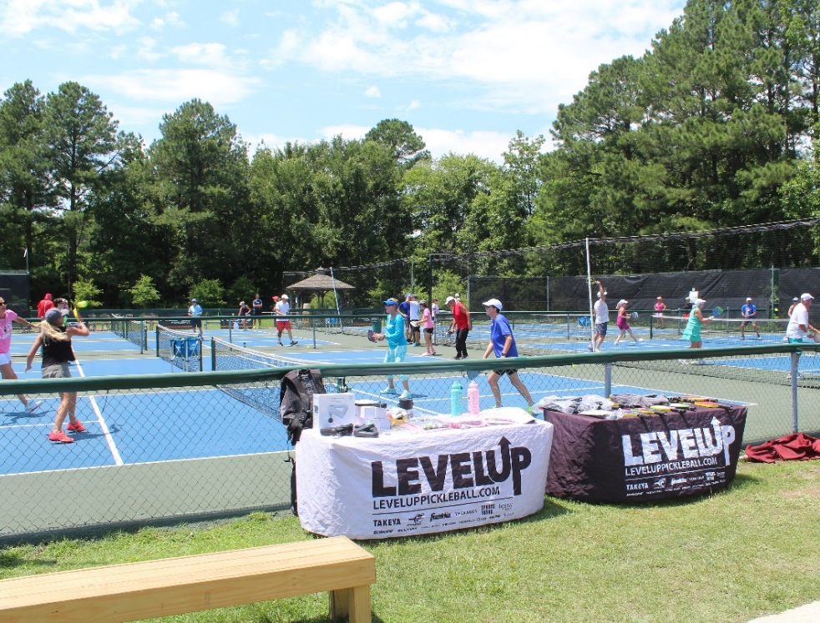
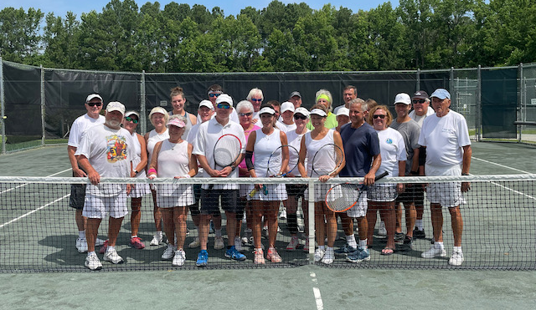
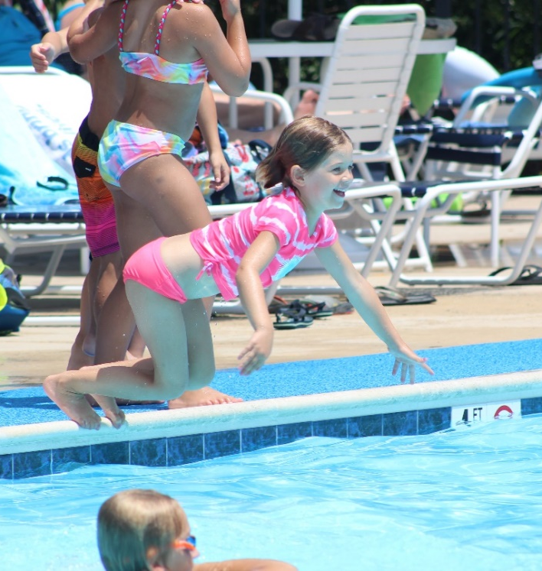
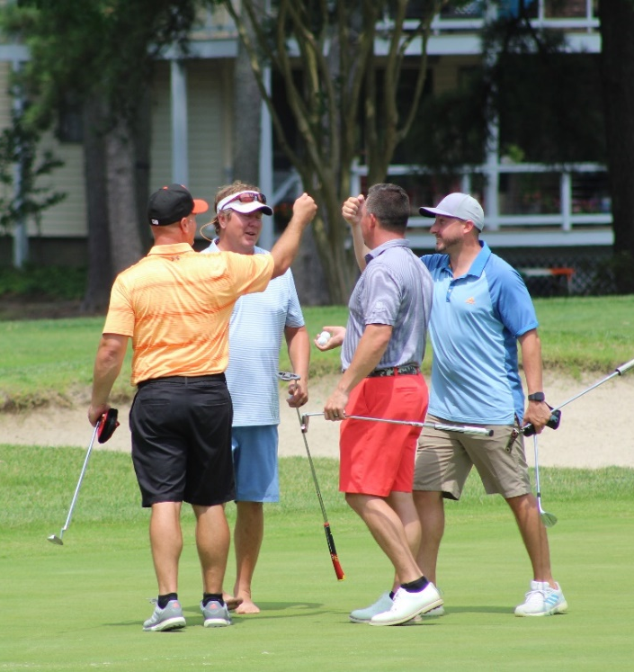
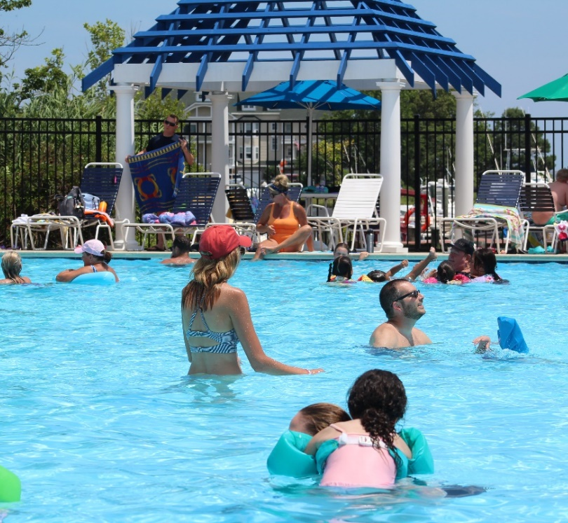
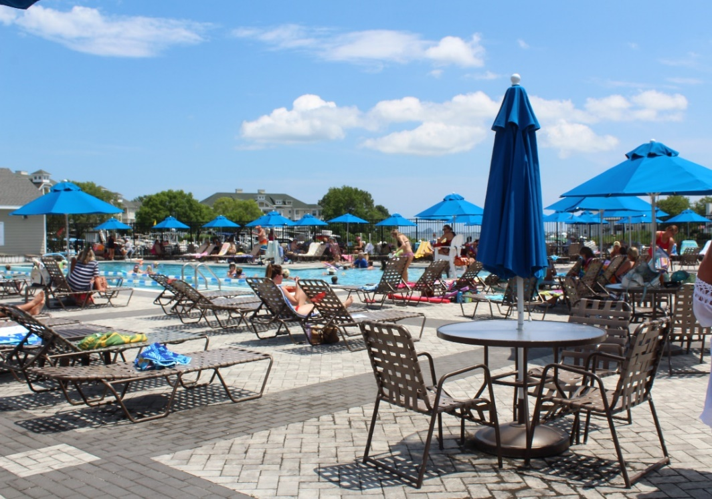
AMENITIES
The Amenities Were Ready And The Numbers Show it!

Slide 28
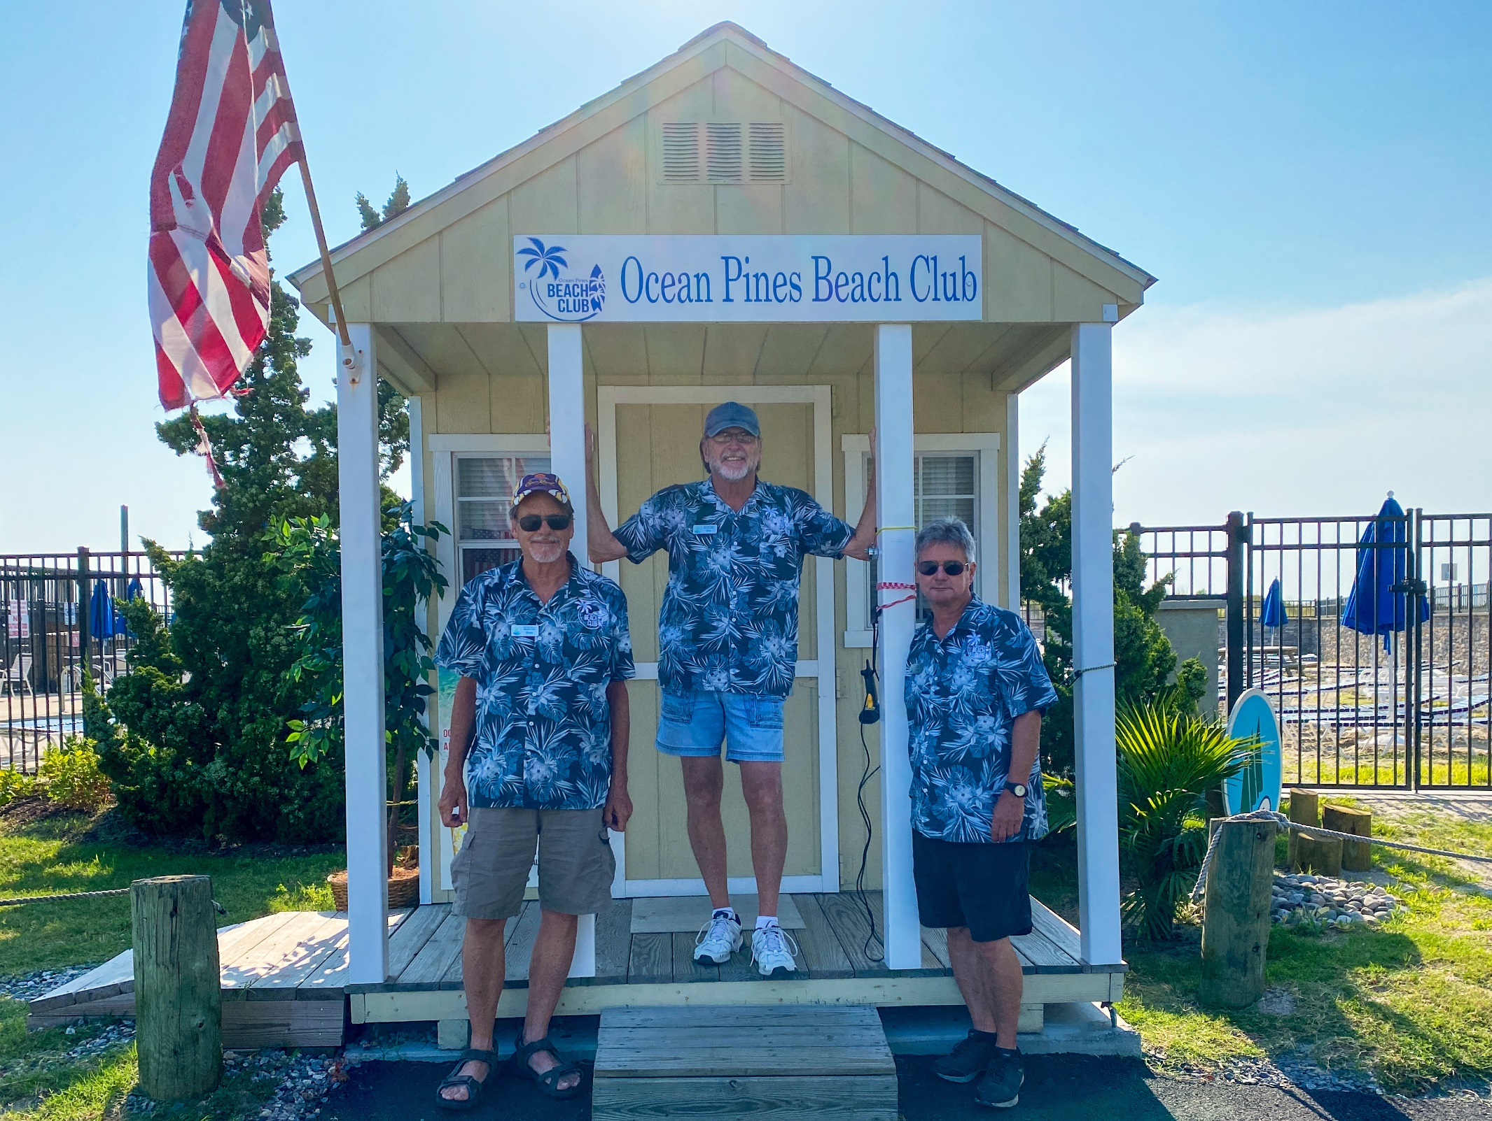
From left, Keith Thomas, Dan Batt (long time manager) and Tom Possident.
Beach Parking Shows Favorable YTD Revenue

Slide 29
GM Report
Amenities
Golf
Food & Beverage
Aquatics
Racquet Sports
Marina
Software
Matt Ortt Contract
Bulkheads
Beach Parking
Recreation & Parks

Slide 30
Golf
We are well into the summer stress period at this point of our season
We have stopped top dressing (applying sand) during the high heat and humidity, will resume practice when the weather is mor cooperative (most likely in September)
Started walk mowing greens several times a week to reduce stress
Roll greens on days we do not mow to help reduce stress
Have been using the fans to reduce soil temperatures and relieve stress
Hand water greens surfaces to prevent over watering and cool the soil to reduce stress, run automatic irrigation where necessary. Constant adjustment based on what we see in the field daily. Lots of data collection from the moisture meters and daily scouting.
Will continue to use ninja tines to help with oxygen and gas exchange in the profile. Must keep air moving in the soil profile. We will not top dress during stress period but will continue to punch holes
Aquatics
Ramping up swim lessons, hired new swim instructors (3) and in the process of bringing 1 more on board
Family Fun Night in conjunction with Rec & Parks and Yacht Club (strong collaboration among 3 departments
Aquatics on track to get back to pre-covid and has delivered expense reduction
Northstar has worked well
Beach Parking
Revenue is strong
Northstar has worked well

Slide 31
Recreation & Parks
July 4th – what can I say, How about “Awesome”!
Estimated over 3000 people
Favorability to budget $14,000
Collaboration among Public Works, Rec & Parks, Public Relations & Marketing, Police, Fire, Neighborhood Watch and others from our team. Led by Debbie Donahue
Summer camp 100%
Farmers Market – record number of vendors
Northstar is working fine. However, “Update” caused rework. In general, more steps than Recware, however, now interfaced
Racquet Sports
We are planning a pickleball tournament October 22nd, 23rd, and 24th
I have engaged Darryl and Cathy Noble as tournament directors
Permit from state for additional courts has not been received
Northstar – day to day processing is fine

Slide 32
Marina
New life rings have been installed in compliance with safety recommendations
New dock bumpers have been installed where necessary
The Marina after inspection received new certification as a Clean Marina by DNR
Marina passed DNR inspection of the Pump Out Station
The Marina is compliant with the new recommendations of the National Electric Code (NEC) and National Fire Protection Agency (NFPA) code with the exception of a Vessel Ground Fault Check Unit which is on order. This requires us to test every vessel for the presence of ground faults, at the time of initial connection to Marina power source.
All docks attained and 73 boards replaced
May slip rental – 84 at Yacht Club - $1,800 - $3,000 / 16 at Swim & Racquet $1,400 - $3,700
June – 9 small craft advisories on weekends
Northstar operational issues due to internet downtime.

Slide 33
Bulkheads
Bulkhead Emergency Replacement
Golf Course Phase 4
• Bulkhead is over 40 years old.
• It has been repaired several times and has temporary pilings holding the wall up.
• This section was planned for replacement in 2022-2023 season.
• If not repaired soon we could see damage to golf course and bridge over canal.
• Contractor can hold current price if we replace now.
• Cost will be much higher if we wait till next year. Product has gone up substantially.
Phase 4 Golf course replacement
Contractors contract price $ 190,635.00
Additional cost above contract ( sod ,Topsoil) $ 8,000.00
Total: $ 198,635.00
537 Linear foot at $355 = $190,635

Slide 34
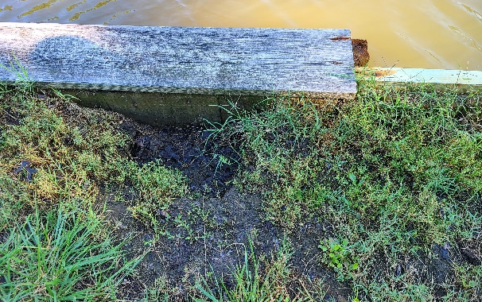
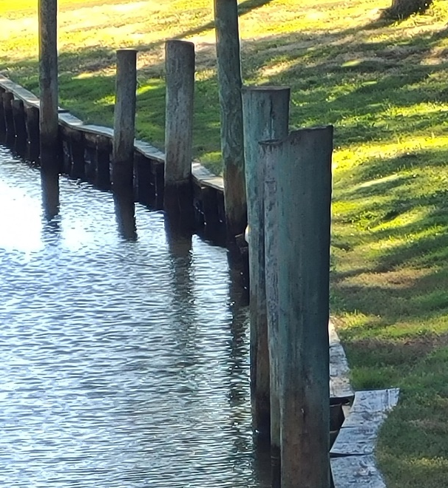
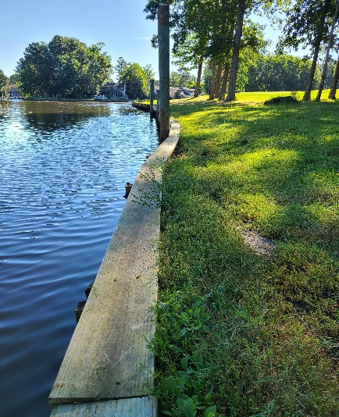
Bulkheads - “Emergency”

Slide 35
Software
Overall progress has been made since my last update to the Board & Association, specifically addressing issues caused by the software updates already presented
Issue: Update(s) caused a situation, loss of some software customization actions taken-
Requested and had a meeting with software company executive
Implemented structure (again) on OP side and discussed the process and resources on the software company side
IT Manager has prepared issue log and is addressing with lead developer
Pros
We have achieved efficiencies on back end (cash reconciliation, interfaces, enhanced inventory management processes, overall finance)
I have already mentioned in my amenity and department updates, overall progress
We have not paid any fees so far in FY 2022

Slide 36
Food & Beverage
Matt Ortt Contract
Year 1 operating results of contract With PPP W/O PPP
Yacht Club $14,178 $(259,161)
Clubhouse 12,139 12,139
Beach Club 92,687 92,687
Operating Profit $119,004 (1) $(154,335) loss
(1) →Includes PPP of $271,300
→Amount is $10,996 short of the automatic trigger (4th year) MOC
Matt Ortt Company community service during Covid (low priced family meals, delivery)
Donations to Police, Fire and nurse stations at Atlantic General Hospital
Trending very positive with banquets and ala carte in current fiscal year
I am requesting Board approval to go forward an to extend the automatic trigger for the 4th year of the current contract

Slide 37
Financial Change month of MAY 2021
May (In 000’s)
 | Budget | Current Year | Favor/ (Unfavor) vs. Budget
Net Revenues | $7,298 | $7,679 | $381
Expenses | 1,149 | 997 | 152
Net Operating | $6,149 | $6,682 | $533

Slide 38
Detail for the Month of may Favor/(Unfavorable) Vs. Budget (in 000’s)
Department/Amenity | Favorable/(Unfavorable)
Beach Parking | $117.1
Golf Ops + Maintenance | 93.5
Racquet Sports | 54.4
Aquatics | 50.2
Public Works/General Maint/CPI | 49.1
Yacht Club | 44.1
Recreation & Parks | 31.7
Clubhouse Grille | 24.5
Police | 24.3
Marinas | 21.7
Beach Club | 13.8
Other (Admin, GM, Finance, Marketing) | 8.3
TOTAL | $532.7

Slide 39
“flash” estimate for month of June 2021 (in 000’s)
Department/Amenity | Favorable/(Unfavorable)
Food & Beverage (Net) | $131.3
Aquatics | 69.0
Public Works/General Maint/CPI | 63.5
Golf Ops + Maintenance | 38.9
Beach Parking | (74.9)
Marinas | (30.3)
Other (Admin, GM, Finance, Marketing, Racquet Sports) | 8.9
TOTAL | $206.4

Slide 40
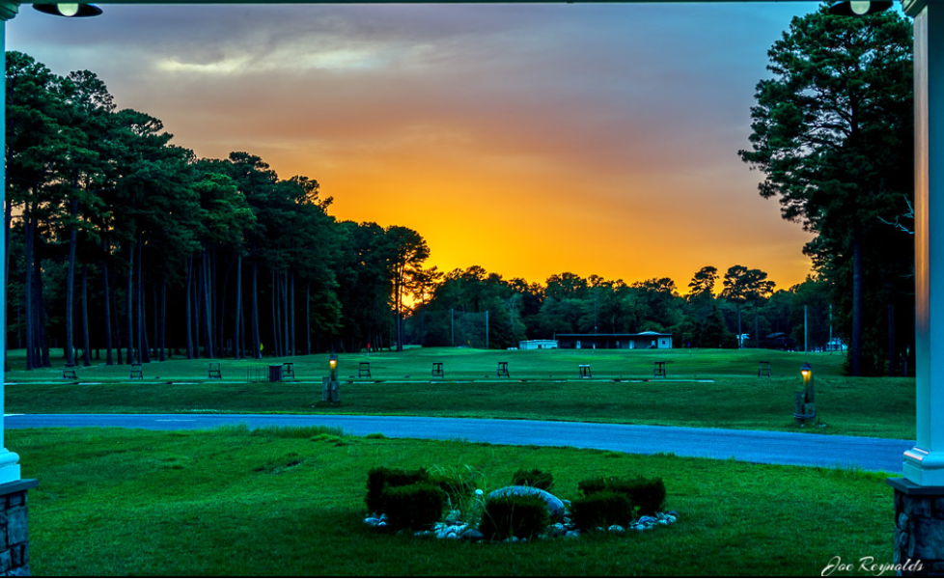
Photo by Joe Reynolds – July 13, 2021

Slide 41
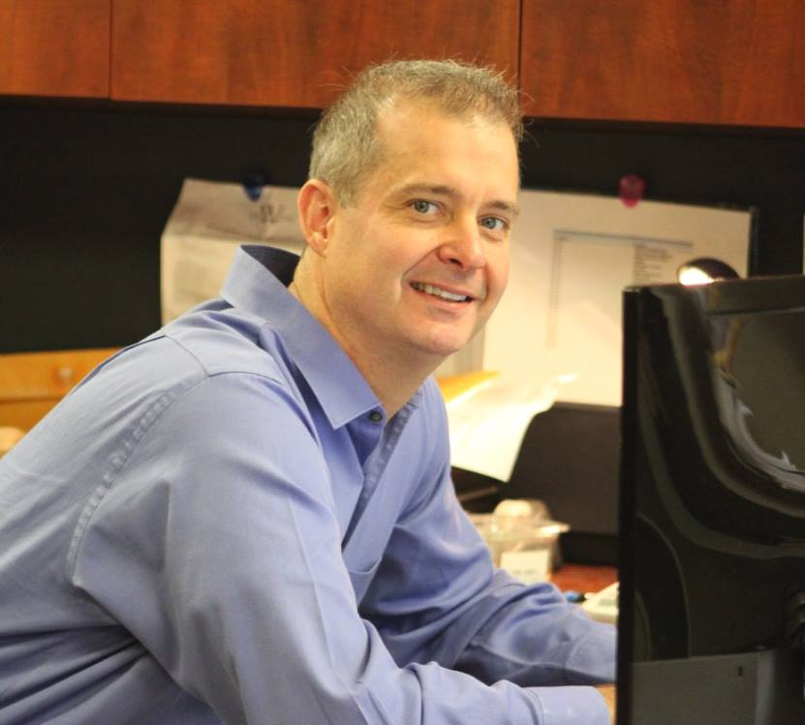
Director of Finance Steve Phillips
Has served as the Ocean Pines Association’s Director of Finance since January 2018
Accounting and Finance professional with for-profit experience in a Fortune 100 and a Fortune 500 company
Extensive not-for-profit experience, along with three years in public accounting.
CPA certified in the state of Maryland
MBA in Finance from Johns Hopkins University
BBA in Accounting from Loyola University in Maryland

Slide 42
Dma reserve study
Draft reports distributed to department heads
Department head review to take place during first 2 weeks of August
Report review with Doug Green from DMA to be held mid to late August
B&F working session likely to take place at August meeting
Board presentation likely to take place in September

Slide 43
FY21 AUDIT
TGM was awarded contract and performing audit procedures for FY22
No significant adjustments – surplus reported internally is accurate
Final report will likely be issued later this week or early next week
TGM will be represented at annual meeting to discuss details

Slide 44
Treasurer’s Report - Doug Parks

Slide 45
Cash & Short-Term Investments
Activity for Month of May
Overall Laddered Investment Rate of Return on CDAR’s for May Approx. 0.85%
As of May 31, 2021, the Association had approx. $16.4 million in cash
Approx. $9.5 million invested in CDAR’s, fully FDIC insured
Approx. $6.9 million in Money Market, and other operating accounts, fully insured

Slide 46
Unaudited Reserves may 2021 ($Millions)
 | GeneralReplace | Bulkheads | Roads | Drainage | New Capital | Total
4/30/21 Balance | $3.9 | $1.0 | $0.2 | $0.5 | $0.1 | $5.7
Contributions/ Interest | 1.6 | 1.1 | - | - | 0.2 | 2.9
Casino Funds | - | - | - | 0.3 | - | 0.3
Transfer (Spend) | (0.1) | - | - | (0.1) | - | (0.2)
5/31/21 Balance | $5.4 | $2.1 | $0.2 | $0.7 | $0.3 | $8.7

Slide 47
Reserves 5/31/21 unaudited estimate (in ooo’s)
 | Beginning Balance |  |  | Unaudited EST Balance
 | 4/30/21 | Additions | Expenditures | 4/30/2022
Major Maintenance & Replacement:
Public Works – Fleet Vehicles |  |  | (302)
Aquatics (Furniture, Roof, Equip) |  |  | (75)
Police Vehicles |  |  | (75)
Golf Maintenance Tri-plex Mower |  |  | (49)
Public Works Boom Mower |  |  | (36)
Golf Ops (Ball Dispenser/Washer) |  |  | (14)
Other |  |  | (50)
Total | 3,853 | 1,685 | (601) | 4,937
Bulkheads & Waterways | 1,010 | 1,059 | (1,368) | 701
Roads | 216 | 3 | (110) | 109
Drainage | 469 | 352 | (303) | 518
New Capital | 102 | 183 | (172) | 113
TOTAL 4/30/22 ESTIMATE | 5,650 | 3,282 | (2,554) | 6,378

Slide 48
Public Comments

Slide 49
CAPITAL PURCHASE REQUESTS
Golf Maintenance
Greens Triplex Mower -
Requesting Authorization to go forward with Staff Recommendation of $36,513.36 for John Deere

Slide 50
CAPITAL PURCHASE REQUESTS
Public Works Bulkheads
Golf Course Emergency Bulkhead Replacement -
Requesting Authorization to go forward with Staff Recommendation of $190,635 ($355 per linear feet, 537 linear feet) for Fisher Marine

Slide 51
CPI Violations None

Slide 52
Unfinished Business None

Slide 53
New Business First Reading – Resolution C-06 Revisions – Colette Horn

Slide 54
Appointments Mary Louise Flanagan – 1st Term – Recreation & Parks

Slide 55
Adjournment

