Slide 1
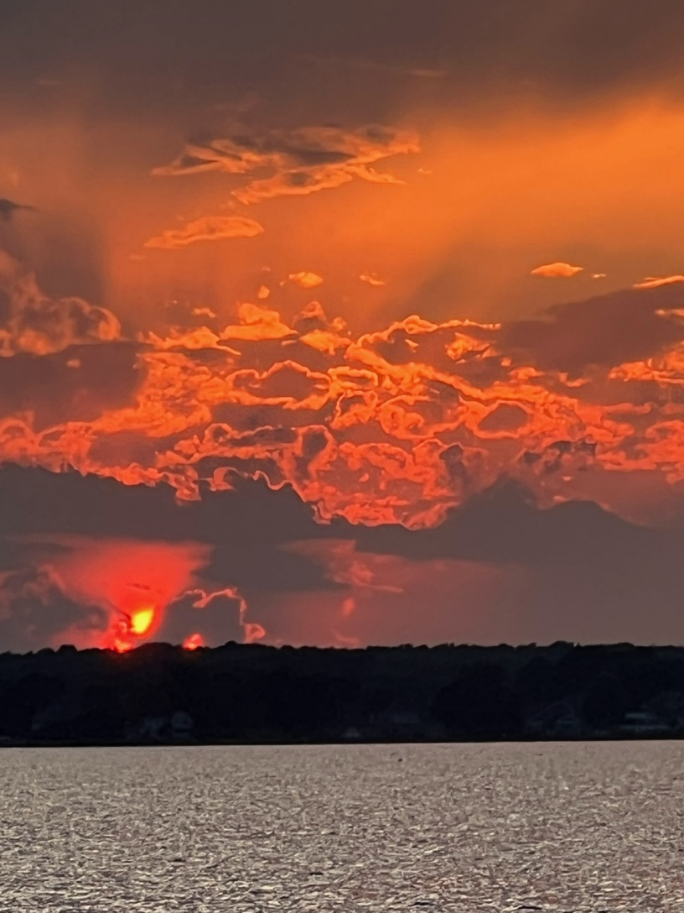
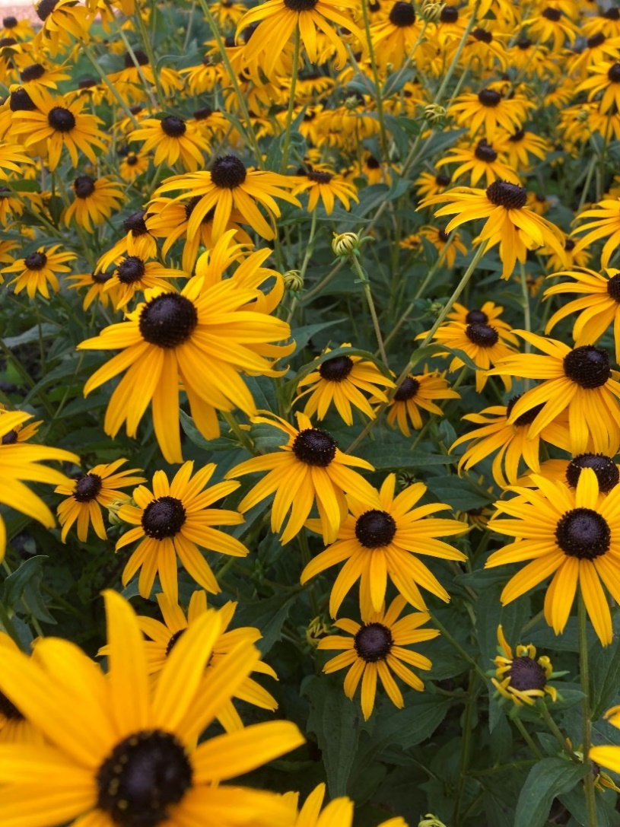
GM Leadership Report – John Viola
Photos taken by Jeff Heavner

Slide 2
Initiatives
Maintenance
Bridge Work
Beach Club
Swim & Racquet
Grounds
Landscaping
Beautification
Drainage
Yacht Club
Renovation Initiatives
“Did You Know”
DMA Reserve Study
4th of July
Camp Ocean Pines
Beach Mats
Mailboxes
Metrics

Slide 3
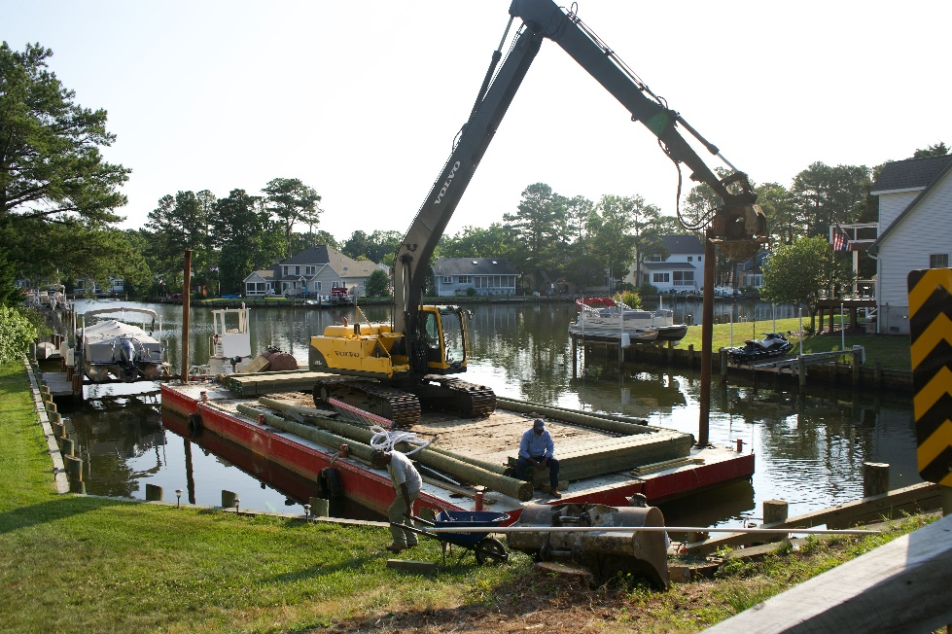
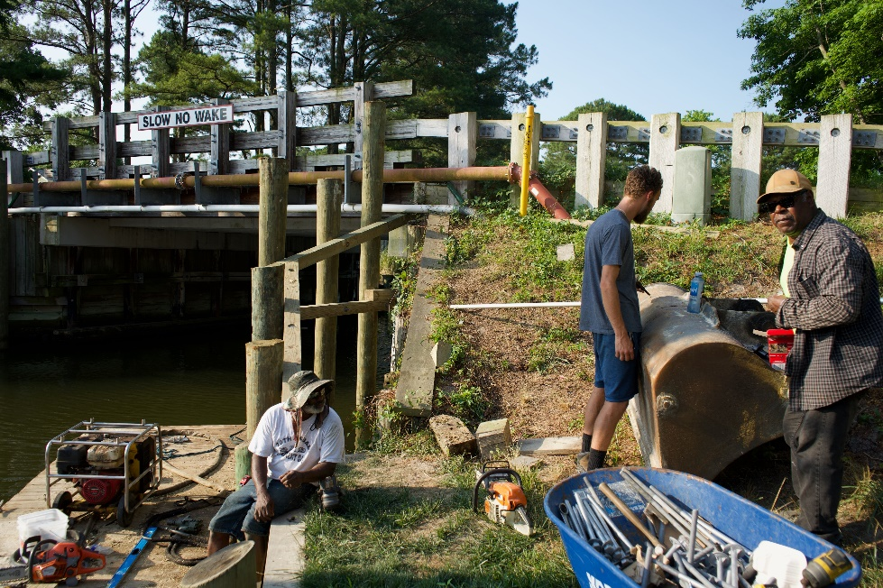
Maintenance
Bridge Work:
Replacement of bridge wingwalls and piles required by SHA inspection
Total cost: $149,500
Approved by Board at the September 30, 2023 Meeting

Slide 4
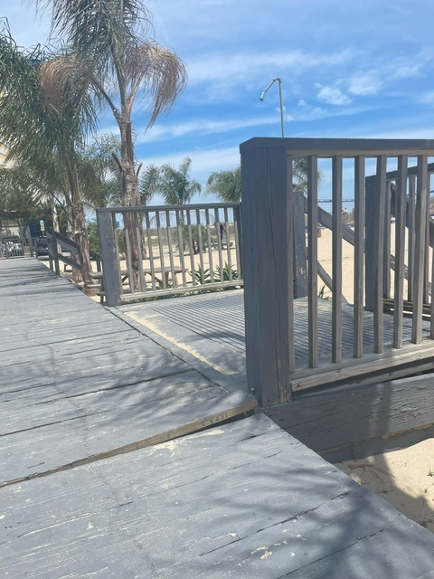
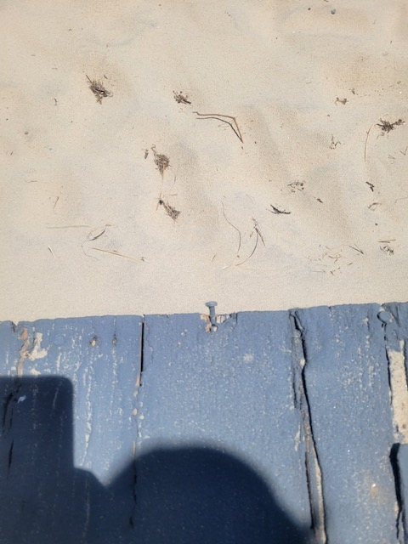
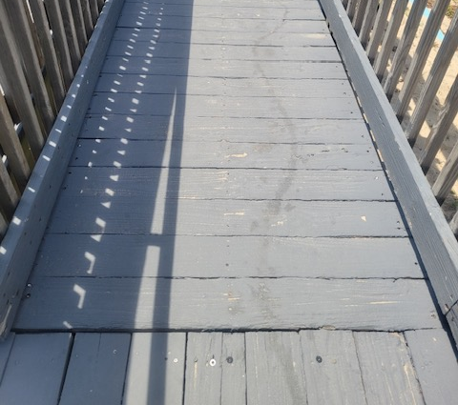
Maintenance
Beach Club:
Reported that boards were coming up and nails exposed; GM instructed Public Works to immediately repair
BEFORE AFTER

Slide 5
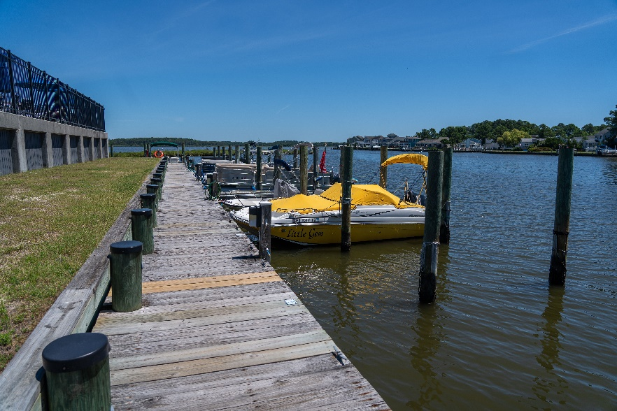
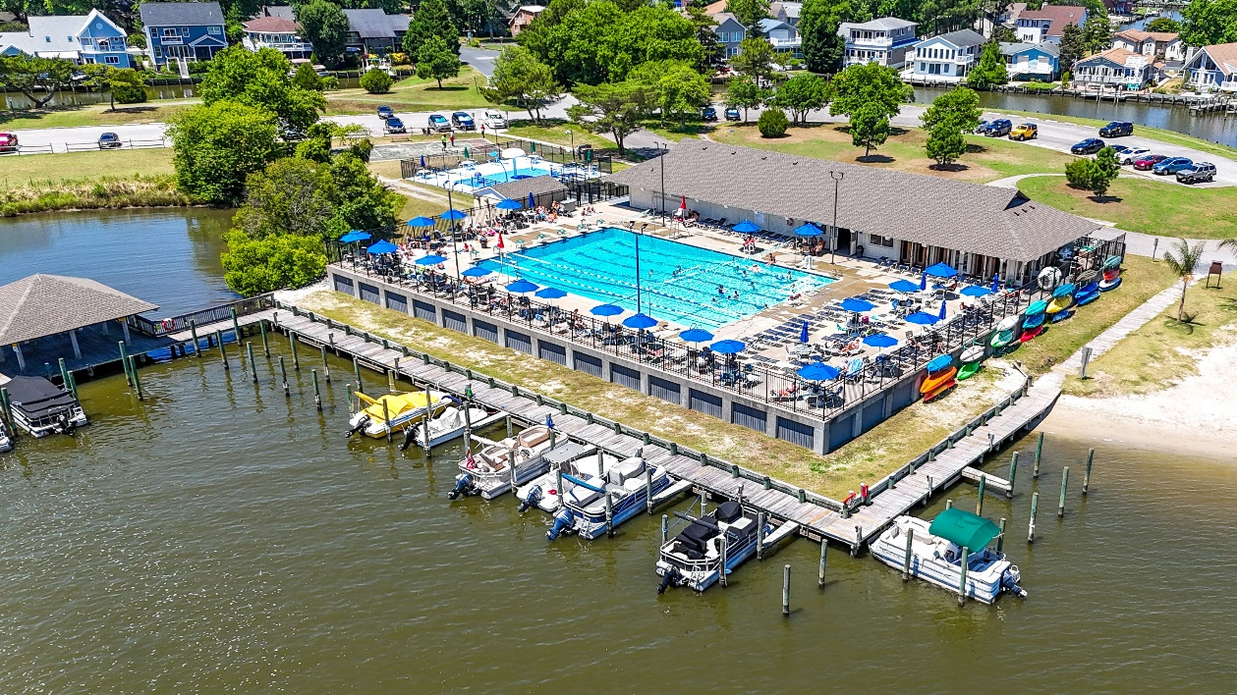
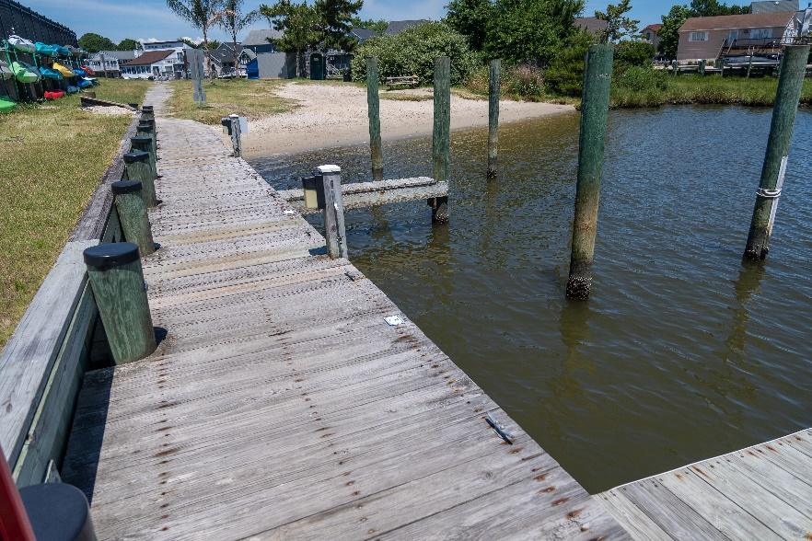
Maintenance
Swim and Racquet:
Boards replaced for safety issues
Considering changing smaller slips into pwc slips

Slide 6
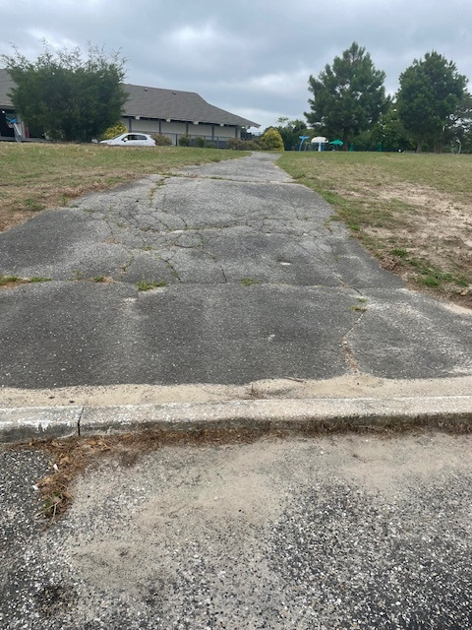
Maintenance
Reports by the Aquatics Advisory Committee of pathway around Swim & Racquet Club has major cracks
Team was already addressing this safety issue
Patched cracks with cold patch
Getting estimate of a thin overlay of asphalt
Team addressing repairing bathroom stall doors and adding hand rails in all stalls that was also reported by the Aquatics Advisory Committee

Slide 7
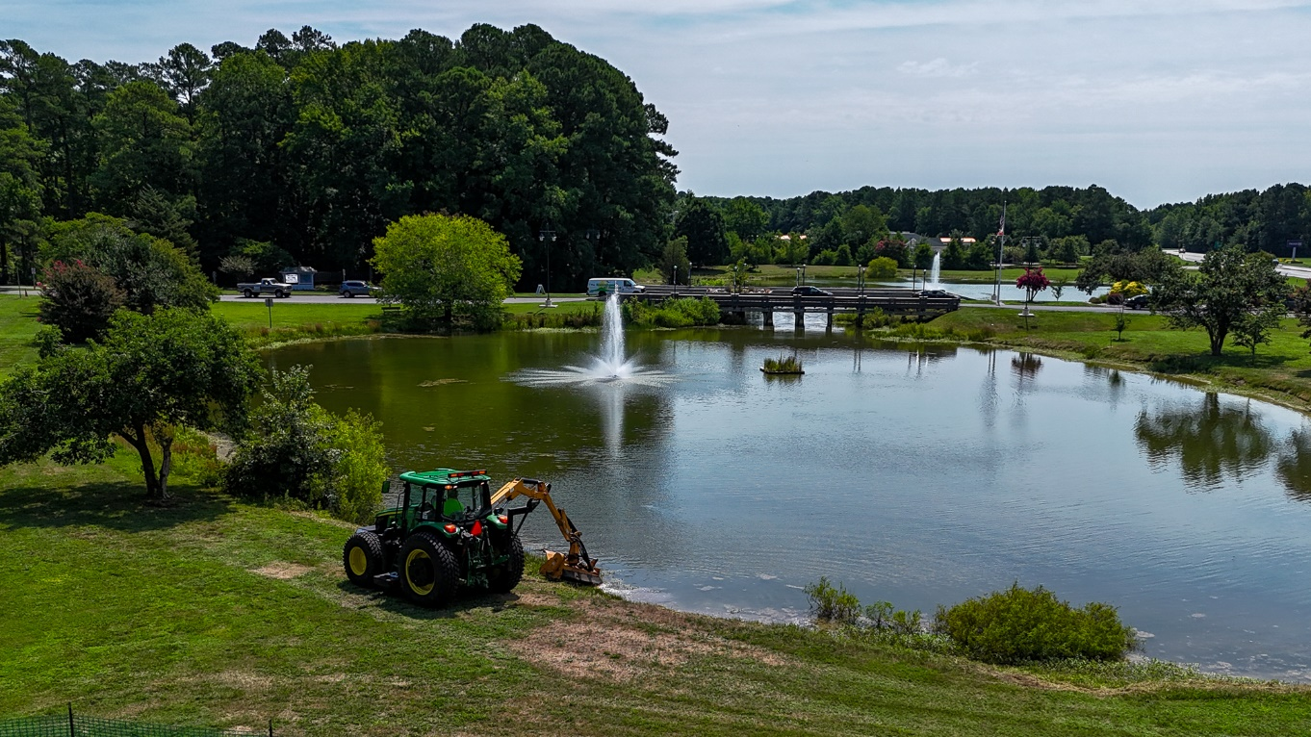
Grounds
Received info@oceanpines email on 7/18 about cutting around the pond
Public Works immediately addressed and grounds were cut

Slide 8
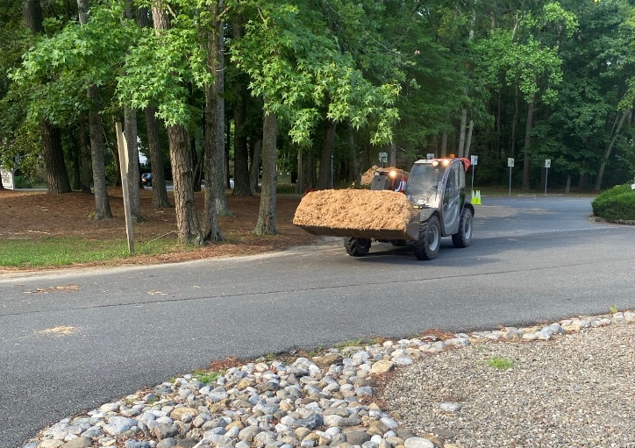
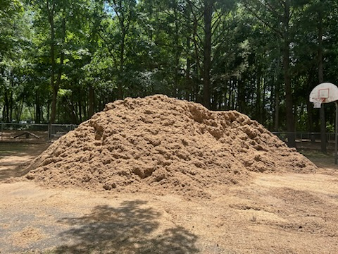
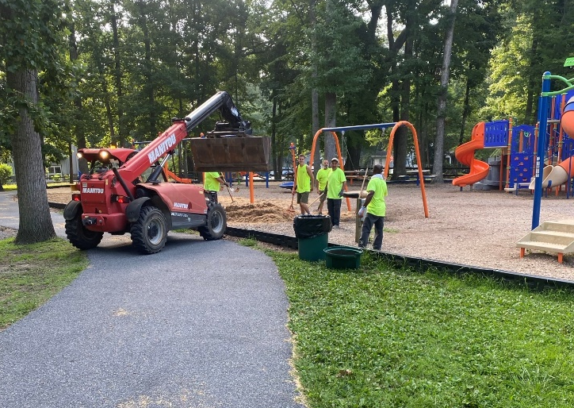
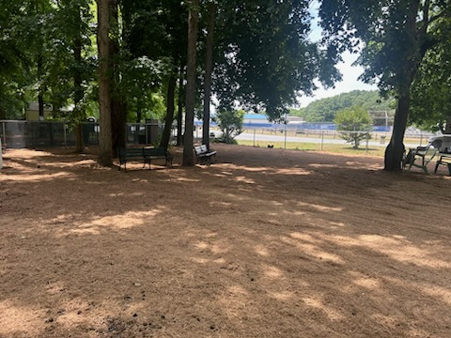
Landscaping
Dog Park:
Additional sand and mulch installed
Mulch: $5,600
Playgrounds:
Mulch installed at all playgrounds by Public Works
Total cost to date: $6,916
Overall budget: $10,000

Slide 9
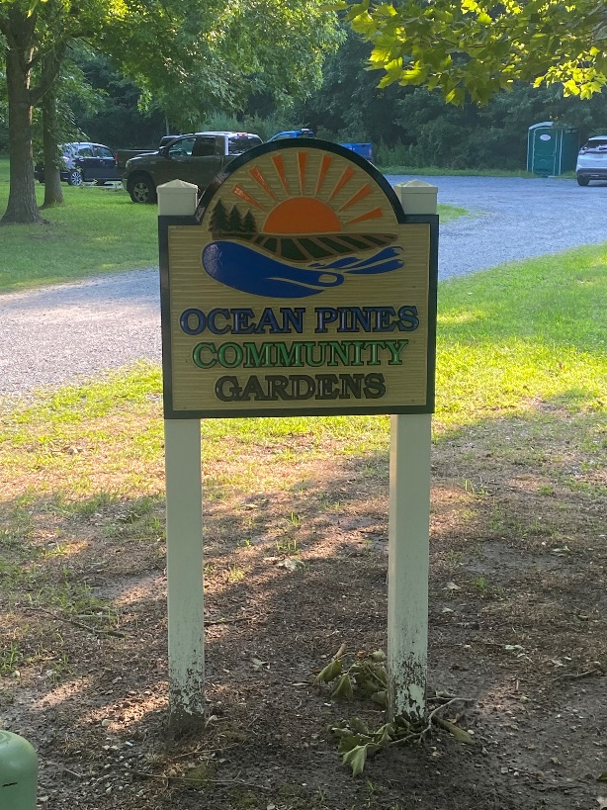
Beautification
New signs installed at Recreation Complex and Community Gardens
Cost: $2,900 (Recreation Complex sign) and $565 (Community Gardens sign)

Slide 10
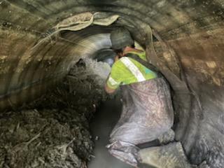
Drainage
Pelican Underground began work on CIPP liners on July 19th
Areas being done:
28 Admiral Avenue
1221 & 1223 Carrollton Lane
Capetown Road
22 Harpoon Road
34, 44, & 84 Lookout Point
57 Ocean Parkway
7 & 52 Pinehurst Road
27 & 48 Seafarer Lane
192 Teal Circle
White Horse Drive
Golf Course (18th green and 10th tee box)
Approved by Board at the March 23, 2024 meeting
Total cost: $210,637
Total spend on CIPP Liners (2021-present): $948,765

Slide 11
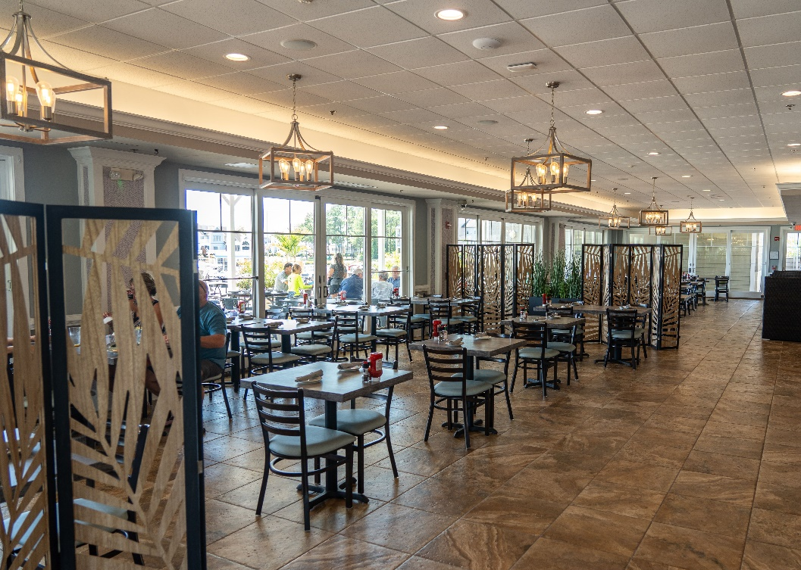
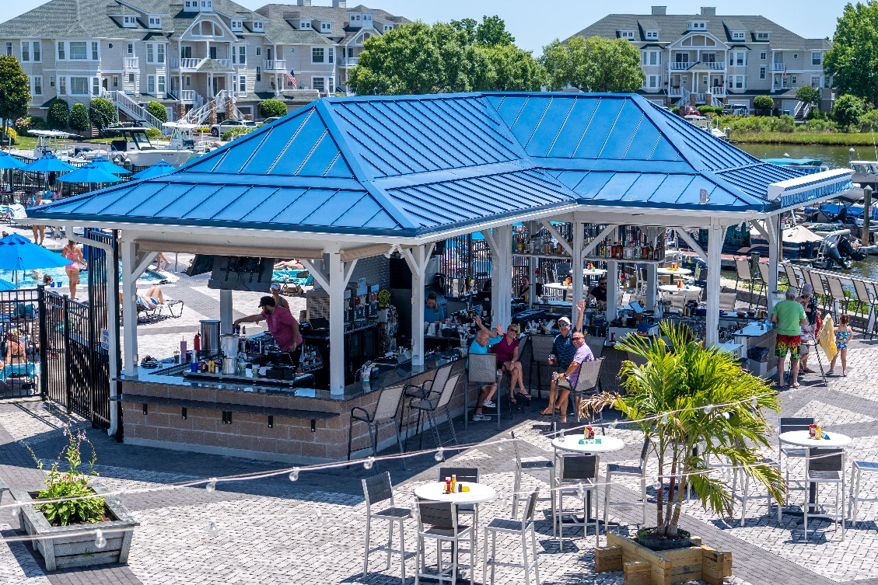
Yacht Club
Inside décor added to enhance the customer experience
Panel dividers and artificial plants
Total cost: $2,023.90
“Record breaking” revenue at newly expanded tiki bar – per Matt Ortt

Slide 12
Renovation Initiatives
Veterans Memorial Pavilion:
Status: Green
Timeline: June-November 2024
Planning stage:
Contractor and architect identified
Reached out to Frank Brown for preliminary drawings
Reviewed with architect
Reviewed with Marie Gilmore
Firehouse:
Met with OPVFD representative and Frank Brown on July 17th to go over building plans
Revised drawings to be developed based upon meeting
Next steps:
Review revised drawings with OPVFD
Develop funding plan

Slide 13
“Did You Know?”
“Did You Know” section created on website and on digital sign
Will rotate facts about Ocean Pines, with the first highlighting Concerts in the Park

Slide 14
DMA Reserve Study
Spoke to Doug Greene (DMA) to discuss revised scheduling
Set for Spring 2026 (April)
Confirmed within new guidelines of 5 years (last review – November 2021)
OPA team will participate in beta program by DMA starting November 2024

Slide 15
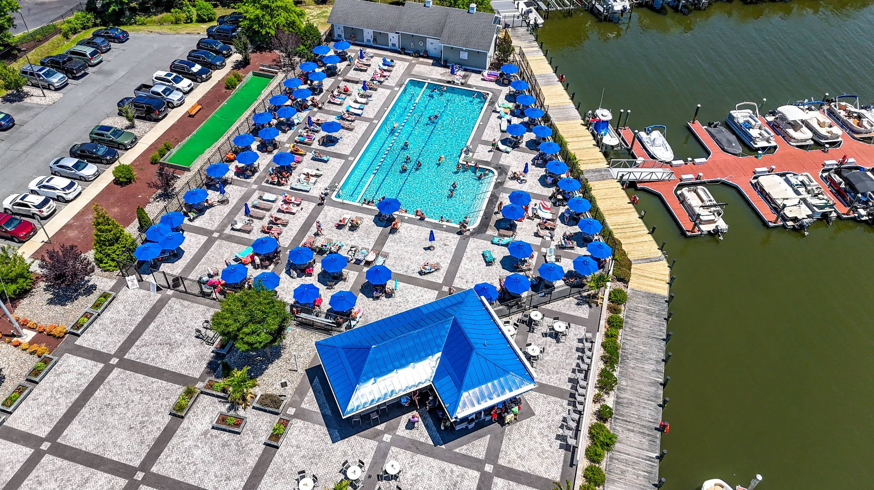
Director of Business Administration – Linda Martin

Slide 16
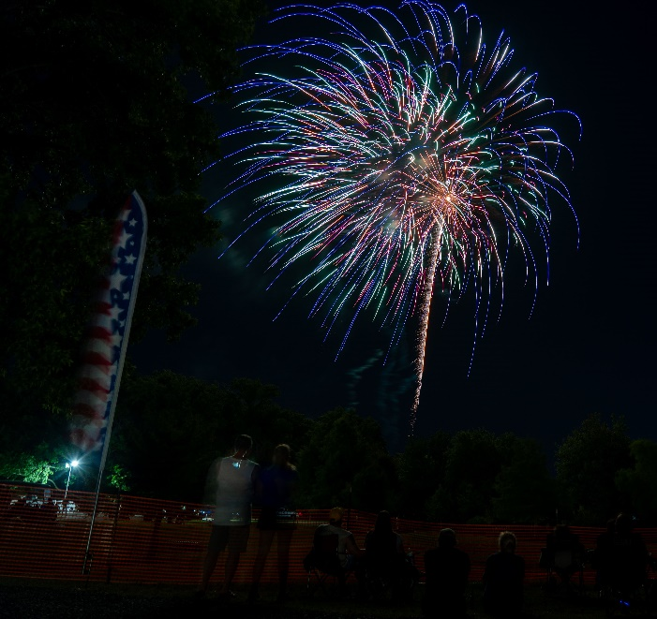
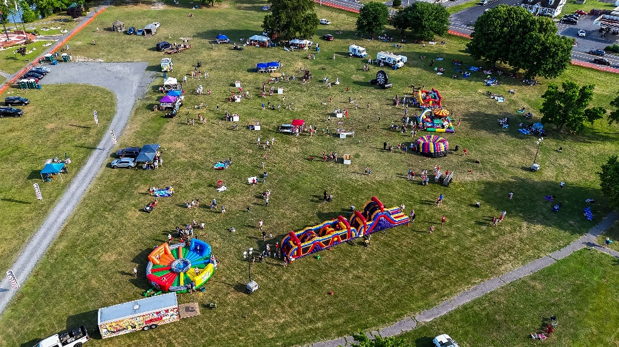
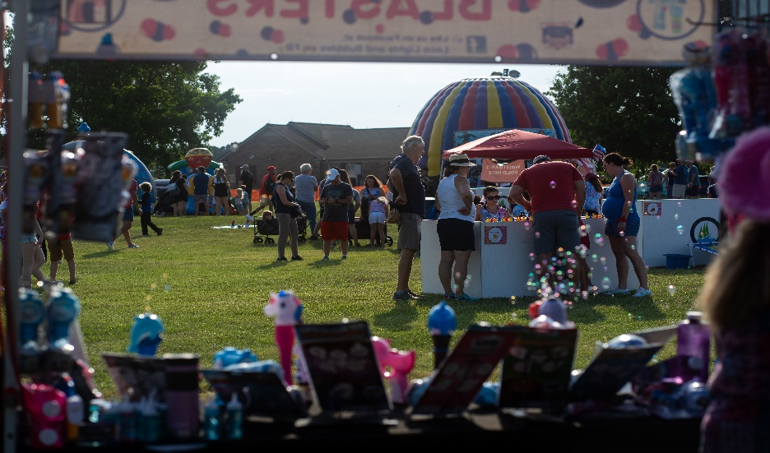
4th of July
Another successful event
5K race, carnival, and fireworks
Total: ($17,925)
Revenue: $18,658
Expenses: $36,583

Slide 17
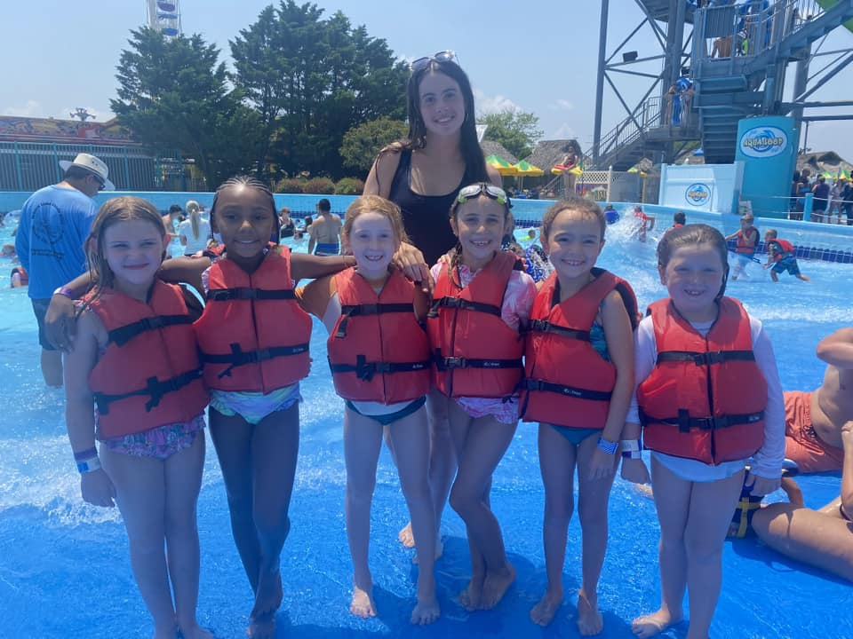
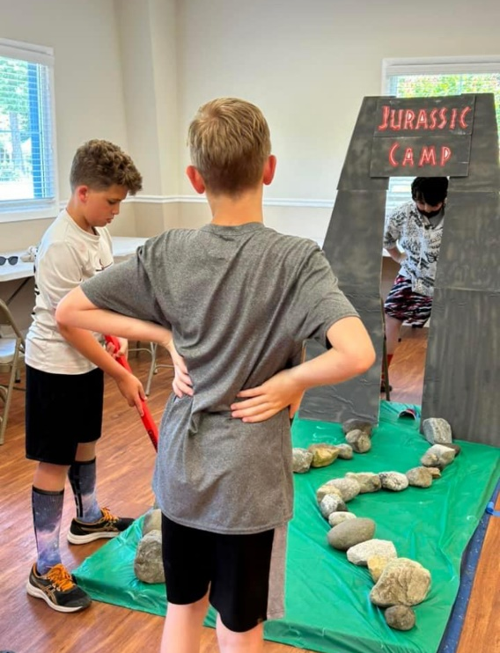
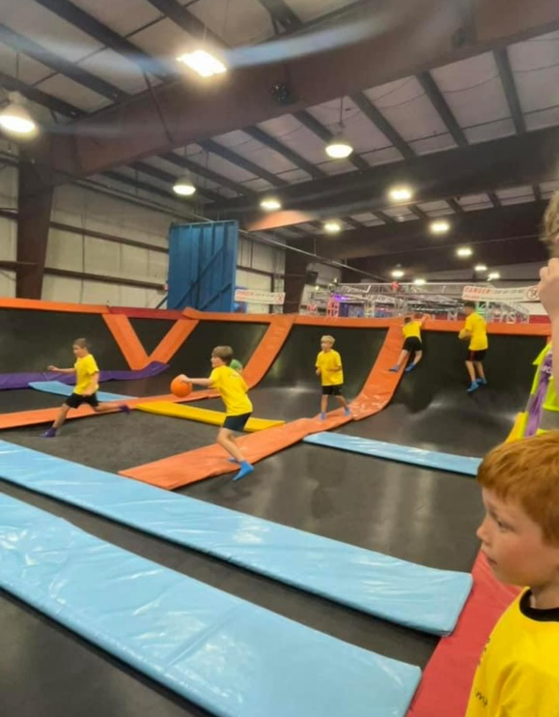
Camp Ocean Pines
First day of camp began on June 17th
Camp registration began on March 4th and was completely full by the end of that same week
Camp runs through to August 23rd

Slide 18
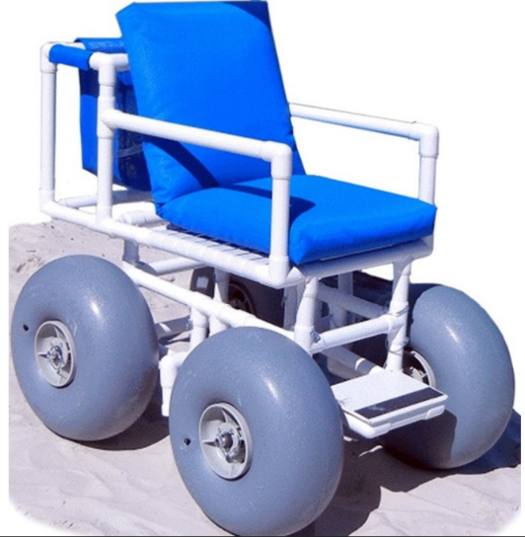
Beach Mats
Request several time in the past and recently on social media about installing beach mats at the Beach Club
Per Town of Ocean City:
Federal guidelines for handicapped access to the beach states beach mats are required to be installed one every half mile
Beach mat installed at 48th Street (next door to the Beach Club) already meets that requirement
Liability issues if Ocean Pines installed one on their own as it would be installed over the dune that Ocean City owns
Options:
See the lifeguard at the Beach Club Pool – handicap beach chair available for use

Slide 19
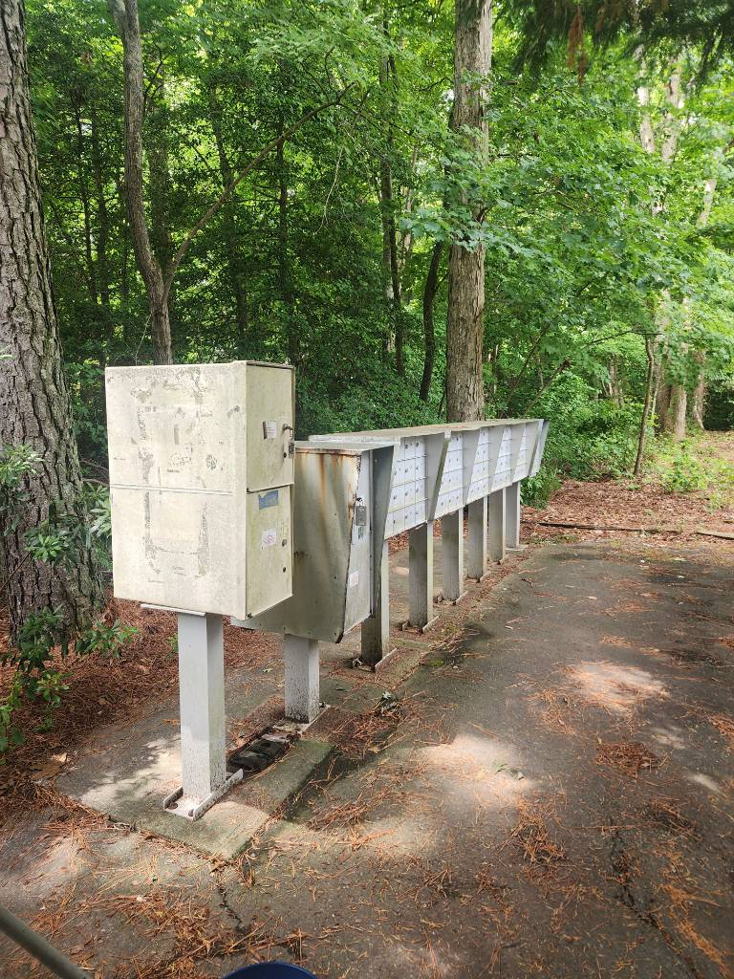
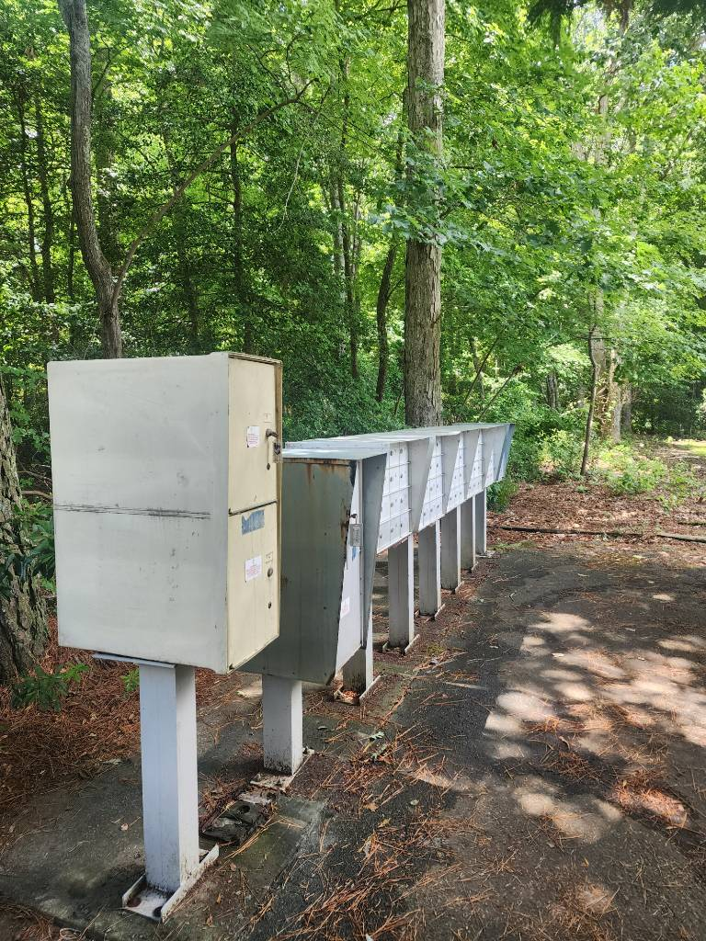
Mailboxes
Cleaning has resumed on mailboxes
Public Works making repairs to mailboxes in lieu of replacing
More mailboxes have been ordered
Before After

Slide 20
CPI Violation Dashboard June
Violations
As of 6/1/24 | New Violations | Closed Violations | As of 6/30/24
247 | 238 | 224 | 261
238 violations initiated in June: 35 maintenance/trash/debris; 56 no permit; 51 signs; 96 miscellaneous
Miscellaneous violations includes stop work orders, trailers, unregistered/junk vehicles, and vehicle parking
223 violations complied out; 262 remain open
68 maintenance/trash/debris; 84 no permit; 16 signs; 94 miscellaneous

Slide 21
Work Orders June
Open Work Orders as of 6/1/24 | New Work Orders | Closed Work Orders | Open Work Orders as of 6/30/24
177 | 107 | 105 | 171
107 work orders initiated in June: 11 bulkhead; 13 drainage; 21 grounds/landscaping; 9 roads; 2 signs; 51 general maintenance
Majority still open in drainage (79):
33 – over 30 days; 37 – over 60 days
Average 1-4 work orders a day to complete depending upon severity
Remainder still open over 30 days:
Bulkheads (17); Grounds (15); Roads (10); Signs (2); General Maintenance (14)

Slide 22
Customer Service Dashboard (from info@oceanpines.org) June
Type | # Received – June
Amenities | 38
CPI | 31
Drainage | 1
General | 48
Public Works | 13
TOTAL | 131

Slide 23
Financials

Slide 24
MONTH OF JUNE 2024 FINANCIAL RESULTS

Slide 25
JUNE 2024 YTD FINANCIAL RESULTS

Slide 26
UNAUDITED RESERVE SUMMARY JUNE 2024 ($ MILLIONS)
 | General Replace | Bulkheads | Roads | Drainage | New Capital | Total
4/30/24 Balance | $5.5 | $0.3 | $0.8 | $0.4 | $0.1 | $7.1
Contributions/ Interest | 1.7 | 1.1 | - | - | - | 2.8
Casino Funds | - | - | 0.3 | 0.1 | - | 0.4
Transfer (Spend) | (0.7) | (0.1) | - | (0.1) | - | (0.9)
6/30/24 Balance | $6.5 | $1.3 | $1.1 | $0.4 | $0.1 | $9.4
Est Remaining FY Spend | (0.8) | (1.1) | (0.3) | (0.1) | - | (2.3)
4/30/25 Estimate | $5.7 | $0.2 | $0.8 | $0.3 | $0.1 | $7.1

Slide 27
Treasurer’s Report - Monica Rakowski

Slide 28
Cash & Short-Term Investments
Month of June
As of June 30, 2024, the Association had Approximately (~) $19.1M in Cash
Cash Increased ~ $1.0M from the Same Time Period Last Year
Cash Decreased ~ $0.1M from May 2024
$10.6M Invested in CDAR’s
$58K in Interest Income Recognized for the Month
Remaining $8.5M in Insured Cash Sweep, Treasury Bills, Money Market and Other Operating Accounts (Diversified Between 2 Local Banks)

Slide 29
Ocean Pines Bike & Pedestrian Work Group – Progress Report
Making our community safer and more accessible for those of all ages and abilities to walk, bike, and roll.
Patti Stevens Chair, Worcester County Bike & Pedestrian Coalition Contact: wcbikeped@gmail.com
Eastern Shore Representative, Maryland Bike & Pedestrian Advisory Committee
July 20, 2024

Slide 30
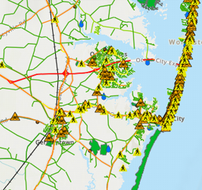
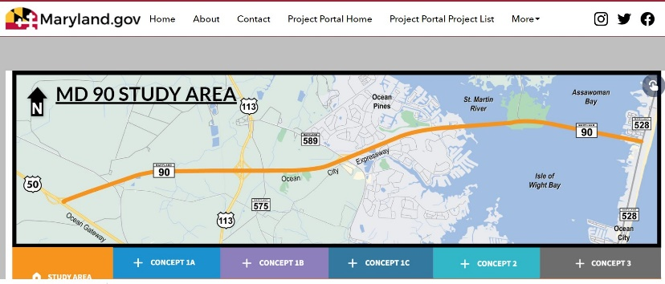
Ocean Pines Community Pedestrian & Bike Safety & Access Workgroup
Problem
Goal – Identify ways to improve safety and accessibility for people to walk, bike, and roll in and around Ocean Pines. MD VISION ZERO – CRASHES are NO ACCIDENT
Data and research show most crashes are caused by human error and road design flaws and can be prevented by the 3 Es - Education, Engineering, Enforcement
Communities around the state with bike and pedestrian plans have obtained state grants and technical assistance.
Worcester County Trails & Greenway Project is seeking input for trails and paths to connect communities.
Workgroup includes representatives of Ocean Pines Chamber of Commerce, residents, public safety and public works and will engage SHA District 1 & Worcester County.
Introduced at Ocean Pines Association Board meeting in October 2023
Opportunity

Slide 31
Bike/Ped Safety and Access Activities
NOVEMBER – Identified issues and opportunities, other interested parties. Walked trails with GM John Viola and Nobie Violante to discuss needed safety improvements
DECEMBER/JANUARY and signs installed at Sherwood Trail Crossings.
PD monitors speed violations in various areas
FEBRUARY -Sidewalk and Crosswalk at 589 + Manklin Creek Rd completed after 10 years!
MARCH –Reviewed and provided comments on County master plan for OP priorities. Planned OP Day activities and information gathering. Prepared and submitted 2 grants.
APRIL – Residents share concerns/priorities for bike/walk safety at Ocean Pines Day
MAY - Maryland State Highway Office awards OPPD grant to fund bike rodeo, e-bike safety course, lights, reflectors, safety guidelines to give out to employees and residents. Community Bike Ride held and participants share safety concerns, suggestions.
JUNE - Coastal Association of Realtors awards grant for demonstration project to paint bike/ped stencils in colorful blocks along segments of heavily used roads in Ocean Pines.
SUMMER – Distribute lights, reflectors, safety info to summer workers through Chamber and to residents at Farmers Markets and other events.
FALL – Conduct Bike Rodeo and E-Bike Safety Education Course working with Ocean Pines Recreation and Police Departments. Plan Demonstration Project to Mark Bike/Ped Lanes.

Slide 32
Work Group Member Contributions
Eddie Wells – Senior Director of Public Works and his team completed 5 new crosswalks and installed signs along Sherwood Trail. Built sidewalk connector to new Manklin/589 Crosswalk.
Chief Tim Robinson, Police Department helped prepare and submitted Maryland Highway Safety Grant to fund safety education and community outreach. Monitors & reports traffic safety data. Coordinated with Public Works on sign and crosswalk placements.
Dr Paul Rogers – MD State Fatality Review Team, reported bike/ped incident data. Requested and secured proposal from ALTA Engineers for bike/ped safety and access study for Ocean Pines.
Pam McGregor – Member OP Rec & Park Advisory Committee led Community Bike Ride, working with schools and recreation department to plan bike rodeo. Set up & staffed Ocean Pines Day display.
Mickey Lobb – Realtor and avid cyclist, provided property ownership info, secured Coastal Association of Realtors grant for best practice pilot project. Will assist with Bike Safety Education.
Kerrie Bunting- Worcester Chamber of Commerce in Ocean Pines, hosted initial meetings. Provided business information and feedback and is assisting with employer outreach.
Patti Stevens – Chair, Worcester County Bike and Pedestrian Coalition prepared grant proposals, submitted comments on Trails Master Plan, nagged/nudged MDOT-SHA on 589 crosswalk.

Slide 33
Worcester County Master Plan Recommendations for Ocean Pines
SHORT TERM w/in 5 years:
Route 589 Sidepath Trail, 10-12 ft wide, set back from Road w/ barrier
Ocean Parkway on road bike trail on existing shoulder, 6-7 ft wide
Yacht Club on road trail
LONG TERM in 10+ years
Route 90 Side Path & on road trail across the Bridge
Others Segments: Route 611 Off Road Trail, Berlin to Snow Hill Side Path on RR Easement
Notes:
Ocean Pines Work Group and other residents provided input to Plan in writing and at February public meeting in Berlin. It is still in draft and comments may be provided until August 1.

Slide 34
Suggested Feedback on Draft Plan
Prioritize 589 off-road trail in 3 phases:
1- Connect South and North gates of Ocean Pines
2 – North gate to Schools & Showell Park
3 - South gate to Grey’s Corner Rd
Add Ocean Pines Beach Club as a priority destination in Ocean City
If/when Route 90 is redesigned and widened the bike/ped should be off road, separated path
Other comments?

Slide 35
Issues Identified by Residents
Crosswalks and signs needed to major recreation areas with significant bike/walk traffic:
Across Ocean Parkway by N Fire Station to White Horse Park Trail
Across Ocean Parkway by Public Works/S Fire Station with path to Manklin Recreation Center.
Need a bike/walk route out of South OP onto 589, possibly along construction road from Triple Crown to new light at AGH Gudelsky Medical Center
Notes:
At Ocean Pines Day, Community Bike Ride and through outreach

Slide 36
Improve Existing Walk/Bike Areas
REMOVE PINE NEEDLES, WEEDS, BLUE REFLECTORS
FILL HOLES/PAVE HOLES LEFT BY UTILITY WORK to allow full width of shoulder
Notes:
Pine Needles near woods across from 1312 Ocean Parkway, Gravel hole at 1128-1130.

Slide 37
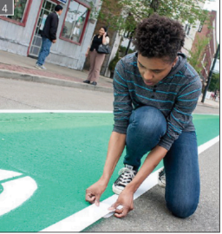
Apply Best Practices in Ocean Pines
JHU Public Health study in 6 cities, AARP funded pilot projects in more
Volunteer Team paints bright color blocks with stencils showing Bike/Ped directions to mark lane
Improves road sharing safety, increases use for active transportation 27%
Work Group would like to work with OPA to do this in 6-8 locations on Ocean Pkwy

