Slide 1
Board of Directors Meeting
June 17, 2023

Slide 2
Approval of Agenda

Slide 3
Approval of Minutes May 20, 2023 – Regular Meeting May 27, 2023 – Special Meeting

Slide 4
President’s Remarks Doug Parks

Slide 5
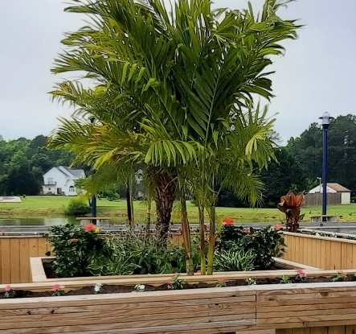
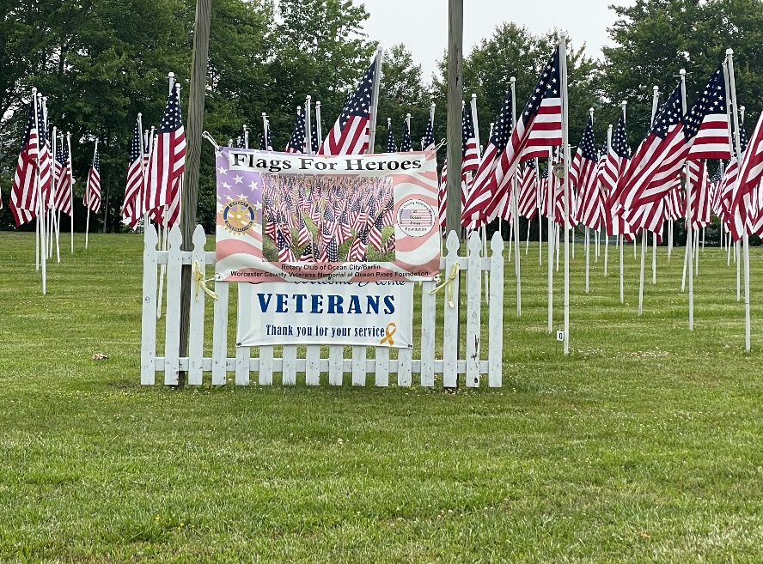
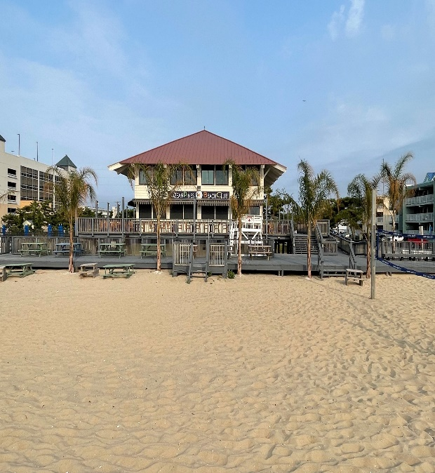
GM Leadership Report – John Viola

Slide 6
Initiatives
Cell Service
Maintenance
Rules Reminder
Metrics
Recreation & Parks Events
Marina Gas Dock
Racquet Center
Golf
Capital Items
Addendum

Slide 7
Cell Service
Using the information OPA provided, Verizon confirmed the issue with poor reception.
OPA should receive an update within the next few weeks on whether upgrades will occur this year.
OPA should start getting regular updates from Verizon on their efforts to improve cell service.

Slide 8
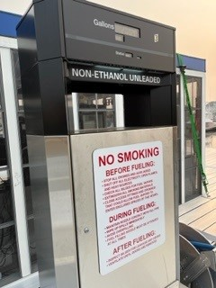
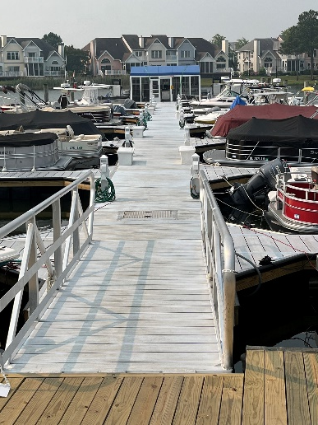
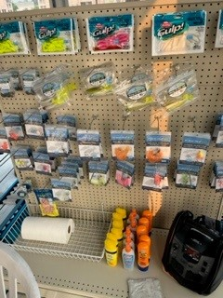
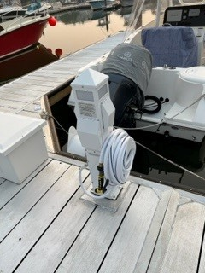
Marina Gas Dock
The gas dock is now open from 6am until 6pm 7 days a week.
Five (5) gas pumps are in operation. All pumps and gas lines are in compliance with the new Maryland Comar (Code of Maryland Regulations) related to fuel. They also comply with the new electrical codes.
New pedestals have been added to each boat slip on the new dock which are in compliance with the new electrical code.
A new line of merchandise has been added which includes fishing gear, bait, snacks, soda, ice cream, shirts, and hats.

Slide 9
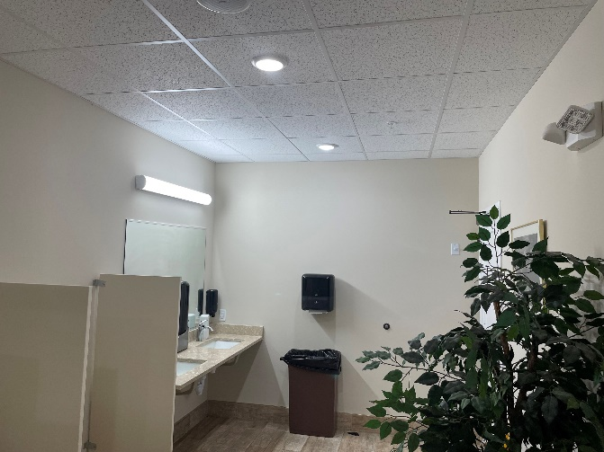
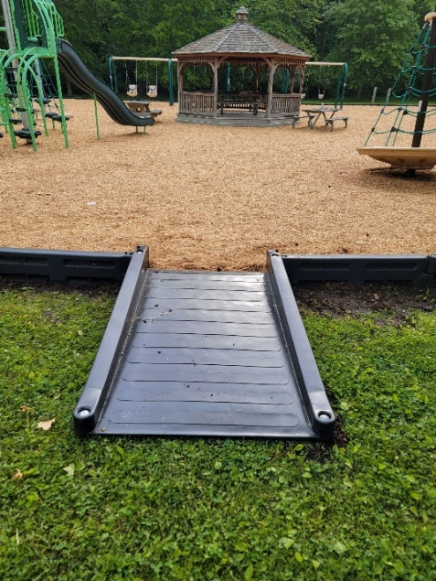
Maintenance
Completed
Golf Clubhouse
Restrooms Painted
Yacht Club
Bar Painted
Restrooms Painted
Bridgewater Playground
Upgrade to add a baby swing and to keep one regular swing
Manklin Playground
Upgraded to add ADA entrance making it easier and a shorter distance to the opening of the playground
Ongoing
Trails Maintenance
Being cleared, trees trimmed, and mulched
Signs for the parks were ordered on May 8th, will be installed upon arrival
Landscaping
North Gate Bridge Trim
North Gate Pond Fountain

Slide 10
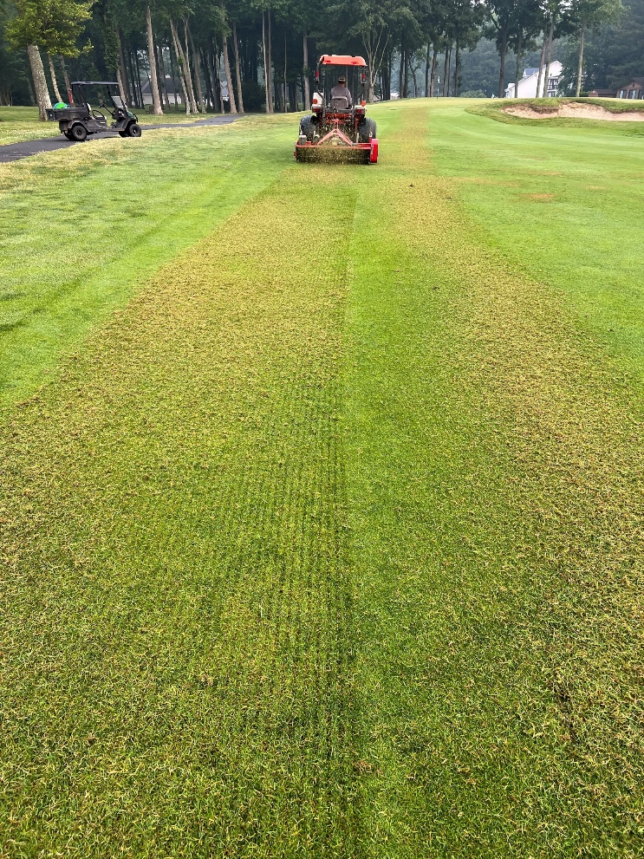
Golf
Golf
Raven's Roost Golf Tournament
Held June 2nd
128 players participated
Increase from 99 players in 2022
2023 Men's Club Championship
June 24th & 25th.
Course & Pro Shop continue to be busy. May sales numbers up over 2022 (8 months in a row).
Golf Maintenance
Verticutting the fairways and greens as part of our thatch management program
Using moisture meters to daily monitor greens, tees, and fairways so we can irrigate accordingly.
Verticutting

Slide 11
Capital Items
Proposed FY2024-2025 Capital Initiatives
Bainbridge Park
Boat Slip Toll Booths
Firehouse
Irrigation System
Racquet Building
Pavilion for Veteran’s Memorial Park
See Addendum for Additional Detail

Slide 12
Bainbridge Park
I have formed a work group for replacement of the Bainbridge Park Playground. In addition, converting it to an ADA compliant playground.
We have begun discussions for pre-planning with two companies.
Apparently, Gametime presented plans to the Recreation and Parks Committee last year
As with all projects of this nature, we will be looking into grants to help with funding.
An ADA Survey was sent out on Thursday, June 15^{th.}

Slide 13
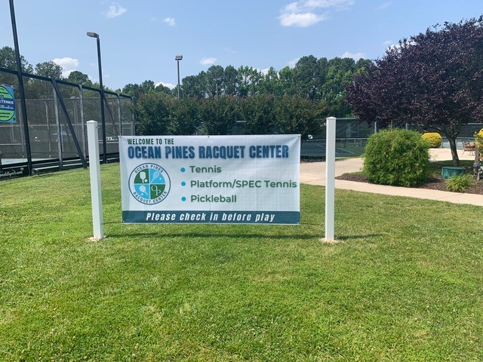
Racquet Center Events
Open House
Held Saturday, May 27, 2023
Platform Clinics
Saturdays in June at 9:30am
Tim Johnson is hosting
Davis Cup/Tennis Event
June 10th
“Pickle Bowl”
June 23rd
See Addendum for details

Slide 14
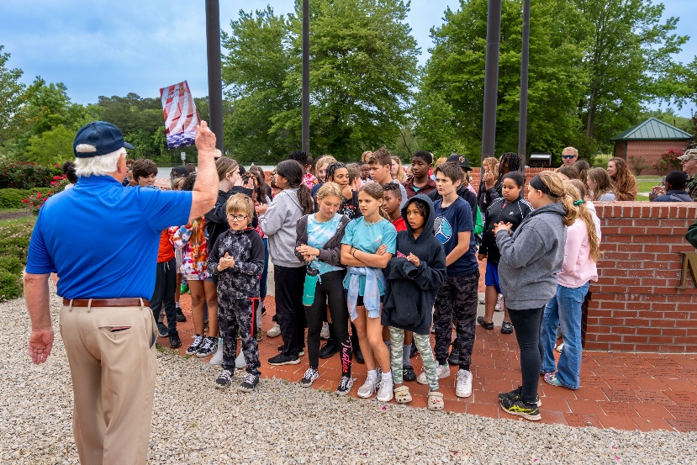
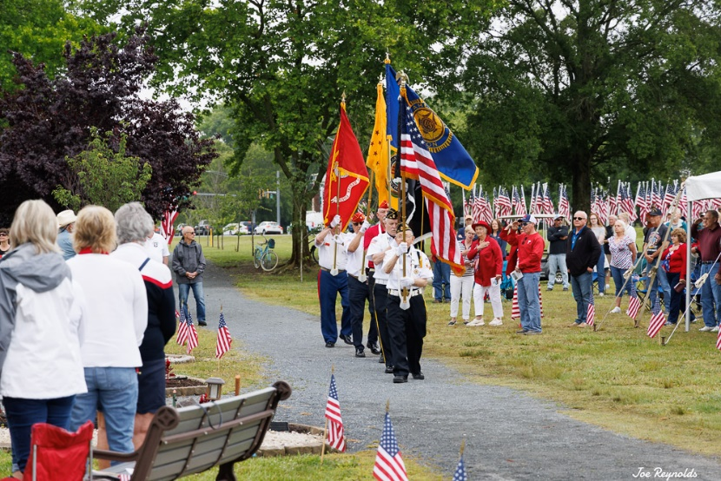
Recreation and Parks
Veterans Memorial
Events Held
Field trip for 5th Graders
Memorial Day Event
Kiwanis Car Show
Upcoming Events
Summer Camp
Concert Schedule
Family Fun Night
See Addendum for Details

Slide 15
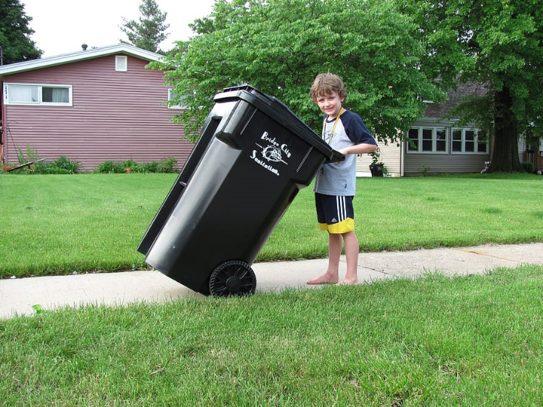
Rules Reminder
ALL DOGS MUST BE ON A LEASH even on Ocean Pines Property – County Law
CURB YOUR DOG
TRASH CANS – Cans must be returned the evening trash is picked up and stored not to be seen.

Slide 16
CPI Violation Dashboard May
Violations (includes legal)
As of 4/30/23 | New Violations | Closed Violations | As of 5/31/23
142 | 73 | 48 | 167
Legal Cases
As of 4/30/23 | New Violations to Legal | Closed Violations in Legl | As of 5/31/23
50 | 0 | 8 | 42
73 violations initiated in May: 56 maintenance/trash/grass; 2 dangerous tree; 6 no permit; 9 miscellaneous
Miscellaneous violations includes signs, stop work orders, trailers, unregistered/junk vehicles, and vehicle parking
48 complied out; 167 remain open (includes the 42 violations in legal)
74 maintenance/trash; 3 dangerous trees; 32 no permit; 58 miscellaneous

Slide 17
Work Orders May
Open Work Orders as of 4/30/23 | New Work Orders | Closed Work Orders | Open Work Orders as of 5/31/23
106 | 121 | 117 | 110
121 work orders initiated in May: 5 bulkhead; 25 drainage; 20 grounds/landscaping; 8 roads; 3 signs; 60 general maintenance
Majority still open in drainage (44):
16 – over 30 days; 9 – over 60 days
Average 1-4 work orders a day to complete depending upon severity

Slide 18
Customer Service Dashboard (from info@oceanpines.org) May
Type | # Received – May
Amenities | 35
CPI | 13
Drainage | 0
General | 84
Public Works | 24
TOTAL | 156

Slide 19
Addendum

Slide 20
Addendum
Marina Gas Dock
Did You Know?
Overall, aluminum docks are said to be safe as they are "bonded“.
Bonded is the same thing as grounded. If lightning strikes, the charge will go to a grounding rod rather than any person or equipment, including the gas lines.
State of Maryland officials were onsite since the beginning of the project, working with installers and guiding OPA through the process. The state has certified the entire gas system, including plumbing and electrical.
The contractor also did an inspection.
Installation was done following standards of the American Boat and Yacht Council and the International Brotherhood of Electrical Workers/National Electrical Contractors Association.
Other safety measures include new piping that meets new federal safety standards. The wiring is also explosive proof, so if there were leaks or fumes from gas pumps, they would not ignite.
Many marinas have aluminum docks. They require less maintenance, have a long life, and are cooler to the touch and more environmentally friendly. No paint or other chemicals go into the bay while power washing.

Slide 21
Boat Slip Toll Booths
Addendum
Research (Benchmark)
Discussing the possibly of putting gates at our boat ramps
What others in the area are doing
Wicomico County: All boat launches are free
Worcester County: All boat launches are free
Assateague: $10 for in-state and $12 for out-of-state residents
Ocean City:
64th St. Boat Ramp: No fee
Caribbean Drive Boat Ramp: $50 for an annual pass
Indian River Marina (Delaware): No fee if your boat is registered in Delaware
Snow Hill: No fees; parking fee if parked overnight

Slide 22
Firehouse
Addendum
Front
Back

Slide 23
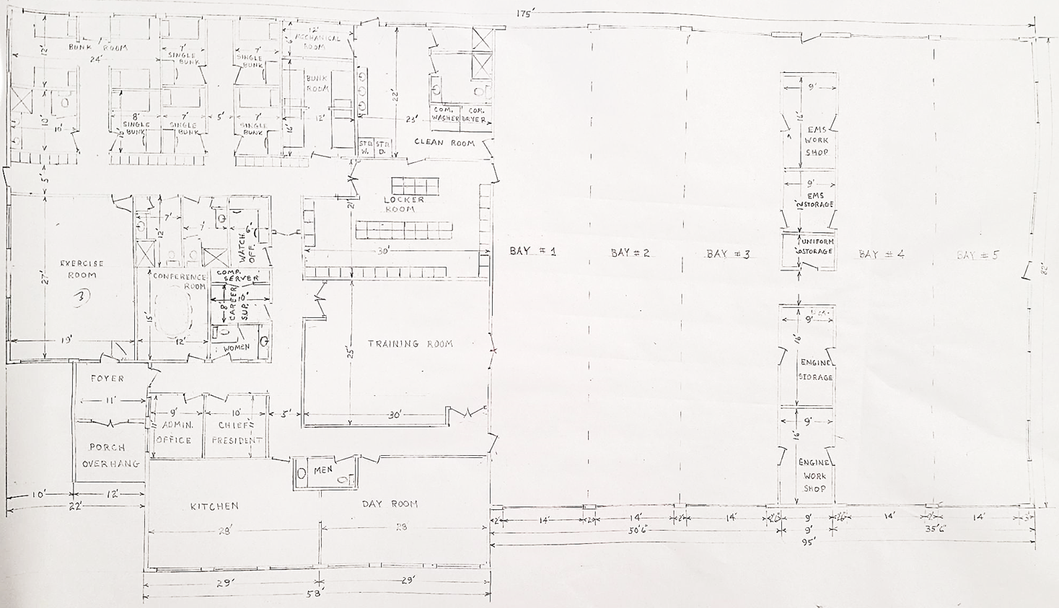
Firehouse Cont.
Addendum
Inside

Slide 24
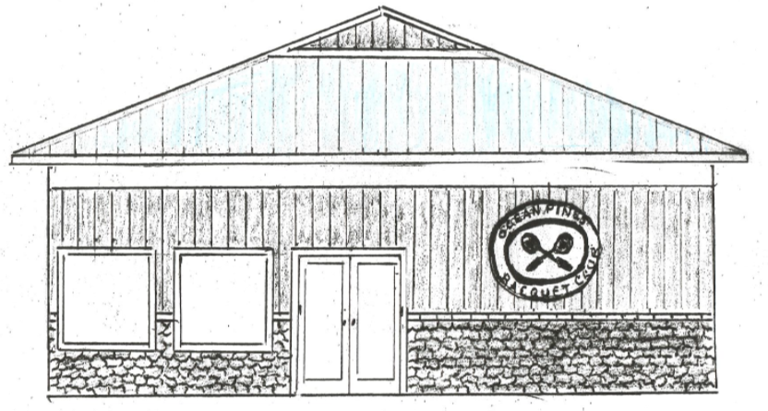
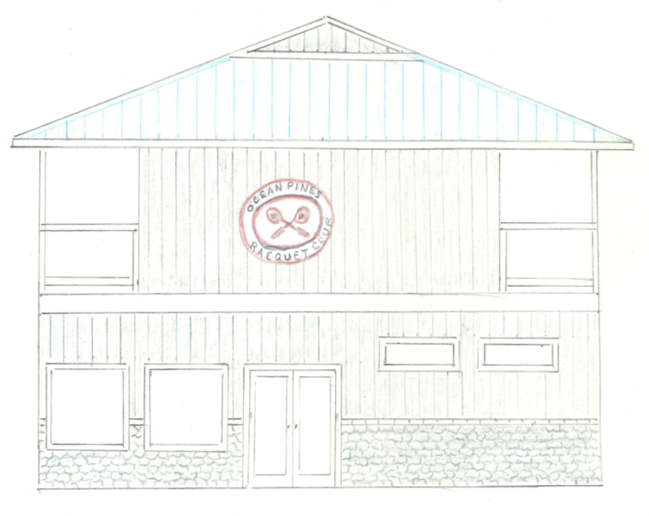
Racquet Center
Addendum
Two Floors
One Floor

Slide 25
Racquet Center Events
Addendum
Open House
Held Saturday, May 27, 2023
Overwhelming success
10 facility tours for new people
60 people participated overall
30 NEW Pickleball participants
15 New Tennis participants
15 NEW Spec Tennis participants
Pro Shop
Now selling Spec Tennis Paddles
Stringing tennis racquets
New sleeves of tennis balls, spec balls, and pickleballs are available as well
Platform Clinics
Saturdays in June at 9:30am
Tim Johnson is hosting
Davis Cup/Tennis Event
June 10th
Teams are divided by country and choose their players
This is a member PLUS 1 event
“Pickle Bowl”
June 23rd
A 1-day in house pickleball tournament
50 players max

Slide 26
Recreation and Parks Events Held
Addendum
Veterans Memorial
Field trip for 5th Graders
600 students attended the Veterans Memorial where they received books and a lot of great information from the members of the Veterans Memorial Group
Memorial Day Event
The Veterans Memorial Group put on an amazing event recognizing and honoring our Veterans.
Kiwanis Car Show
Held June 3

Slide 27
Recreation and Parks Upcoming Events
Addendum
Camp
Summer camp counselors to arrive June 12th
Our campers to arrive June 19th
Concert Schedule
June 22nd is the first concert “Uptown Band” starting at 7pm in White Horse Park
Family Fun Night
Beginning June 21st at 6pm
Held again this year at the Yacht Club
Jolly Rogers Tickets
Now on sale at the Recreation Department – Waterpark, Speed World, Day time rides, Nighttime rides

Slide 28
Financials

Slide 29
UNAUDITED FINANCIAL CHANGE MONTH OF APRIL 2023
April (In 000’s)
 | Budget | Current Year | Favor/ (Unfavor) vs. Budget
Net Revenues | $399 | $453 | $54
Expenses | 1,106 | 1,124 | (18)
Net Operating | ($707) | ($671) | $36

Slide 30
UNAUDITED MONTH OF APRIL FAVOR/(UNFAVORABLE) VS. BUDGET (in 000’s)
Department/Amenity | Favorable/(Unfavorable)
Golf Ops + Maintenance | 52
Public Works, CPI + Gen Maintenance | 59
Police | 14
Admin, Finance, GM, Marketing | (31)
Recreation | (29)
F&B (Yacht, Beach + Clubhouse) | (17)
Other Net (Marinas, Beach Parking, Racquet Sports) | (12)
TOTAL | $36

Slide 31
UNAUDITED FINANCIAL CHANGE YEAR-TO-DATE APRIL 2023
YTD April 2023 (In 000’s)
 | Budget | Current Year | Favor/ (Unfavor) vs. Budget
Net Revenues | $13,960 | $15,030 | $1,070
Expenses | 13,960 | 13,879 | 81
Net Operating | - | $1,151 | $1,151

Slide 32
UNAUDITED YEAR-TO-DATE APRIL FAVOR/(UNFAVORABLE) VS. BUDGET (in 000’s)
Department/Amenity | Favorable/(Unfavorable)
Public Works, Gen Maint, CPI | 320
Golf Ops & Maintenance | 267
Police | 163
Aquatics | 128
Yacht Club | 85
Beach Club | 81
Rec & Parks | 63
Marinas | 25
Racquet Sports | 25
Beach Parking | 20
Clubhouse Grille | (16)
Other Net (Admin, GM Office, Finance, PR/Marketing, Clubhouse Grille) | (10)
TOTAL | $1,151

Slide 33
UNAUDITED RESERVES APRIL 2023 ($Millions)
 | GeneralReplace | Bulkheads | Roads | Drainage | New Capital | Total
4/30/22 Balance | $4.8 | $0.5 | $0.0 | $0.7 | $0.1 | $6.1
Contributions/ Interest | 1.9 | 1.1 | 0.7 | - | 0.2 | 3.9
Casino Funds | - | - | 0.4 | 0.1 | - | 0.5
Transfer (Spend) | (1.5) | (1.1) | (0.4) | (0.6) | (0.2) | (3.8)
4/30/23 Balance | $5.2 | $0.5 | $0.7 | $0.2 | $0.1 | $6.7

Slide 34
“FLASH” PRELIMINARY ESTIMATE FOR MONTH OF MAY 2023
May (In 000’s)
 | Budget | Current Year | Favor/ (Unfavor) vs. Budget
Net Revenues | $7,555 | $7,640 | $85
Expenses | 1,150 | 1,085 | 65
Net Operating | $6,405 | $6,555 | $150

Slide 35
“FLASH” PRELIMINARY ESTIMATE MONTH OF APRIL FAVOR/(UNFAVORABLE) VS. BUDGET (in 000’s)
Department/Amenity | Favorable/(Unfavorable)
Golf Ops + Maintenance | 45
Admin/GM/Finance/Marketing | 34
Aquatics | 32
Police | 32
Public Works, CPI + Gen Maintenance | 23
Racquet Sports | 14
Beach Parking | 10
Beach Club | (16)
Marinas | (15)
Yacht Club | (12)
Other Net (Rec & Parks, Clubhouse Grille) | 3
TOTAL | $150

Slide 36
TREASURER’S REPORT- MONICA RAKOWSKI

Slide 37
CASH & SHORT-TERM INVESTMENTS
PRELIMINARY ESTIMATE FOR MONTH OF MAY
As of May 31, 2023, the Association had approximately (~) $18.5M in Cash
Cash decreased ~ ($0.1M) from the same time period last year
Cash increased ~ $0.8M from April 2023
$11.1M invested in CDAR’s
Remaining $7.4M in Insured Cash Sweep, Treasury Bills, Money Market and other Operating accounts (diversified between 2 local banks)

Slide 38
Public Comments
Members wishing to make comments must state their name and address.

Slide 39
Capital Requests

Slide 40
Capital Requests
Public Works –
Atlantic Tractor LLC
Requesting authorization to go forward with staff recommendation of $21,783.31 for replacement of limb cutter.

Slide 41
Capital Requests
Public Works –
Atlantic Tractor LLC
Requesting authorization to go forward with staff recommendation of $30,449.47 for replacement of John Deere Gators.

Slide 42
Capital Requests
Public Works –
Gator Dock Marine Inc.
Requesting authorization to go forward with staff recommendation of $19,429.80 for replacement of small dock removed during 2022-23 bulkhead replacement. Pintail Park Recreation Area (northern area)

Slide 43
Capital Requests
Public Works –
Gator Dock Marine Inc.
Requesting authorization to go forward with staff recommendation of $61,160.49 for new Pintail Park Kayak Launch Gangway & Floating Dock (southern area).

Slide 44
Adjournment

