Slide 1
Board of Directors Meeting
May 15, 2021

Slide 2
Approval of Agenda

Slide 3
Approval of Minutes March 26, 2021 - Closed Meeting April 21, 2021 – Regular Meeting

Slide 4
President’s Remarks Larry Perrone

Slide 5
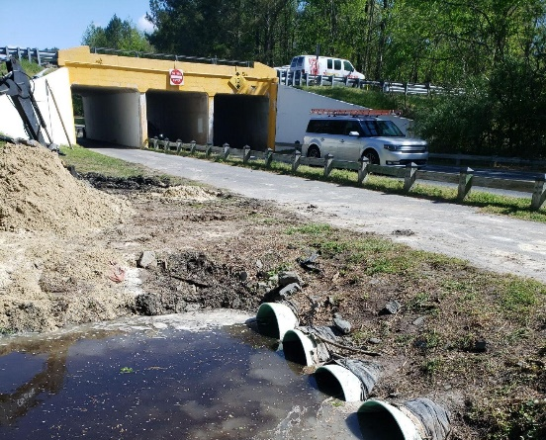
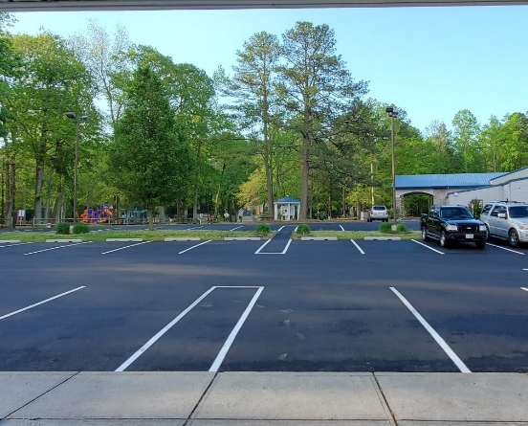
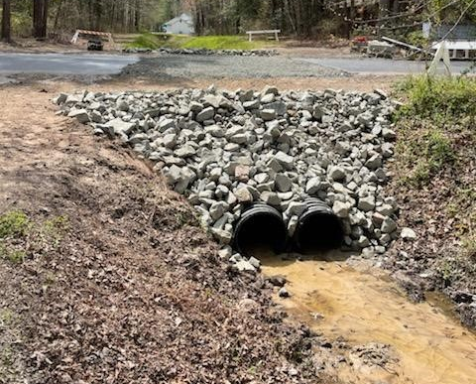
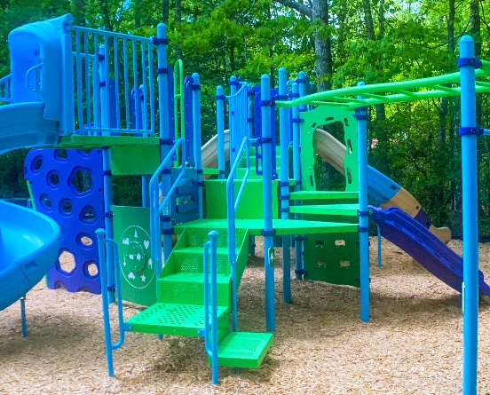
GM Leadership Report John Viola
Pipe Liners
Administration Parking Lot
High Sheriff Trail Pipes
Robinhood Park Playground

Slide 6
Your assessment
dollars at work

Slide 7
GM Report
DMA Study
Finance
Aquatics – Status of Pools
Public Works
Pipe Liners
Bainbridge Project
Year End Audit
Northstar
PPP
Recreation & Parks
Marina
Racquet

Slide 8
DMA Study – Budget - $16,000
DMA (Doug Greene) completed review of buildings, drainage, roads and bulkheads April 12th through 16th.
Bulkhead draft report received for review on future bulkhead replacement dates
DMA roads study in progress, we should receive week of May 17th
Draft of the General Reserve Study to be completed by DMA by the end of May.
Team will present the General Reserve Study to the Budget & Finance Committee in early June.
Reserve Study to be presented to the Board at either the June 16 or July 21 Board Meeting.
Aquatics
The outdoor pools will be opening Saturday, May 29th.
The only restriction at the outdoor pools is masks need to be worn in the bathrooms. Lounge chairs will go out and we will operate without capacity limitations.
Everything is on schedule. We are hiring and training. In-service training is scheduled for May 22nd and 23rd.
Pool hours are returning to pre-Covid hours (see website).
All permits have been applied for-Beach Parking and Pools.
Family Fun night will resume. Wednesdays at 6:00 Yacht Club pool.
Parks and Rec will be bringing camp kids to Mumford’s and Swim and Racquet on Tuesdays. This is a return to pre-covid life.
We are still very short of swim instructors. We are advertising for staff through all Ocean Pines options. Due to the shortage we are not offering Group swim lessons.

Slide 9
Public Works
Pipe Liners
Contractors arrived on April 25th and completed all work by May 5th .
Pipes Lined :
4 pipes under Ocean Parkway by Rt.90
1 pipe at 215 Ocean Parkway
1 pipe at 159 Ocean Parkway
2 pipes at 736 Ocean Parkway
1 pipe at 30 Offshore
1 pipe at 102 Robinhood
1 pipe on Fosse Grange
1 pipe by Pintail Park and Ocean Parkway
Budget – $207,000
Final Cost - $212,000

Slide 10
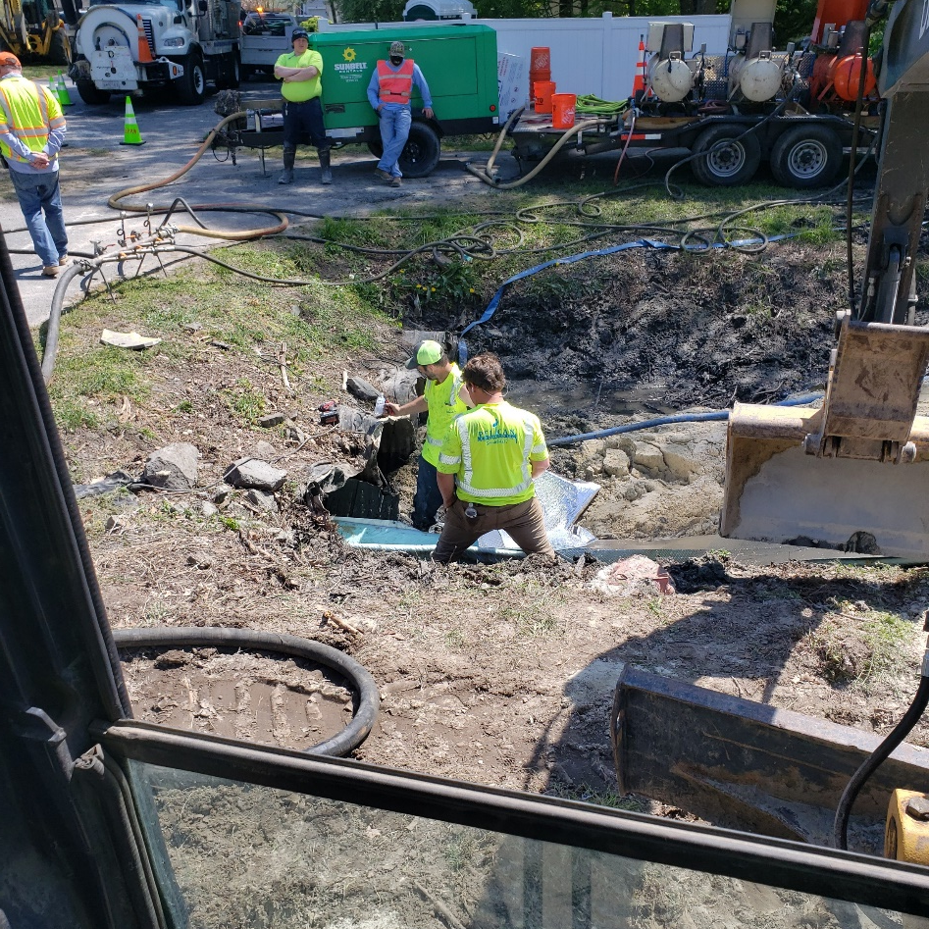
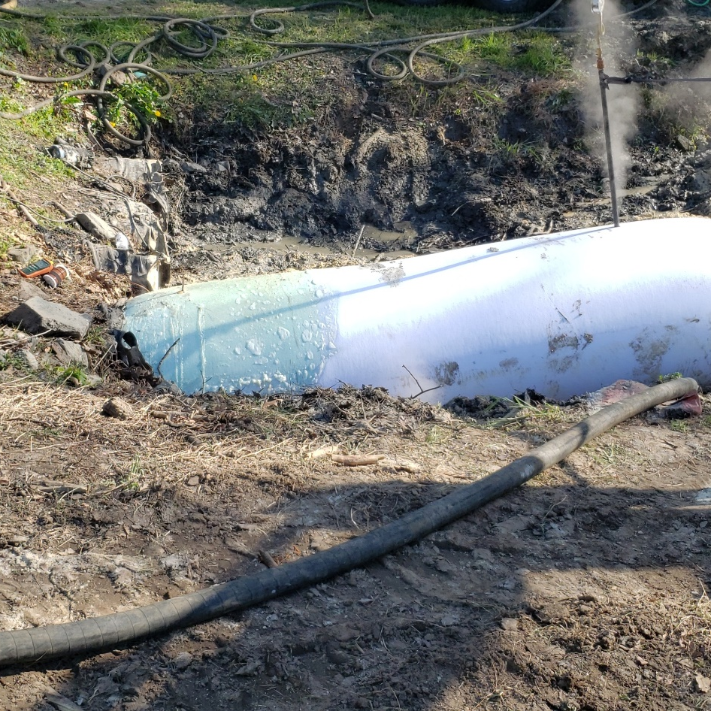
Contractor pulling liner through pipe
Filling liner with steam to react with the epoxy and cure pipe
CIPP
Project Update

Slide 11
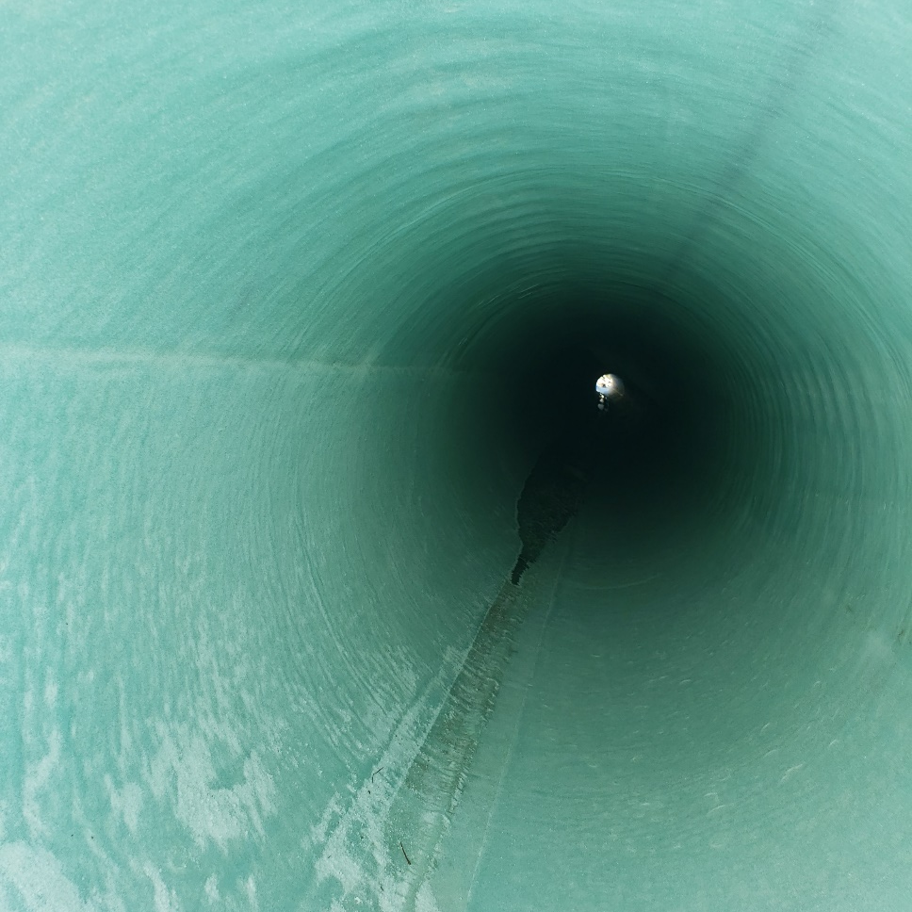
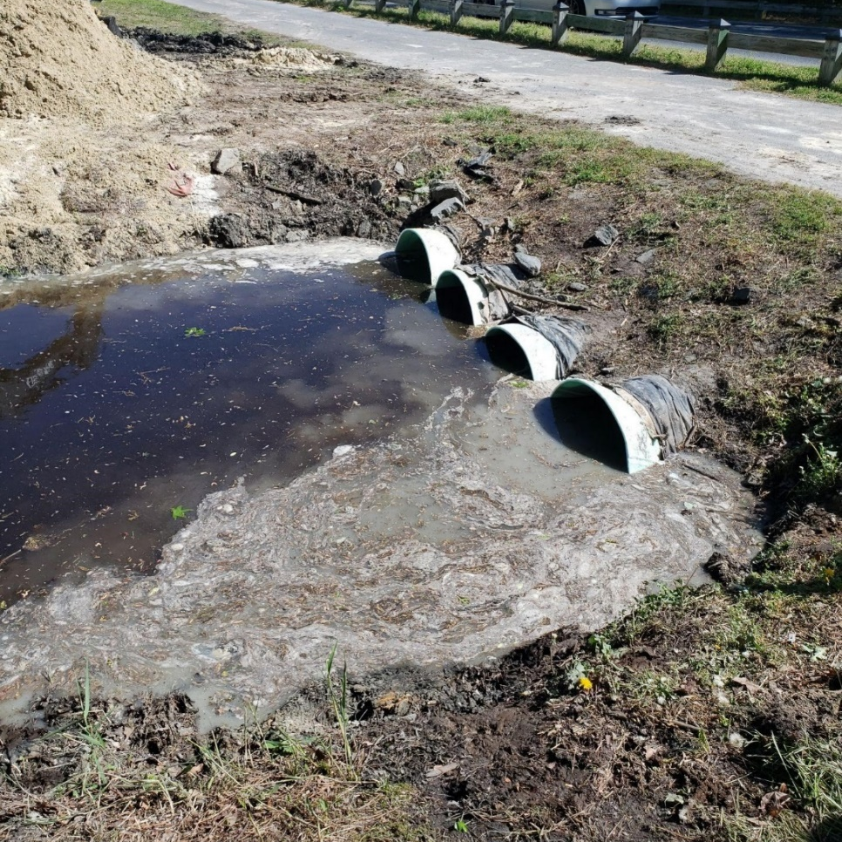
Inside cured liner
New Pipes with water flowing through
CIPP
Project Update

Slide 12
Bainbridge Project
Bainbridge
 | Budget
 |  | Grant | $482,337
 |  | OPA (budget) | $235,000
 |  | Contract EQR | $534,650
 | First payment submitted for reimbursement
 | Payment
 | How much we spent last year
 |  | Vista | $122,176
 |  | County (for review permits) | $ 32,474

Slide 13
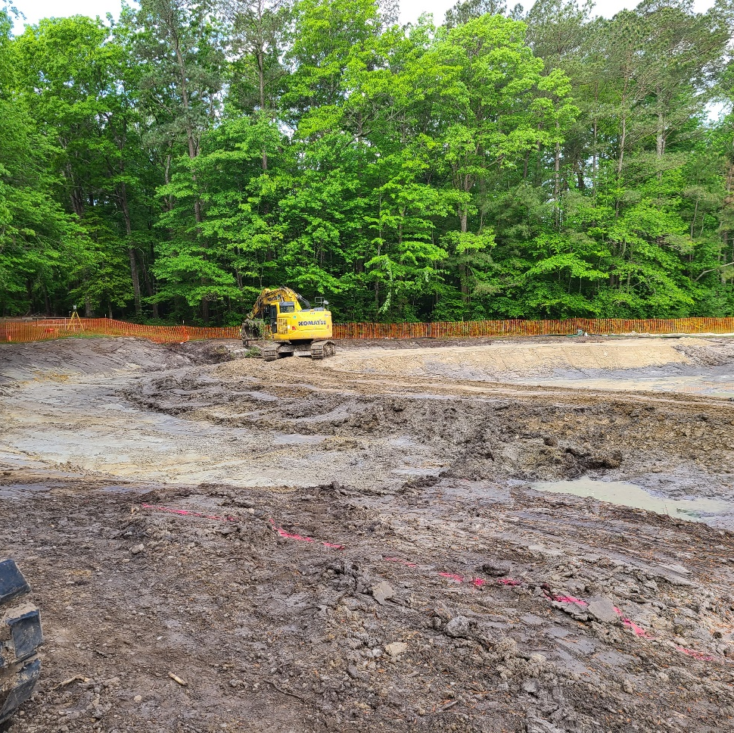
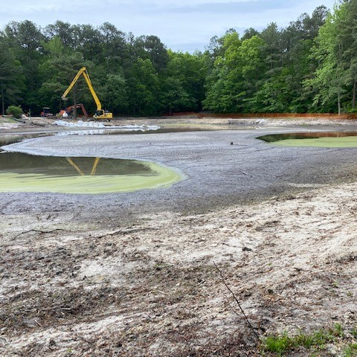
Bainbridge Project
Forebay - Inlet of the pond where filtration takes place before entering main pond, completion by May 12th. Separated by dirt berm.
Main Pond – benches for planting are completed, located under the water.

Slide 14
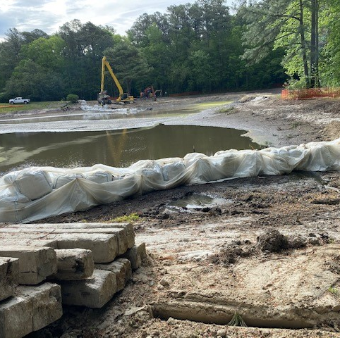
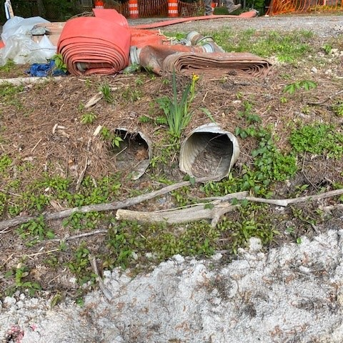
Bainbridge Project
Outfall Structure – scheduled to be completed Monday, May 17th. Takes water out of the pond
Next step is to replace these 2 pipes
3 Crossings – Beaconhill, Sandyhook and Pinehurst will start next week
Ditches – excavated the soil out and replace with more impervious soil. Also, will start next week with completion mid-June.

Slide 15
Finance
Year End Audit
TGM was onsite for preliminary audit procedures the week of April 19th (procedures primarily consisted of internal control documentation, questionnaires, walk-through of procedures/controls, fixed assets analysis)
TGM was onsite for inventory test counts on April 30th
TGM to return for final procedures on June 1st
Northstar
Still proceeding, no substantial change from last month’s report.
PPP
Forgiveness application and back-up support provided to Bank of Ocean City in mid-March
Bank of Ocean City provided application and support to SBA on 3/16/2021
SBA has 90 days to provide response letter, so will likely be determined prior to issuance of year-end audited financials

Slide 16
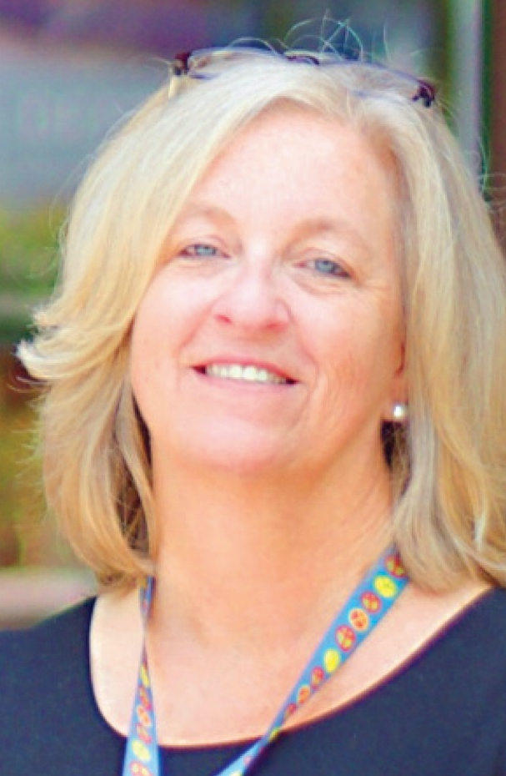
Director Debbie Donahue

Slide 17
RECREATION AND PARKS
Lights in the gym have been upgraded to be more efficient and safer – No bulbs – LED – looks great
Robinhood complete – ribbon cutting done on May 10 - Robinhood playground cost was $49,375 (increase of $2,000 because we waited through COVID) plus $2,000 for mulch for a total cost of $51,000
Mulching is getting done to all parks as we speak
Paving of the Admin Parking lot is complete – with the exception of a few missed lines, which are scheduled to be completed. Gained 16 parking spaces.
Summer concerts will start June 24 in White Horse Park
Family Fun Night will start at the Yacht Club on June 23
Summer Camp will begin June 21

Slide 18
MARINA
Open and doing well for the month of May - $13,500 in fuel sales since May 1
All slips are full at both marinas
Hours for the marina fuel dock are 8 am – 6 pm and will change to 6 am – 6 pm as of Memorial Day weekend
Please note that all slips are rented and are only open to those that have paid the fee, signed the rental agreement submitted their insurance and registration
We have 3 T-Docks open for temporary public usage that can hold up to 7 boats and 2 spaces at the Mumford’s Ramp.

Slide 19
RACQUET SPORTS
Resurfacing of the tennis courts is complete
Terra Firma is continuing the pickleball courts repairs
NEW Pickleball courts – per Vista Design
To date we have completed the wetland delineation and field surveying required to prepare a base sheet suitable for design. We have also coordinated with Dave Bradford, of Worcester Co, regarding his requirements for located all new improvements so as to allow him to permit the construction near / in the Critical Area.
We hope to have a conceptual design by early next week which we will share with OPA before forwarding to Dave Bradford for his input. Following everyone’s OK, we will finalize the plans and process through Worcester Co Critical Areas, Planning, and SWM as well as Worcester Soils Conservation District.

Slide 20
BEAUTIFICATION OF OCEAN PINES
Replaced the flowers at the golf course – ladies take care of the flowers and weeding on the golf course along with golf maintenance and public works
The work group is gathering new ideas to add a new look to the entrances of Ocean Pines
The cherry Blossom trees look great on the parkway on Cathell Road and will be placed along the pool side of the south gate pond
New signage is being constructed for the White Horse Park Complex, delivery is expected by the end of June

Slide 21
FORECAST VARIANCE TO BUDGET (in 000’S)
Forecast 4/30/21 | $1,150
Deduct:
Ocean Pines PPP | (1,143)
Food & Beverage PPP | (271)
Coronavirus Relief (estimate) | (105)
Forecasted Operations without Stimulus | (369)
Note:
1- At this time $70 has been forgiven
2- All Ocean Pines PPP went to fund salaries

Slide 22
Public Comments

Slide 23
CAPITAL PURCHASE REQUESTS
NONE

Slide 24
CPI Violations None

Slide 25
Unfinished Business Discussion – Short Term Rental Recommendation – Frank Daly Motion – Lease with Seacrets for Parking Lot Use – Colette Horn Motion - Succession Planning for GM Position Document Approval – Colette Horn

Slide 26
New Business First reading – Repeal of Resolution B-08 – Frank Daly

Slide 27
Appointments Ann Shockley – Chair – ARC

Slide 28
Adjournment

