Slide 1
Board of Directors Meeting
March 7, 2020

Slide 2
Approval of Agenda

Slide 3
Approval of Minutes February 5, 2020 – Regular Meeting February 18, 2020 – Special Meeting

Slide 4
President’s Remarks Doug Parks

Slide 5
Announcement of Email Votes/Motions – Colette Horn

Slide 6
GM Report John Viola

Slide 7
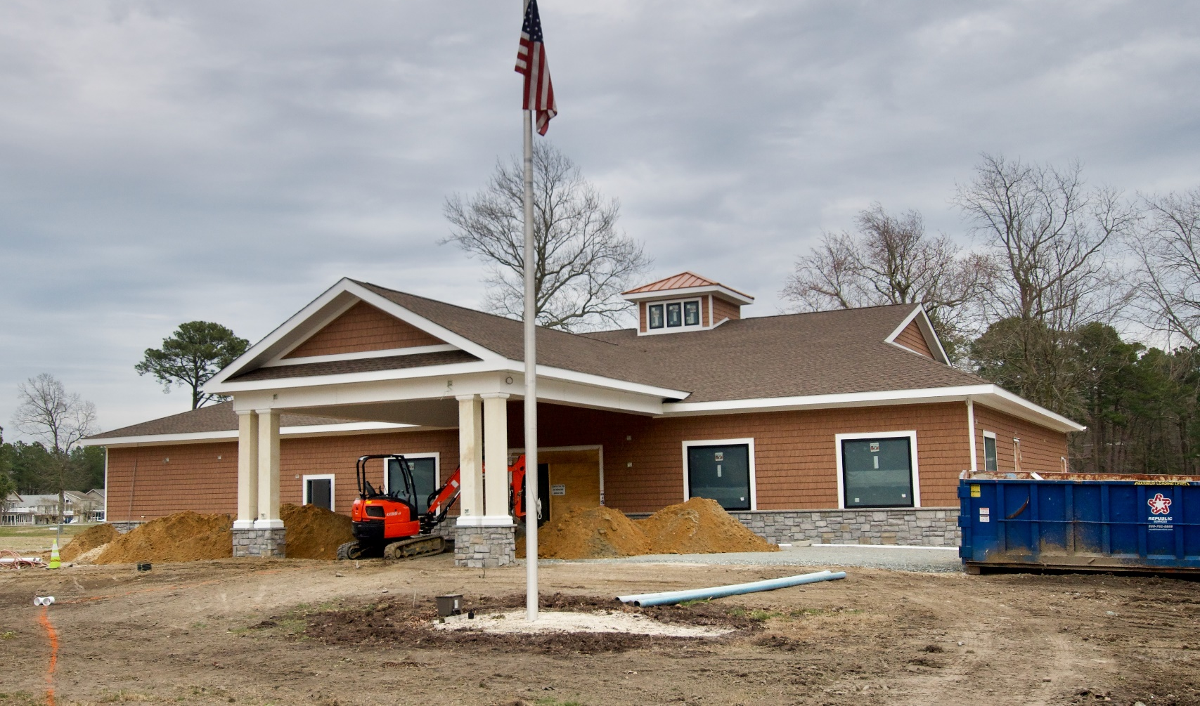

Slide 8
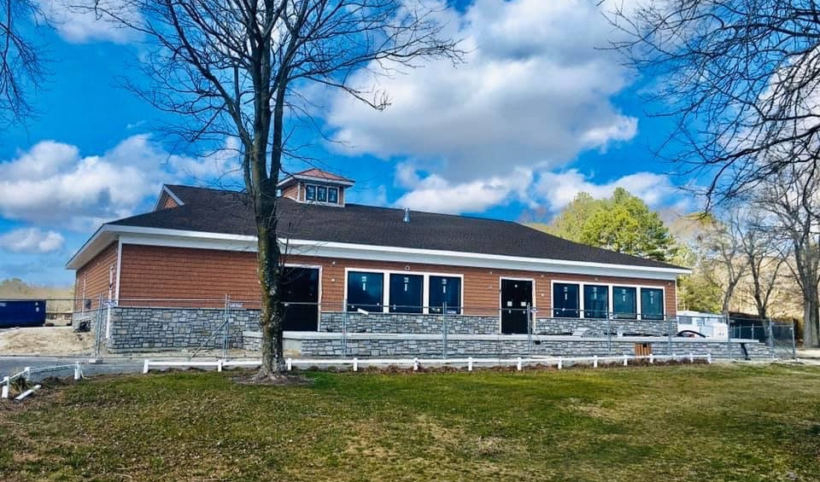

Slide 9
OP Dashboard
Month of February 2020 |  | Explanations
# of Customer Service Calls – Level 1 | 6 | Homeowner issues, Republic, Mediacom, Comcast, etc. These were dispersed to 2nd tier CS or completed by Senior Executive Assistant through calls & emails.
# of Customer Service Call Responded to | 6
# of Customer Service Calls – Level 2 | 34 | Drainage, Bulkheads, Homeowner issues. These were done by Director of A & OP Logistics, PW Director and Operations manager through visits, calls & emails.
# of Customer Service Call Responded to | 34
# of CPI Violations Reported/Visited | 23
# of CPI Violations Complied | 9

Slide 10
GM REPORT
March 7, 2020
John Viola
Initiatives | Construction Status | Projects Completion Date | Budget Cost | As of 2/29/20 Spend YTD
Clubhouse | On Track | May 2020 | $1.6 mil | $1,041,339
Cart Barn | On Track | *March 2020 | $430,000 | $291,213
Police Building | On Track | September 2020 | $1.276 mil | $283,614
Northstar (Software Project) | On Track | *December 2020 | $400,000 | $317,409
Admin. Renovation | Plan Phase | September 2020 | $220,000 | $0
*Extended

Slide 11
Financial Change for the Month of January 2020
January
 | Budget | Current Year | Favor/ (Unfavor) vs. Budget
Revenues | $123,049 | $114,793 | $(8,256)
Expenses | 803,569 | 776,896 | 26,673
New Capital | - | - | -
Net Operating | $(680,520) | $(662,103) | $18,417

Slide 12
Financial Change Year to Date 5/1/19 – 1/31/20 (9 months)
YTD
 | Budget | Current Year | Favor/ (Unfavor) vs. Budget
Revenues | $11,861,894 | $12,292,555 | $430,661
Expenses | 9,652,509 | 9,441,737 | 210,772
New Capital | - | - | -
Net Operating | $2,209,385 | $2,850,818 | $641,433

Slide 13
Treasurer’s Report - Larry Perrone

Slide 14
Cash & Short-Term Investments
Activity for Month of January
Overall Laddered Investment Rate of Return for January Approx. 2.5%
At January 31, 2020, the Association had approx. $10.8 million in cash
Approx. $4.8 million invested in CDAR’s fully FDIC insured
Approx. $6.0 million in Money Market (earning 2%) and other operating accounts, fully insured

Slide 15
Reserves January 2020 ($Millions)
 | Replacement | Bulkheads | Roads | Total
4/30/19 Balance | $5.2 | $2.5 | $1.1 | $8.8
Assessments/Interest | 2.0 | 0.7 | - | 2.7
Casino Funds | - | - | 0.3 | 0.3
Transfer (Spend) | (1.8) | (1.2) | (0.5) | (3.5)
1/31/20 Balance | $5.4 | $2.0 | $0.9 | $8.3

Slide 16
Reserves 4/30/20 Forecasted (in thousands)
 | Balance |  |  | Projected Balance
 | 4/30/2019 | Additions | Expenditures | 4/30/2020
Major Maintenance & Replacement:
Police Renovation |  |  | (1,000)
Country Club Renovation |  |  | (1,600)
Cart Barn |  |  | (350)
Northstar |  |  | (275)
WHP Playground Equip |  |  | (153)
Craft Building |  |  | (98)
Yacht Club + Beach Club |  |  | (120)
Golf Ops/Maintenance |  |  | (200)
Aquatics/Rec/Other |  |  | (275)
Total | 5,257 | 2,025 | (4,071) | 3,211
Bulkheads & Waterways | 2,478 | 735 | (1,935) | 1,278
Roads | 1,101 | 355 | (933) | 523
TOTAL 4/30/20 | 8,836 | 3,115 | (6,939) | 5,012

Slide 17
Public Comments

Slide 18
Capital Purchase Requests Public Works – 2020-2021 Bulkheads Police Dept. – Furniture

Slide 19
2019-2020 Bulkhead Replacement
In the Budget for 2020/2021
Requesting Authorization to go Forward in 2020/2021 with Staff Recommendation of $1,182,150 from Fisher Marine for 3,330 linear feet of bulkhead.
Signing Contract now will guarantee price for next year.

Slide 20
Police Department Furniture
Requesting Authorization to go with hired Professional recommendation of $44,584.05 to furnish the Police Department.
Benchmarked to recent local comparable industry build.
Better quality
Lower Cost and Installed
Guaranteed
Quality Environment will Assist in Recruitment and Retainment of Officers

Slide 21
CPI Violations 55 Grand Port Rd. 92 White Sail Circle 19 Deerfield Court

Slide 22
Unfinished Business Motion - Acceptance of the Architectural Review Committee Revised Guidelines – Steve Tuttle

Slide 23
New Business Motion - The Board hereby approves the proposed single source contract through the MD Department of Environment not to exceed $19,000. – Doug Parks First Reading – Resolution M-01 – Frank Daly First Reading – Resolution C-11 – Frank Daly

Slide 24
New Business (cont’d) First Reading – Resolution F-03 – Doug Parks First Reading – Resolution C-01 – Colette Horn Motion – To Adjourn to closed session for the purpose of discussion of matters pertaining to employees and personnel specifically related to potential amendment to the General Manager’s contract, as permitted by the MD Homeowner’s Association Act, Section 11B-111(4)(i). - Colette Horn

Slide 25
Appointments - Susan Holt – 1st Term – ARC (alternate) Larry Malone – 3rd Term – ARC Olga Novy – 2nd Term – Golf Ronald Porcelli – 1st Term – R&P Martha Aurthur – 1st Term – R&P Helen Johnson – 1st Term – Strategic Planning Patricia Benner – 1st Term – E&NA

Slide 26
Adjourn TO CLOSED SESSION

