Slide 1
Board of Directors Meeting
March 18, 2023

Slide 2
Approval of Agenda

Slide 3
Approval of Minutes February 18, 2023 – Regular Meeting

Slide 4
President’s Remarks Doug Parks

Slide 5
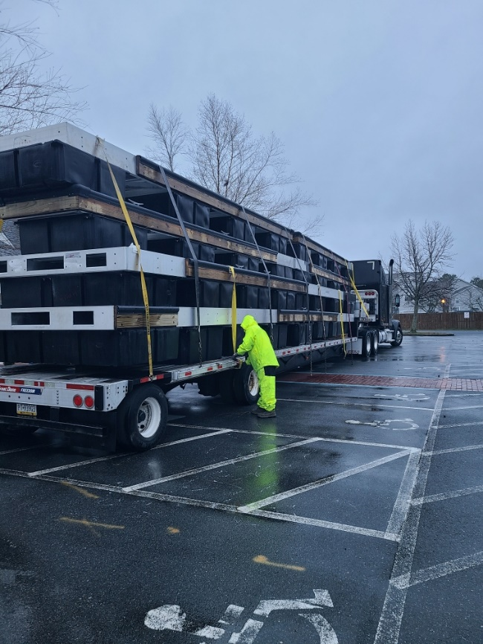
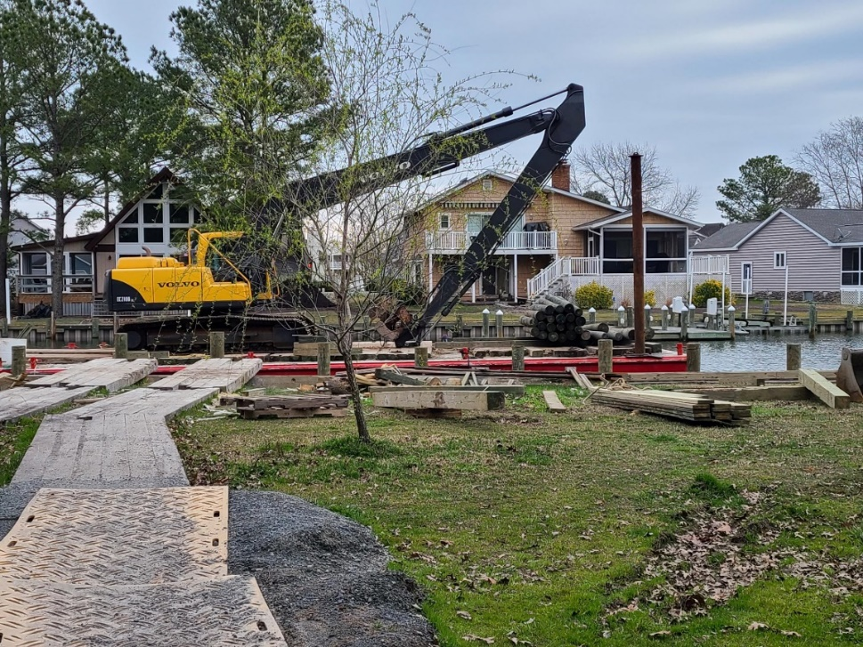
GM Leadership Report – John Viola

Slide 6
Initiatives
Metrics
Dog Park
Marina
Police Department
Leaf Program
Job Fair / Open Positions
Racquet Center
Other
Yacht Club
Safety / AED’s

Slide 7
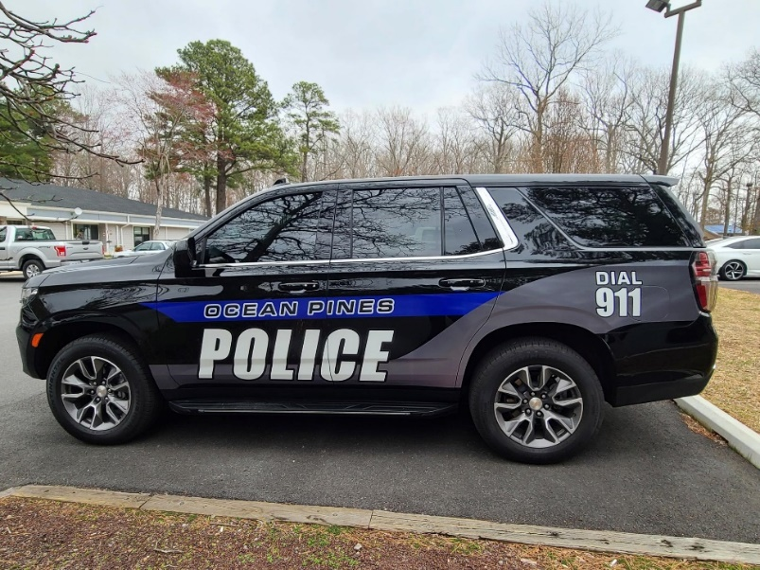
Police Department
Ongoing investigation
Where are we on the Police Department?
What are we doing for recruitment?
Met with Iron View on February 26, 2023 and March 7, 2023 to research trying to enhance the current 401K plan to make it more competitive with other police force retirement plans (will present to Board today)
Salaries increased to be competitive with other agencies
Received 20 resumes, with 10 also including applications
Testing to be conducted on March 25, 2023

Slide 8
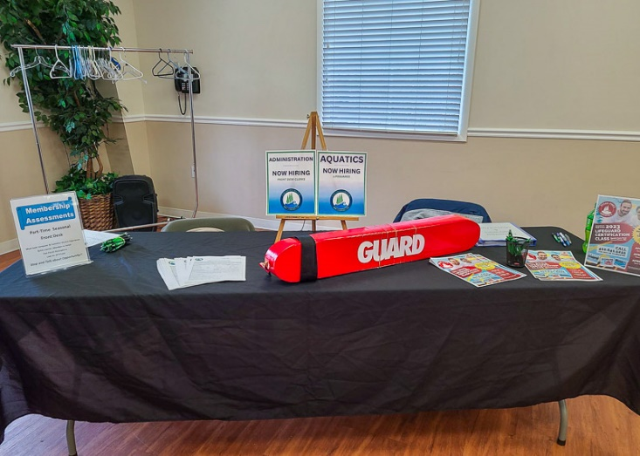
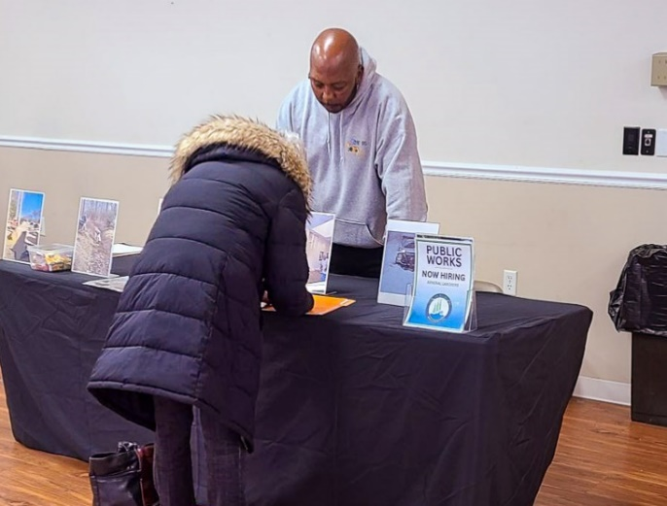
Job Fair Open Positions
Update on open positions:
Aquatics: 30 seasonal positions still open; 4 applications received; 1 position filled
Membership/Front Desk: 1 seasonal opening
Public Works: 6 positions still open; 25 applications received
Police: 6 open positions for officers; 1 opening for dispatch
Racquet Center Manager: 6 applicants interviewed
Recreation & Parks: 6 open positions (5 Sr. Counselors/1 Jr. Counselors)
Ocean Pines Job Fair held on March 11, 2023 – attended by around 50 (25 applications received)
Attending Stephen Decatur Job Fair on April 27, 2023

Slide 9
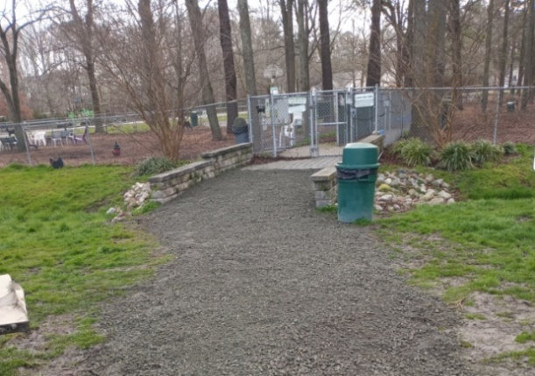
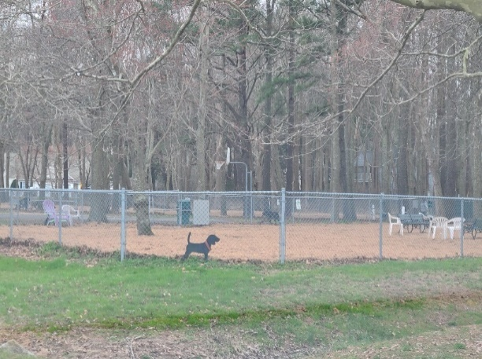
Dog Park
Requested repairs made:
Tool board temporarily repaired, then replaced with a small vinyl shed for the tools
Entryway filled in with gravel and fence repaired
Mulch delivered on February 28th; finished installing on March 8th
Quote on a 4-piece agility course received on March 13th: cost – estimated $5,000

Slide 10
Racquet Center
What has been done:
2022 – court repairs and new pickleball courts
2021 – court and fence repairs; new junior tennis courts
2020 – court repairs, fence replacement, shade awning
2019 – screen replacement
Current Year:
Repairs to inside of clubhouse (started March 10th):
Repairing walls, repairing base, painting sunroom wall, ceiling, and cabinets
Landscaping
Towel racks ordered for all sports
Repairing ruts in ground near new pickleball courts
Shed near dog park cleaned out to accommodate larger equipment (rollers)
Shade structure being built and will be installed in April
Resurfacing har tru tennis courts: $19,580.00 (ATC) (approved by Board 2/18/23) (to be done this Spring, along with addressing cracks in all courts)
Met with team on March 14th to prepare preliminary sketches for building and warming hut

Slide 11
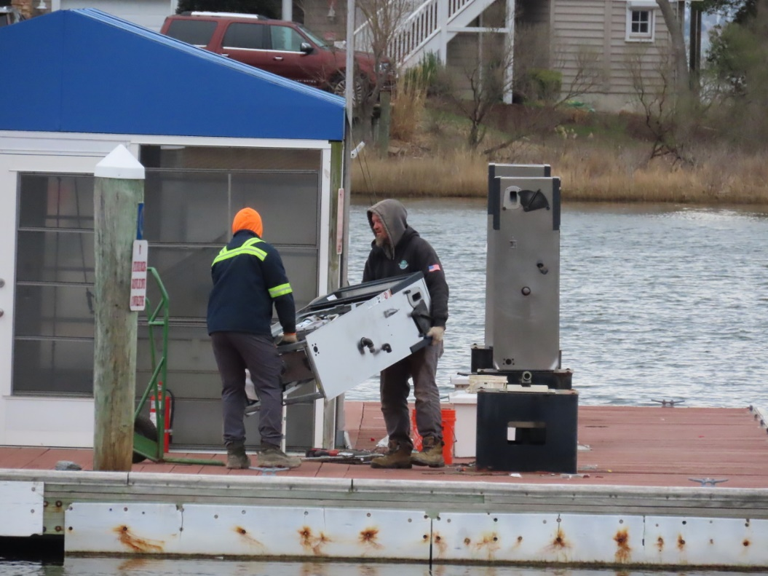
Marina
Replacement of gas lines and fuel dispensers:
Approved by Board on 9/24/22
Total cost: $169,520.56
Petro Supply, Inc. began work on March 1st
Marina Fuel C Dock:
Approved by Board on 10/6/22
Total cost: $330,596.68
Required by MDE to be replaced
Dock to be manufactured and installed prior to Memorial Day by Gator Dock & Marine

Slide 12
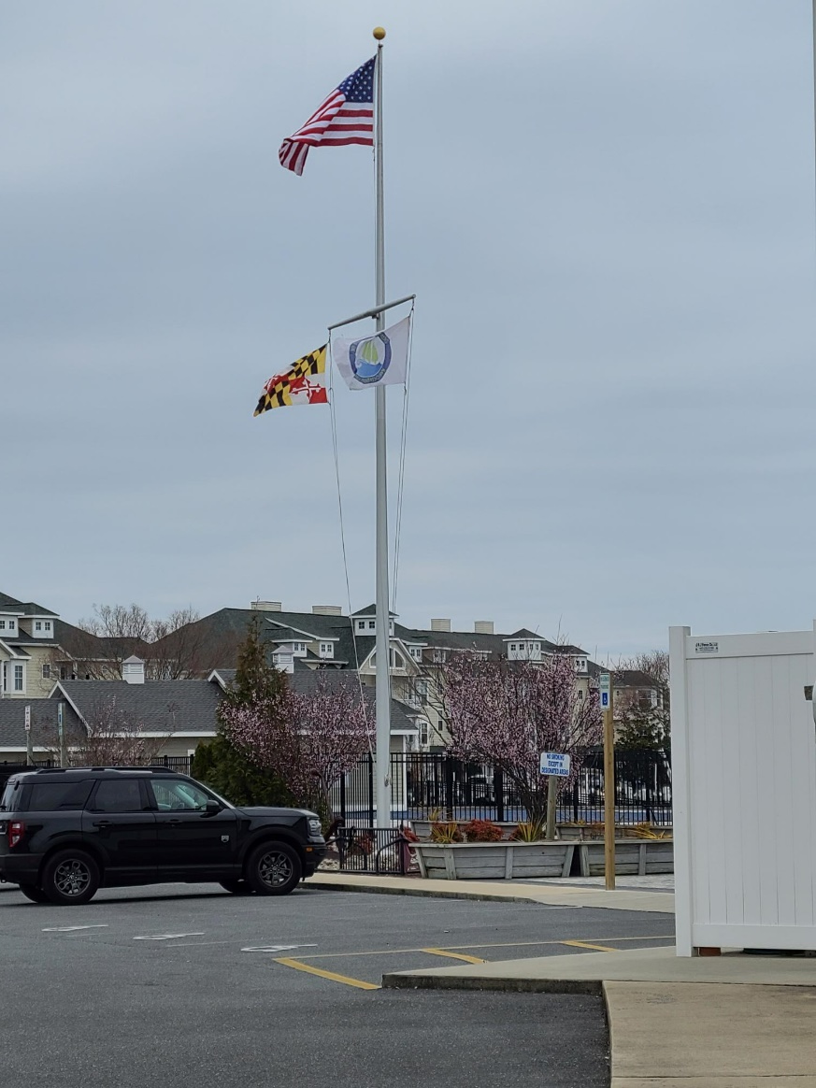
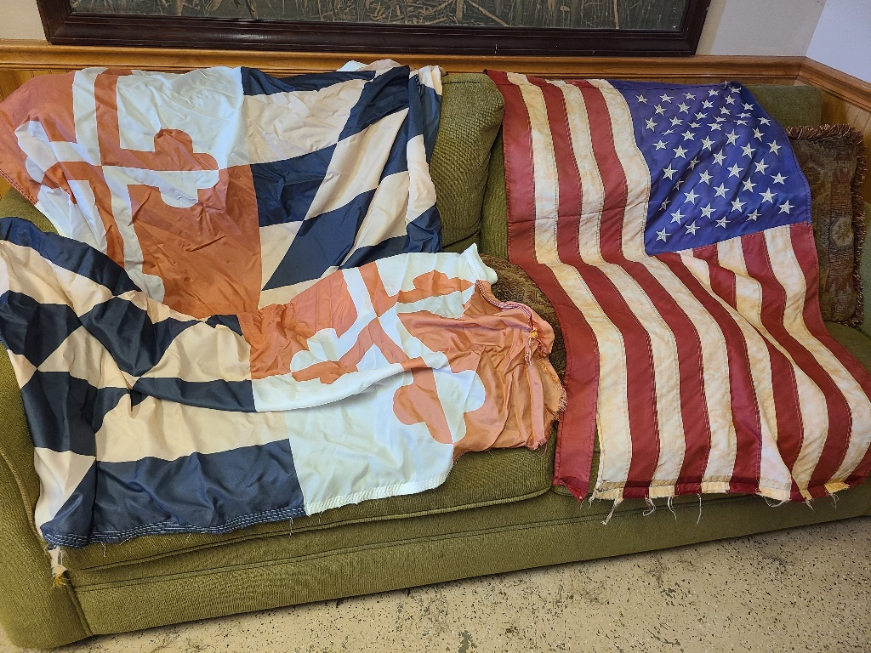
Yacht Club
Work order placed February 18th; flag replaced February 21st

Slide 13
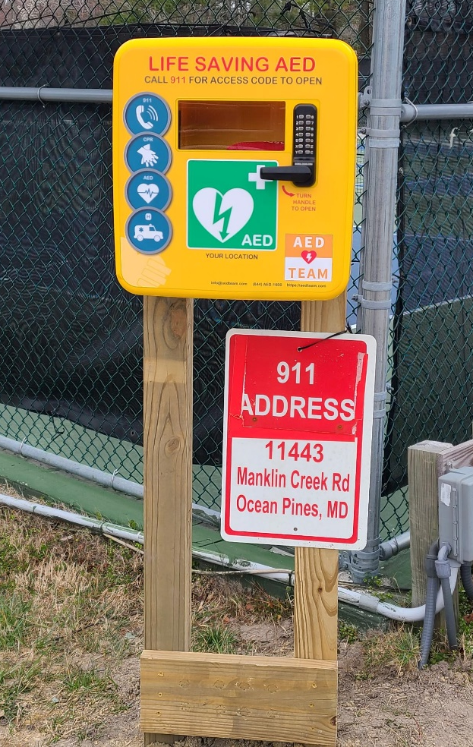
Safety/AED’s
Outside AED for Racquet Center has been delivered and will be installed by Public Works
Staff and members will have a code to unlock the box and all staff will be certified in the usage of the AED
Cost: $2,900.00
AED ordered for Police Station
AED Training scheduled for Ocean Pines staff
March 20: Recreation staff
June 13: Camp counselors
TBD: Marina staff and other Ocean Pines staff

Slide 14
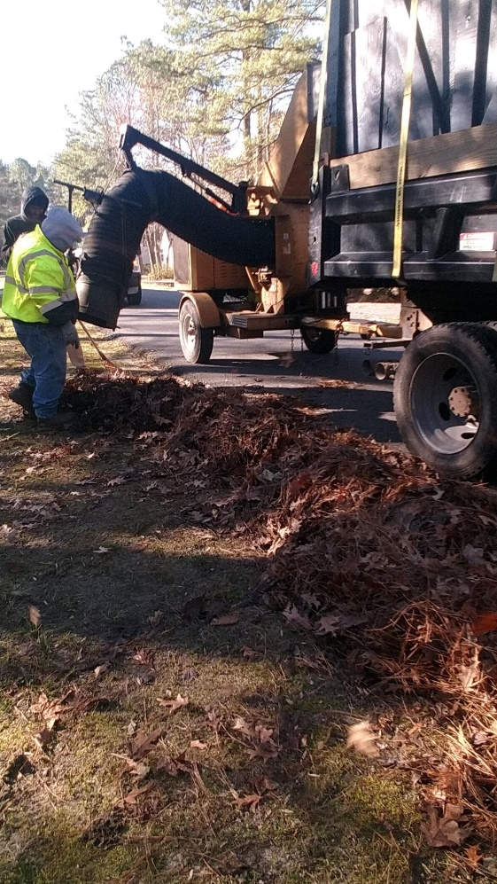
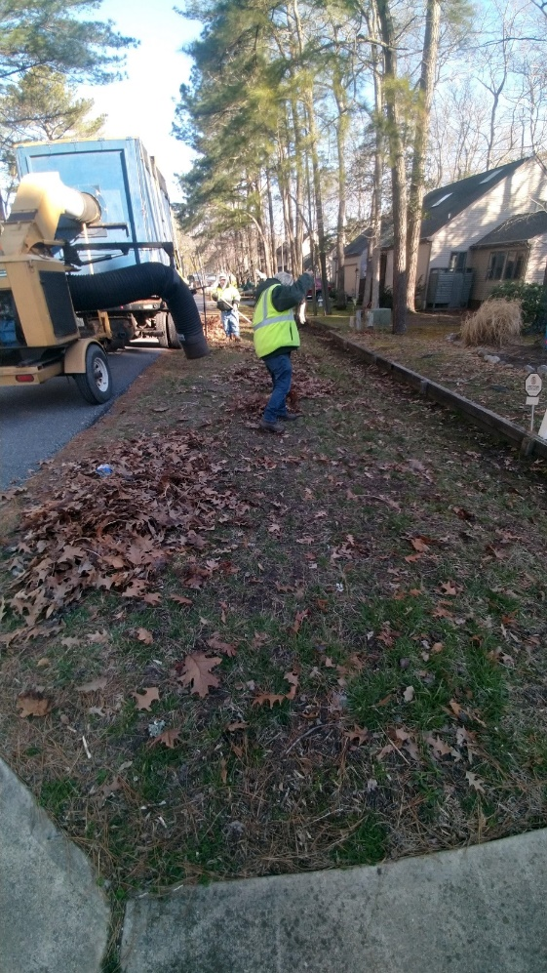
Leaf Program (to begin in Fall 2023)
Ocean Pines will continue to pick up bagged leaves in November and December (also picked up by Republic)
Ocean Pines will no longer be vacuuming the leaves with the vacuum truck – homeowners will now be responsible for bagging up those leaves.
To obtain a yard waste sticker, please contact Public Works at 410-641-7425 – free the first year
The yard will be open for yard debris drop off in the Fall, Spring, and as needed (need to call Public Works prior to dropping off debris on the as needed basis)

Slide 15
Other
Admin Renovations: currently working on HVAC; project should be completed within the next week
Steen Properties: 26 of the 30 lots closed on; mailboxes ordered

Slide 16
CPI Violation Dashboard February
Violations (includes legal)
As of 1/31/23 | New Violations | Closed Violations | As of 2/28/23
129 | 60 | 37 | 152
Legal Cases
As of 1/31/23 | New Violations to Legal | Closed Violations in Legal | As of 2/28/23
57 | 0 | 5 | 52
60 violations initiated in February; 37 complied out; 152 remain open (includes the 52 violations in legal)

Slide 17
Work Orders February
Open Work Orders as of 1/31/23 | New Work Orders | Closed Work Orders | Open Work Orders as of 2/28/23
73 | 74 | 73 | 74
74 work orders initiated in February: 1 bulkhead; 20 drainage; 14 grounds/landscaping; 8 roads; 1 signs; 30 general maintenance
Majority still open in drainage (47):
15 – over 30 days; 6 – over 60 days; 10 – over 90 days
Average 1-4 work orders a day to complete depending upon severity

Slide 18
Customer Service Dashboard (from info@oceanpines.org) February
Type | # Received – Feb.
Amenities | 23
CPI | 7
Drainage | 0
General | 41
Public Works | 10
TOTAL | 81

Slide 19
Financials

Slide 20
Financial Change Month of February 2023
February (In 000’s)
 | Budget | Current Year | Favor/ (Unfavor) vs. Budget
Net Revenues | $208 | $207 | ($1)
Expenses | 934 | 899 | 35
Net Operating | ($726) | ($692) | $34

Slide 21
Financial Change Year-to-Date February 2023
YTD February 2023 (In 000’s)
 | Budget | Current Year | Favor/ (Unfavor) vs. Budget
Net Revenues | $13,285 | $14,230 | $945
Expenses | 11,726 | 11,558 | 168
Net Operating | $1,559 | $2,672 | $1,113

Slide 22
Month of February Favor/(Unfavorable) vs. Budget (in 000’s)
Department/Amenity | Favorable/ (Unfavorable)
Public Works, Gen Maint, CPI | 24
Golf Ops + Maintenance | 19
Police | 18
Yacht Club | (11)
Racquet Sports | (7)
Clubhouse Grille | (4)
Other Net (Marinas, Beach Club, Aquatics, Beach Parking, Finance, GM Office, Admin) | (5)
TOTAL | $34

Slide 23
Year-to-Date February Favor/(Unfavorable) vs. Budget (in 000’s)
Department/Amenity | Favorable/(Unfavorable)
Public Works, Gen Maint, CPI | 265
Golf Ops & Maintenance | 228
Aquatics | 135
Police | 116
Rec & Parks | 100
Beach Club | 86
Yacht Club | 81
Marinas | 33
Racquet Sports | 27
Beach Parking | 23
Finance | 17
Other Net (Admin, GM Office, PR/Marketing, Clubhouse Grille) | 2
TOTAL | $1,113

Slide 24
Unaudited Reserves February 2023 ($ Millions)
 | GeneralReplace | Bulkheads | Roads | Drainage | New Capital | Total
4/30/22 Balance | $4.8 | $0.5 | $0.0 | $0.7 | $0.1 | $6.1
Contributions/ Interest | 1.9 | 1.1 | 0.7 | - | 0.2 | 3.9
Casino Funds | - | - | 0.3 | 0.1 | - | 0.4
Transfer (Spend) | (0.9) | (0.9) | (0.2) | (0.6) | (0.2) | (2.8)
2/28/23 Balance | $5.8 | $0.7 | $0.8 | $0.2 | $0.1 | $7.6

Slide 25
Reserves Year-End Unaudited Estimate (in ooo’s)
 | Beginning Balance |  |  | Unaudited EST Balance
 | 4/30/22 | Additions | Expenditures | 4/30/2023
Major Maintenance & Replacement:
Marina Fuel Lines/Pumps/C Deck |  |  | (500)
Police Vehicles |  |  | (165)
Golf Maint Mowers/Sprayer |  |  | (145)
Admin Building Renovation |  |  | (125)
Aquatics Furniture, Equipment |  |  | (100)
Public Works Utility Vehicle |  |  | (75)
North Gate Bridge |  |  | (75)
Court Renovations |  |  | (75)
Other |  |  | (100)
Total | 4,769 | 1,925 | (1,360) | 5,334
Bulkheads & Waterways | 536 | 1,084 | (1,253) | 367
Roads | 5 | 1,055 | (365) | 695
Drainage | 687 | 120 | (610) | 197
New Capital | 150 | 215 | (335) | 30
TOTAL 4/30/23 ESTIMATE | 6,147 | 4,399 | (3,923) | 6,623

Slide 26
Treasurer’s Report Monica Rakowski

Slide 27
Cash & Short-Term Investments
Activity for Month of February
As of February 28, 2023, the Association had approx. ~ $13.0M in cash
Cash increased ~ $0.7M from the same time period last year
Cash decreased ~($0.9M) from January 2023
$11.1M invested in CDAR’s
Remaining $1.9M in Insured Cash Sweep, Money Market and Other Operating Accounts
Note: With Interest Rates continuing to increase in the marketplace, there will continue to be an upward trend of interest income realized within the Reserve Accounts in the coming months

