Slide 1
GM Leadership Report – John Viola

Slide 2
Ocean Pines Traffic Safety
“Share the Road Ocean Pines” Grant – through the MD Highway Safety Office
Reflector Bands, Small Blinking Lights, Bicycle Lights, Education Materials
Education
Autos / Bicyclists / Pedestrians
Enforcement

Slide 3
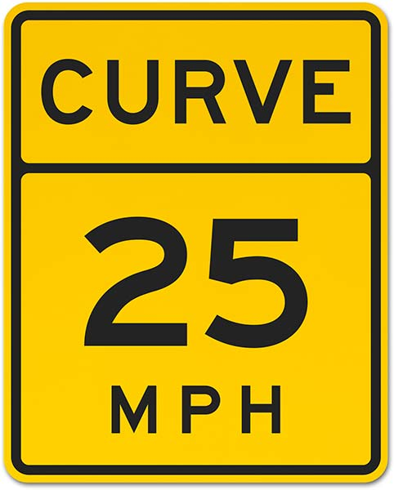
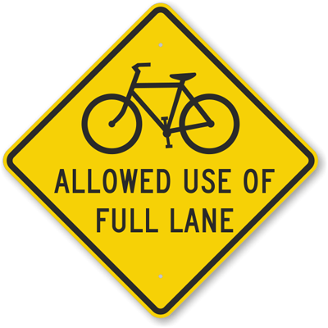
New Signage Considered
Advisory Speed for curves
Watch for Bicyclists and Pedestrians
Road Markings on existing shoulders for Pedestrians and Bicyclists on

Slide 4
Initiatives
Racquet Sports Building
Golf Bridge
Electronic Signs
Fire Department Building
Golf Irrigation
Jet Ski Launches
Pricing Study
FMLI
Budget
Metrics

Slide 5
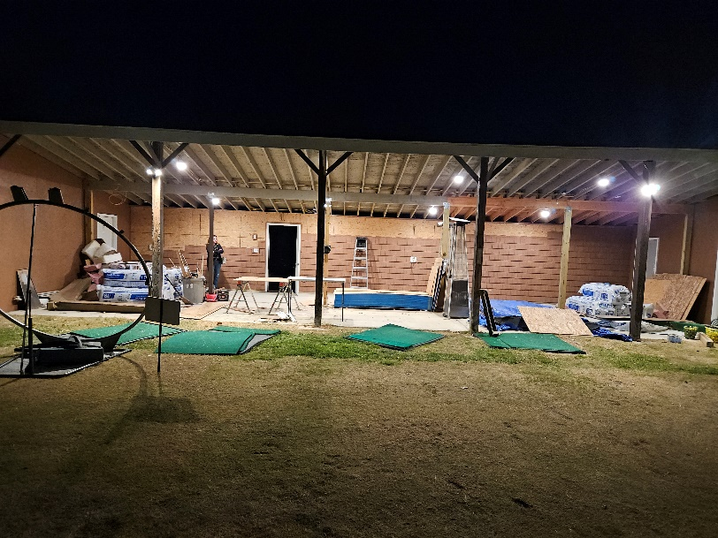
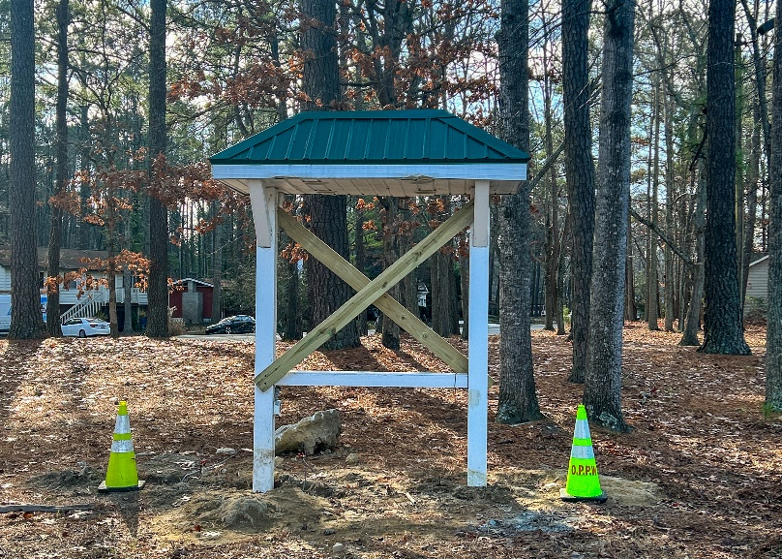
Initiatives
Driving Range Building
Work continues
Racquet Sports Building
On track
Scheduled to start in January
Golf Bridge – 4th Fairway
Going forward today with request
Scheduled to start in January
Electronic Signs
4 approved in budget
2 additional signs to be installed within the next month
Other 2 – obtaining approval from Worcester County
Fire Department
On track
Team met to discuss fit out

Slide 6
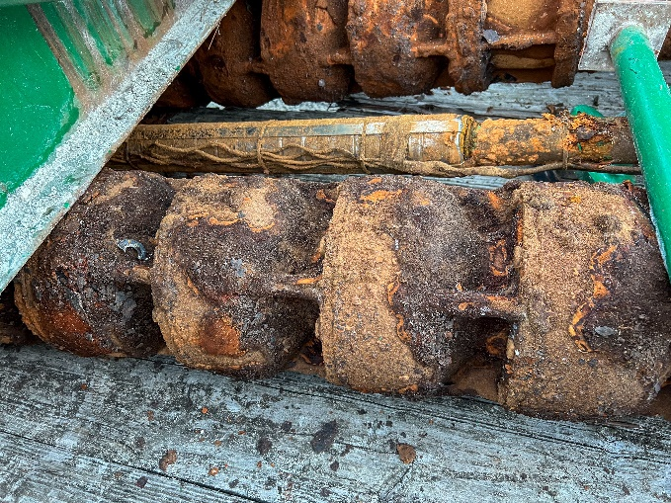
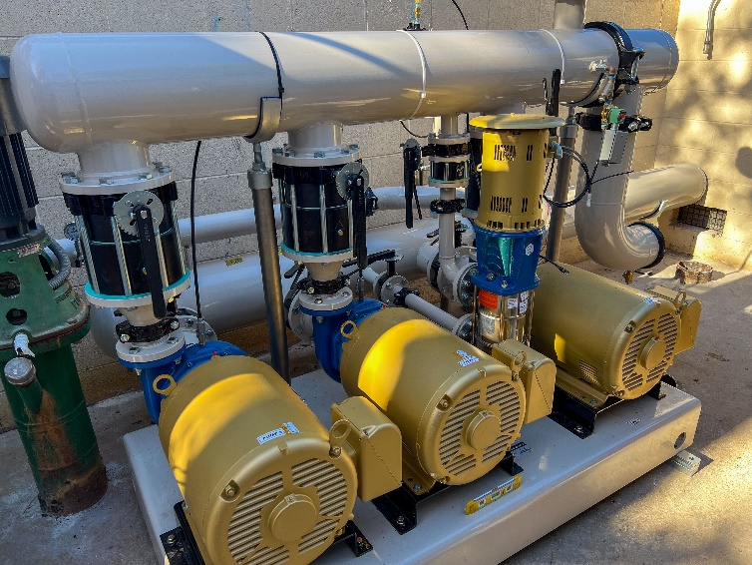
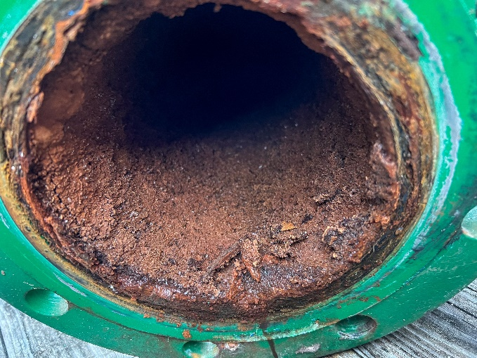
Golf Irrigation
New pumping station installed in pump house
Installing sprinkler heads and connecting main pipes to pumps
Requesting permission to go forward with preferred vendor for emergency replacement of sprinkler heads and main pipe lines for 2 fairways and greens
BEFORE
AFTER

Slide 7
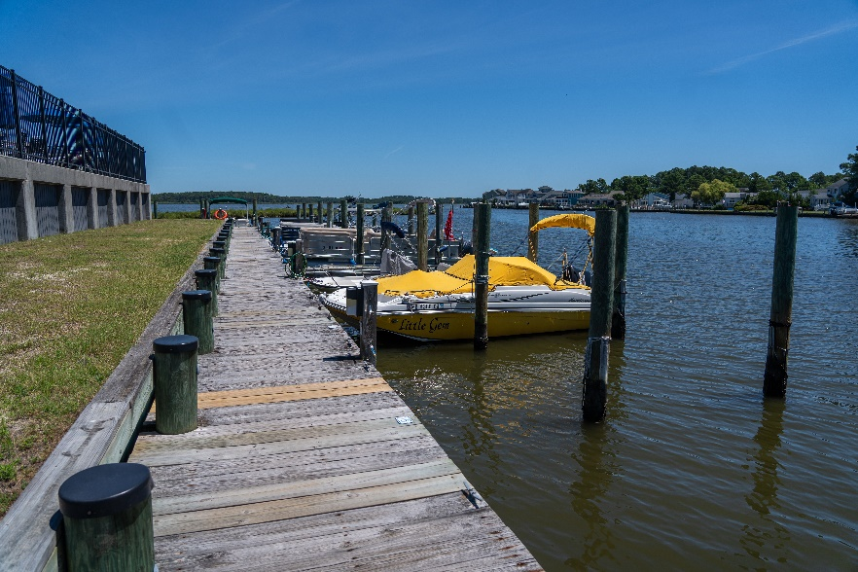
Jet Ski Launches
Permits being applied for 6 Jet Ski Launches at the Swim & Racquet Marina
A Plus Marine Service to install
Total cost: $18,882.85

Slide 8
Pricing Study
Team calculated aggregated inflation numbers for the last 5-6 years compared to pricing increases
Benchmarking to comparable amenities was addressed
Recommendations were made by department heads (SME’s)
We incorporated the findings into the budget process

Slide 9
FMLI
In 2022, Maryland enacted a Paid Family and Medical Leave Program
All employers with 1 or more Maryland-based employees will be required to provide this benefit
Program is funded by contributions from employee & employer – slated to begin July 1, 2025
0.9% of wages, up to the social security wage base is to be split between employers & employees (payroll deduction)
Estimated annual cost to OPA is approximately $30K
Benefits will not be available to the employee until July 1, 2026
Employee is eligible for benefits if they have worked at least 680 hours in the 4 most recently completed quarters
State approves leave – must be used for certain qualifying reasons (i.e., to care for a family member with a serious health condition)

Slide 10
FY 2025/2026 Budget
Dates for review:
Budget & Finance review: January 2nd - 3rd
Board review: January 8th – 9th
Town Hall: February 5th (tentatively)
Budget approval: February 22nd (tentatively)
Addressing public safety, maintenance, and infrastructure (Fire Department)
FMLI, medical costs, and liability insurance increases
Pricing study conducted
Budget binders to be available to Budget & Finance Committee and Board on/about December 27th

Slide 11
Director of Business Administration – Linda Martin

Slide 12
CPI Violation Dashboard November
Violations
As of 11/1/24 | New Violations | Closed Violations | As of 11/30/24
193 | 225 | 119 | 299
225 violations initiated in November: 32 maintenance/trash/debris; 29 no permit; 87 signs; 77 miscellaneous
Miscellaneous violations includes stop work orders, trailers, unregistered/junk vehicles, and vehicle parking
119 violations complied out; 299 remain open
68 maintenance/trash/debris; 56 no permit; 68 signs; 107 miscellaneous
71 of 299 violations still open are in legal

Slide 13
Work Orders November
Open Work Orders as of 11/1/24 | New Work Orders | Closed Work Orders | Open Work Orders as of 11/30/24
88 | 39 | 48 | 79
39 work orders initiated in November: 2 bulkhead; 11 drainage; 5 grounds/landscaping; 3 roads; 1 sign; 17 general maintenance
Majority still open in drainage (38):
8 – over 30 days; 18 – over 60 days
Average 1-4 work orders a day to complete depending upon severity

Slide 14
Customer Service Dashboard (from info@oceanpines.org) November
Type | # Received – Nov.
Amenities | 6
CPI | 12
Drainage | 0
General | 22
Public Works | 9
TOTAL | 49

Slide 15
Financials

Slide 16
MONTH OF NOVEMBER 2024 FINANCIAL RESULTS

Slide 17
NOVEMBER 2024 YTD FINANCIAL RESULTS

Slide 18
UNAUDITED RESERVE SUMMARY NOVEMBER 2024 ($ MILLIONS)
 | General Replace | Bulkheads | Roads | Drainage | New Capital | Total
4/30/24 Balance | $5.5 | $0.3 | $0.8 | $0.4 | $0.1 | $7.1
Contributions/ Interest | 2.0 | 1.1 | - | 0.1 | - | 3.2
Casino Funds | - | - | 0.3 | 0.1 | - | 0.4
Transfer (Spend) | (1.9) | (0.5) | - | (0.3) | - | (2.7)
11/30/24 Balance | $5.6 | $0.9 | $1.1 | $0.3 | $0.1 | $8.0

Slide 19
PUBLIC SAFETY PERCENTAGE OF ASSESSMENT

Slide 20
Treasurer’s Report - Monica Rakowski

Slide 21
Cash & Short-Term Investments
Month of November
As of November 30, 2024, the Association had Approximately (~) $16.1M in Cash
Cash Decreased ~ ($0.7)M from the Same Time Period Last Year
Cash Decreased ~ ($0.9M) from October 2024
$10.8M Invested in CDAR’s
$57K in Interest Income Recognized for the Month
Remaining $5.3M in Insured Cash Sweep, Treasury Bills, Money Market and Other Operating Accounts (Diversified Between 2 Local Banks)

