Slide 1
GM Leadership Report – John Viola

Slide 2
Initiatives
Veterans Memorial Gazebo
Golf
Racquet Sports
Holiday Decorations
RFP – Food & Beverage
Budget
Holiday Events
Mailboxes
Leaf Maintenance
Metrics

Slide 3
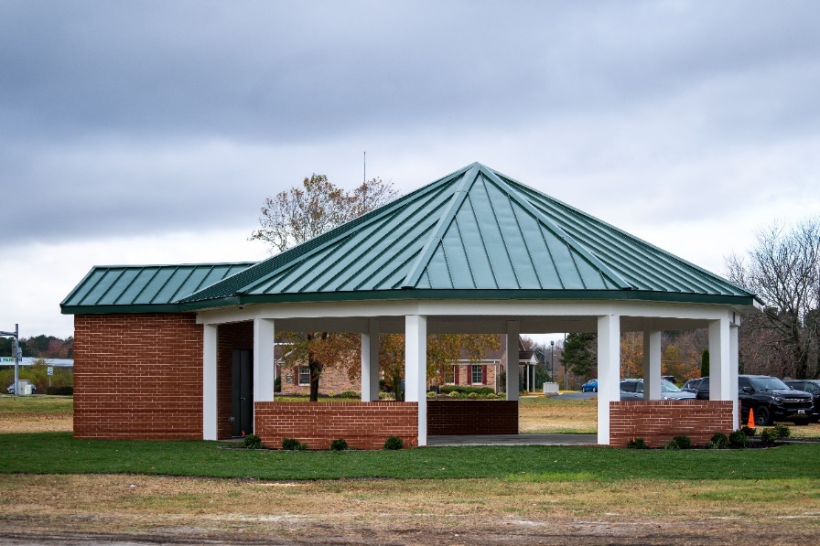
Veterans Memorial Pavilion
Dedication ceremony held prior to the Veterans Day event on November 11th
Preliminary estimate approved by Board on December 13, 2023 for $100,000 (gazebo kit)
Enhanced structure estimated $150,000 in February 2024
Final budget requested and approved $200,000
Not included in original estimate:
Added brick work ($42,000), door/frames ($3,000), architectural design ($20,000)
Increase in contractors fee (+$20,000), lumber (+$10,000), roofing (+$10,000)

Slide 4
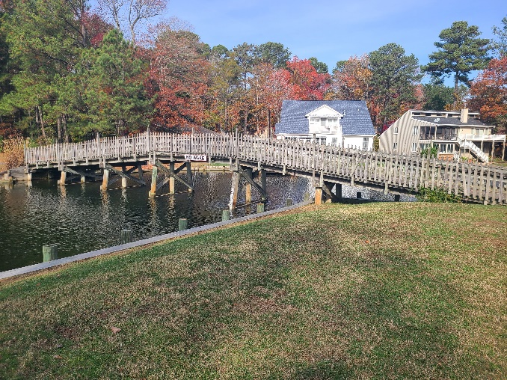
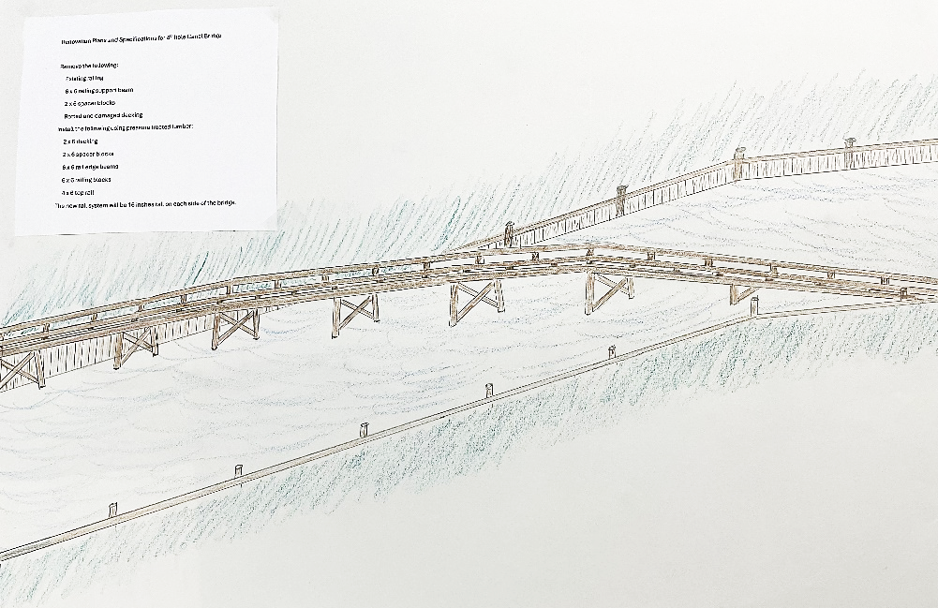
Golf
Driving range building
Scheduled to be completed in December
Bridge on 4th fairway
Waiting on cost from contractor (estimated: $40,000)
Replacing current fencing on sides of bridge with railings
Scheduled to be completed in January (1 week)
Minimal disruption to golf course

Slide 5
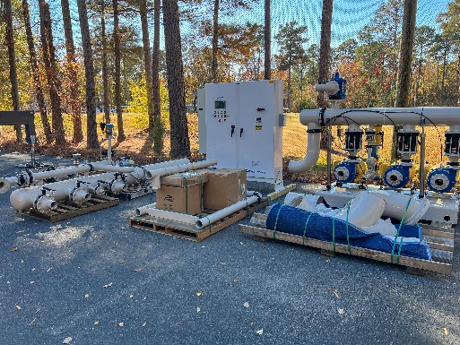
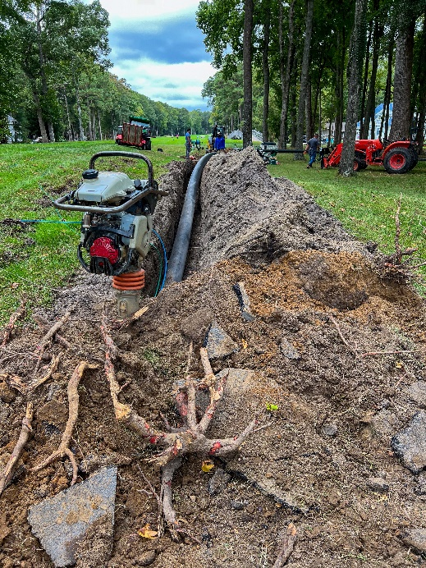
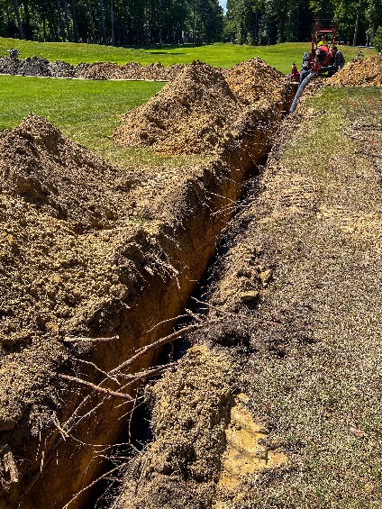
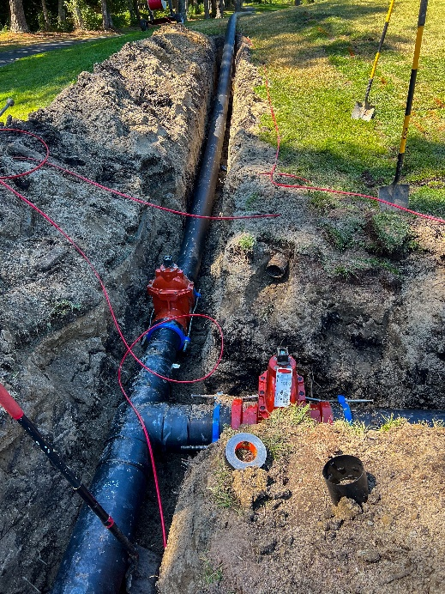
Golf
Irrigation
Phase I still in process
On track, on budget
Pumping station to begin within next few weeks

Slide 6
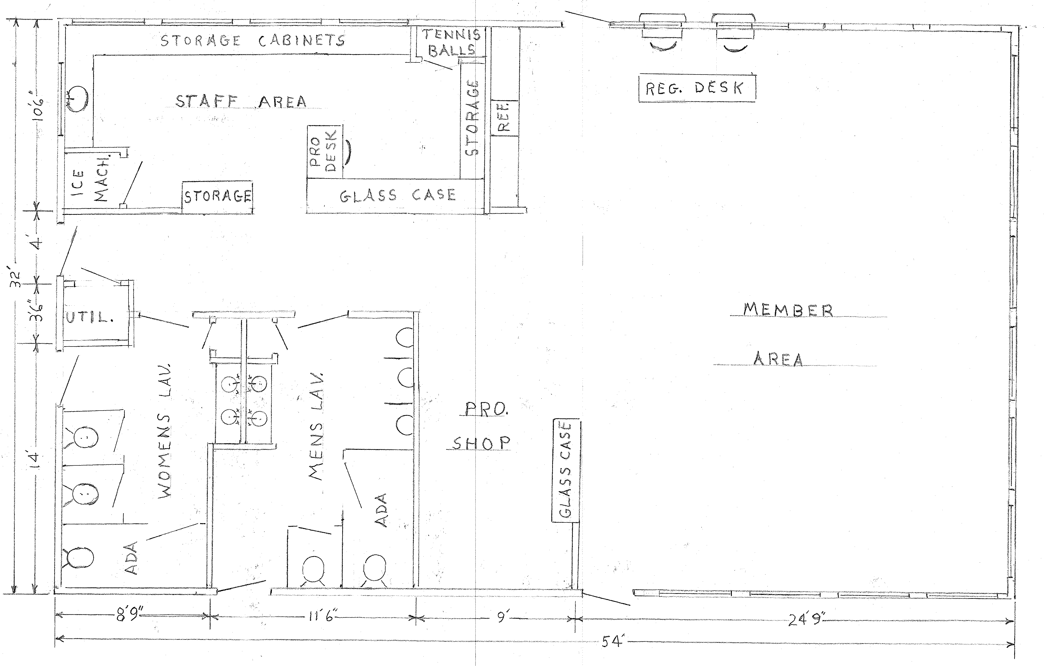
Racquet Sports – Renovations
Status: green
Project to begin in the winter
Racquet Sports Director to finalize initial drawing by next week

Slide 7
Holiday Decorations
Holiday decorations will be displayed starting next week
Extra lights will be added throughout Ocean Pines
Electronic signage to include holiday messaging
Additional decorations to be added for Hannukah and Kwanzaa

Slide 8
RFP – Food & Beverage
Current contract for food and beverage services ends April 30, 2025
RFP required per Section 9.05 of the Bylaws
Board tasked GM to initiate and deliver proposals with analysis and recommendation(s)
Next steps: Board to authorize the General Manager to begin negotiation of a food and beverage contract

Slide 9
FY 2025/2026 Budget
Reviewing budget with departments
To include pricing study by all amenities
Increased cost of safety
On track to deliver budget binders to Budget & Finance and Board prior to the holidays
Meetings scheduled (officially approved):
Budget & Finance review: January 2nd - 3rd
Board review: January 8th – 9th

Slide 10
Director of Business Administration – Linda Martin

Slide 11
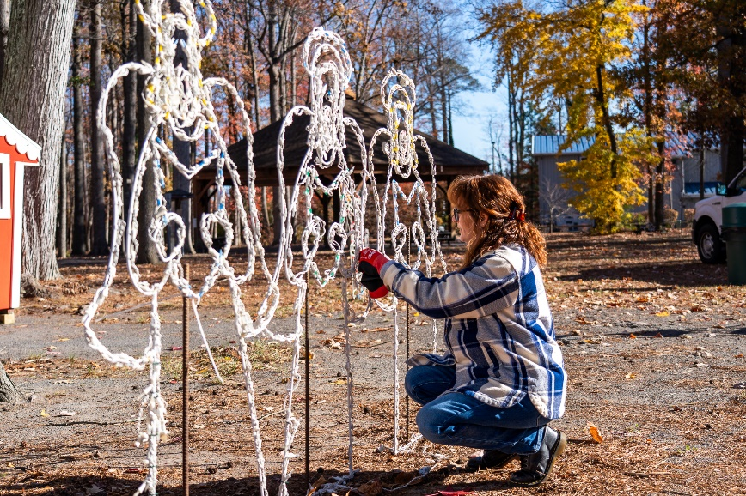
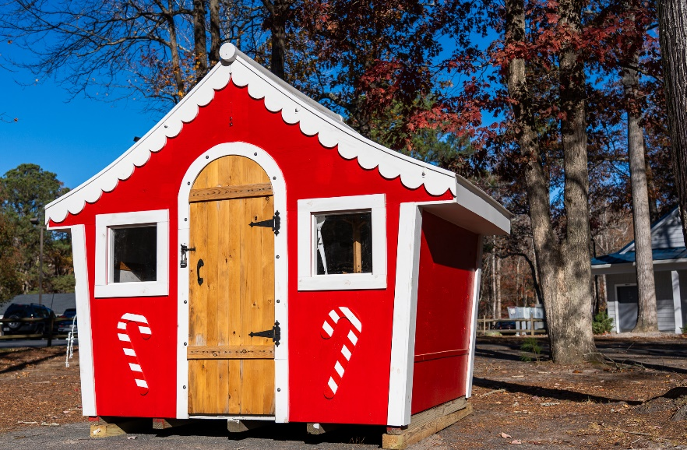
Holiday Events
Light up the Pines: register by December 9th
November 30th: Tree Lighting Ceremony, 6:30 p.m., White Horse Park
December 7th: breakfast with Santa, 8-11 a.m., Community Center
December 10th: Vienna Boys Choir, 7 p.m., OC Performing Arts Center – tickets still on sale
December 21st: swim with Santa, 5-8 p.m., Sports Core Pool

Slide 12
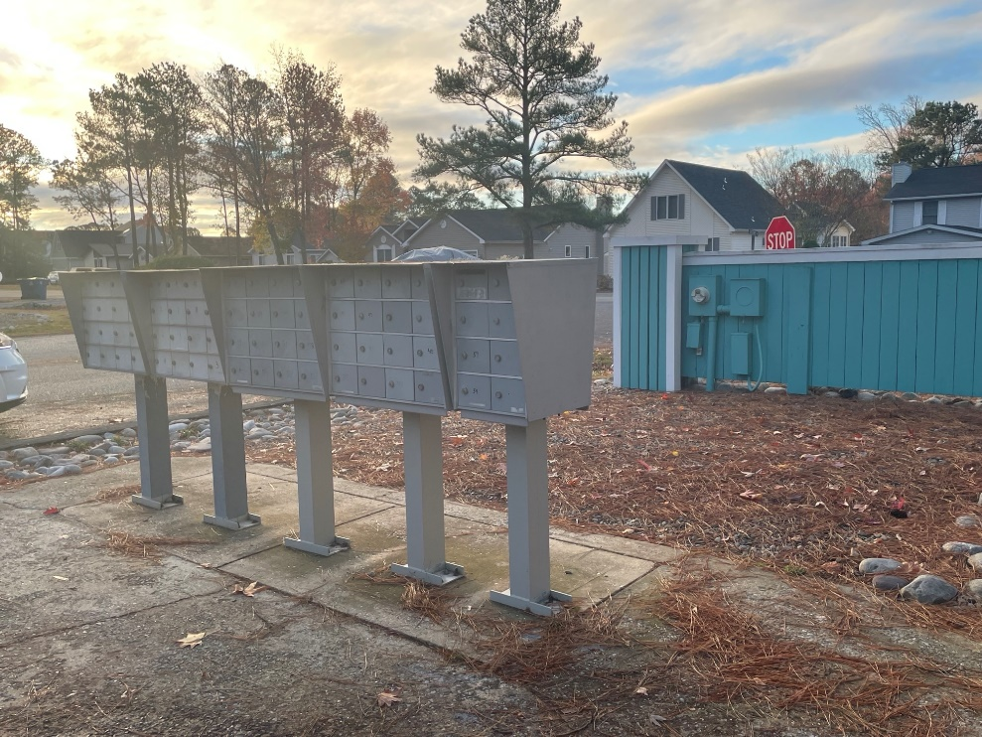
Mailboxes
Public Works still working on mailboxes
Doing repairs in-house in lieu of replacing boxes
Recently repaired Terns Landing mailboxes

Slide 13
Leaf Maintenance
Leaf bag program continues
Republic will pick up 4 bags with normal trash pick up
Republic also having special pick up of paper bags only on November 23rd and December 7th, 14th, and 21st
Public Works will start picking up bagged leaves on November 25th – January 3rd
Public Works will also have the yard open the whole month of December (except on holidays) from 8:00 a.m. – 3:00 p.m.
If you have your leaves raked up to the road, they will not be picked up unless bagged

Slide 14
CPI Violation Dashboard October
Violations
As of 10/1/24 | New Violations | Closed Violations | As of 10/31/24
307 | 116 | 230 | 193
116 violations initiated in October: 29 maintenance/trash/debris; 25 no permit; 8 signs; 54 miscellaneous
Miscellaneous violations includes stop work orders, trailers, unregistered/junk vehicles, and vehicle parking
230 violations complied out; 193 remain open
64 maintenance/trash/debris; 47 no permit; 8 signs; 74 miscellaneous
71 of 193 violations still open are in legal

Slide 15
Work Orders October
Open Work Orders as of 10/1/24 | New Work Orders | Closed Work Orders | Open Work Orders as of 10/31/24
94 | 70 | 76 | 88
70 work orders initiated in October: 7 bulkhead; 13 drainage; 14 grounds/landscaping; 4 roads; 1 sign; 31 general maintenance
Majority still open in drainage (43):
13 – over 30 days; 17 – over 60 days
Average 1-4 work orders a day to complete depending upon severity

Slide 16
Customer Service Dashboard (from info@oceanpines.org) October
Type | # Received – Oct.
Amenities | 7
CPI | 13
Drainage | 0
General | 96
Public Works | 8
TOTAL | 124

Slide 17
Financials

Slide 18
MONTH OF OCTOBER 2024 FINANCIAL RESULTS

Slide 19
OCTOBER 2024 YTD FINANCIAL RESULTS

Slide 20
UNAUDITED RESERVE SUMMARY OCTOBER 2024 ($ MILLIONS)
 | General Replace | Bulkheads | Roads | Drainage | New Capital | Total
4/30/24 Balance | $5.5 | $0.3 | $0.8 | $0.4 | $0.1 | $7.1
Contributions/ Interest | 1.9 | 1.1 | - | - | - | 3.0
Casino Funds | - | - | 0.3 | 0.1 | - | 0.4
Transfer (Spend) | (1.7) | (0.4) | - | (0.2) | - | (2.3)
10/31/24 Balance | $5.7 | $1.0 | $1.1 | $0.3 | $0.1 | $8.2
Est Remaining FY Spend | (0.7) | (0.7) | (0.3) | (0.2) | - | (1.9)
4/30/25 Estimate | $5.0 | $0.3 | $0.8 | $0.1 | $0.1 | $6.3

Slide 21
Treasurer’s Report - Monica Rakowski

Slide 22
Cash & Short-Term Investments
Month of October
As of October 31, 2024, the Association had Approximately (~) $17.0M in Cash
Cash Decreased ~ ($0.4)M from the Same Time Period Last Year
Cash Decreased ~ ($0.9M) from September 2024
$11.7M Invested in CDAR’s
$62K in Interest Income Recognized for the Month
Remaining $5.3M in Insured Cash Sweep, Treasury Bills, Money Market and Other Operating Accounts (Diversified Between 2 Local Banks)

