Slide 1
Board of Directors Meeting
November 19, 2022

Slide 2
Approval of Agenda

Slide 3
Approval of Minutes October 15, 2022 – Regular Meeting October 20, 2022 – Special Meeting October 25, 2022 – Special Meeting November 10, 2022 – Special Meeting

Slide 4
Announcement of Email Votes/Motions

Slide 5
President’s Remarks Doug Parks

Slide 6
Creating Safe Places to Walk and Bike on
November 19, 2022
Ocean Pines Association
Board of Directors Meeting
Patti Stevens, Chair
Worcester County Bike and Pedestrian Coalition
Eastern Shore Representative - Maryland Bike & Pedestrian Advisory Committee

Slide 7
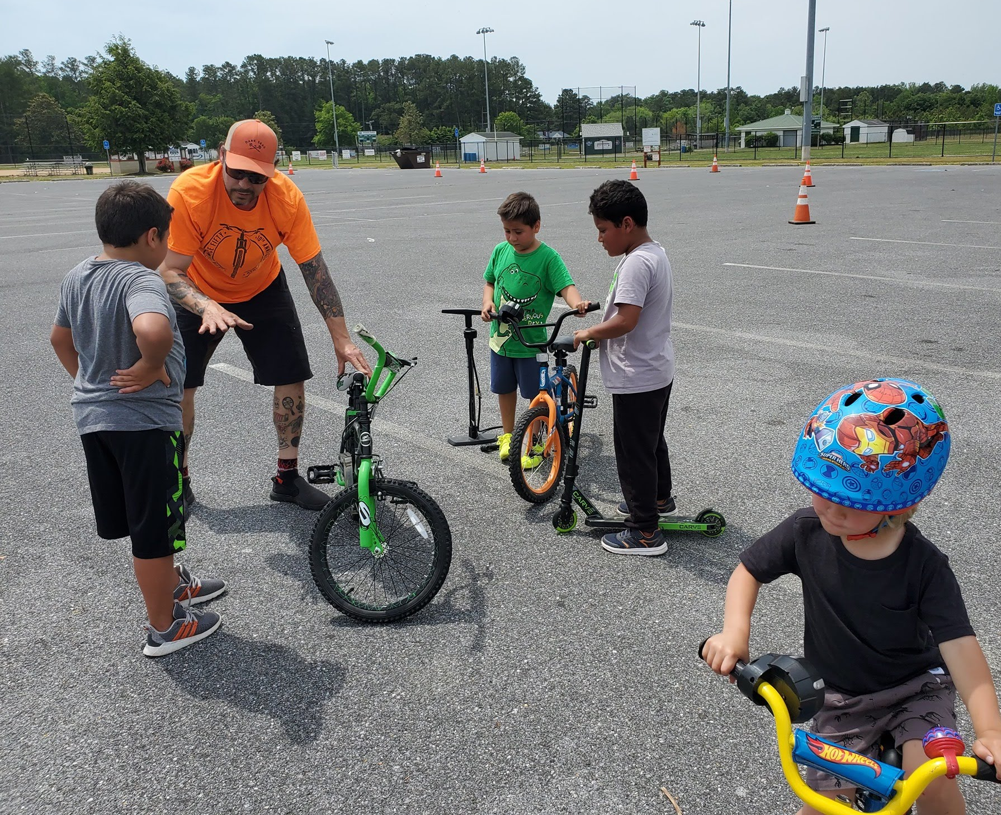
Worcester County Bike and Pedestrian Coalition
Formed in 2020 to improve awareness and safety and to expand places to walk and bike safely in and around the county.
Town, county, community, and non-profit representatives participate in quarterly meetings.
Celebrate National Bike Month in May with community rides in Berlin, Pocomoke City, Snow Hill, and Ocean Pines.
Plan and support the Maryland Coast Bike Festival in May.
Secure grants and in-kind resources from state, regional, and private funders to support events, provide safety items, and regional planning. Received $100K State Grant with Lower Shore Land Trust.
Connected and launched the Eastern Shore Regional Trail Network in 2022 with Eastern Shore Land Conservancy.
Identified and continue advocating for road improvements, trails, and connections, including Pocomoke Wildlands Trail to Snow Hill, Huntingfields Connection to JW Smith Park in Snow Hill, Keyser Point Road Safe Route to School, and Route 90 bridge bike-ped path.

Slide 8
Prioritize Safe Connections,Trails, and Road Intersections
Existing Plans- Short Term - Seeking Funds
Pocomoke State Forest Trail to Snow Hill. Berlin Bikeway on Rail Trail from Heron Park to Main Street. Improve trails & crossings in Ocean Pines.
Medium Term- Approved in planning - Separated trails on 611 and 376 (Assateague Rd). South Point HOA Community Trail.
Longer term - Review and update studies for Rail Trail projects from Berlin to OC, Snow Hill to Berlin. Pocomoke City to ES Virginia Rail Trail.
Advocate for Route 90 Bridge to include separated Bike/Ped lanes (like Wilson and Indian River Bridges).
Communicate priority improvements to Planners, Leaders, SHA and developers.

Slide 9
Bike and Pedestrian Initiatives – Here and Near
Walkable/Bikeable Berlin – Master Plan developed in 2013 by Lower Shore Land Trust with Town of Berlin
OC Bike Ped Advisory Committee – Created Strategic Plan to improve signage and route maps to bike/walk safely from Inlet to Delaware line.
Snow Hill Bikeway Feasibility Study – May 2022
Worcester County Walkability Plan - 2018 Health Department. Hosts Just Walk Worcester Campaign.
Ocean Pines Residents listed safe places to walk and bike as most desired in both the Community Wide Survey and the Rec & Park Survey!
Yet There is not a current plan or budget to improve or maintain bike and walk trails in Ocean Pines.
Mobility Master Plan
SOMERSET COUNTY
Plan for bike, walk, &
Active recreation
Queen Anne’s County Bike and Pedestrian Connectivity & Safety Recommendations

Slide 10
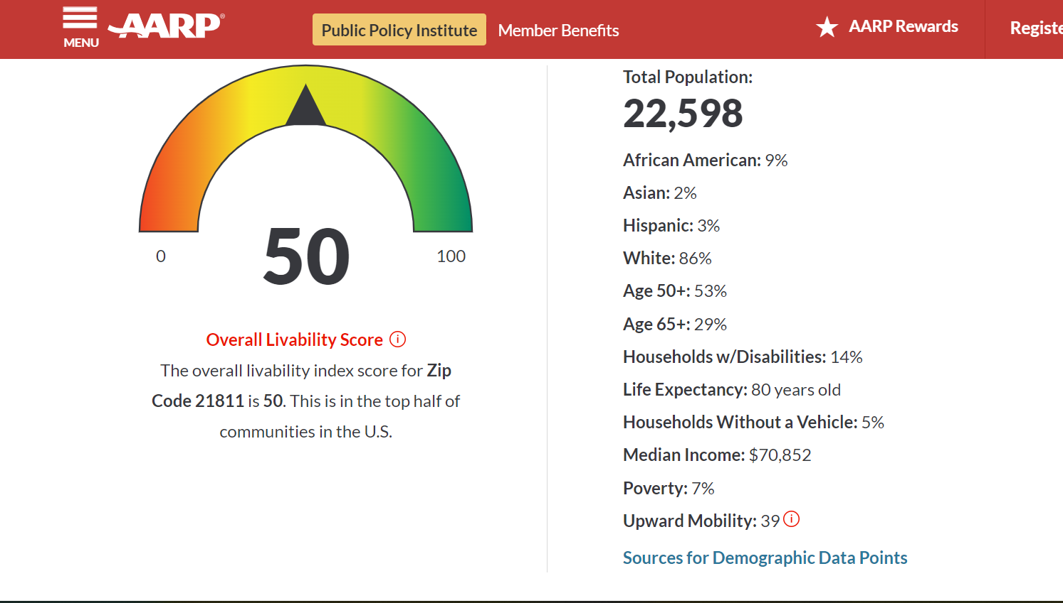
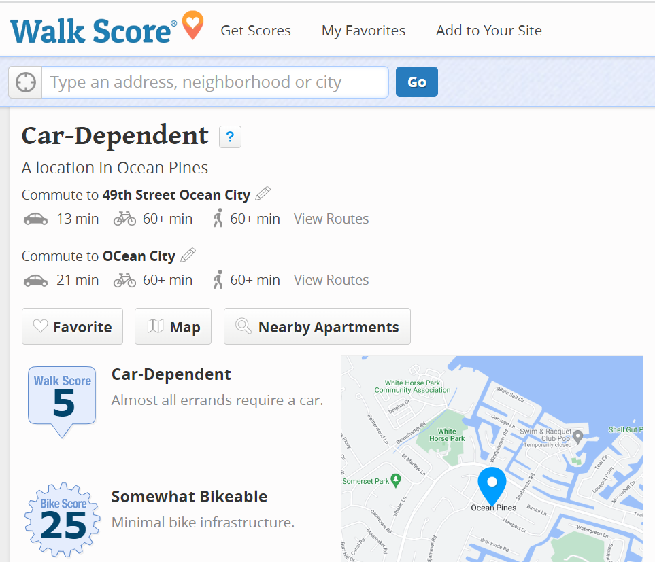
How Does Ocean Pines Rank in Walkability & Livability?
Feedback in Bikability Audit and recent Surveys indicate what residents think would improve walk and bike safety & access in Ocean Pines.

Slide 11
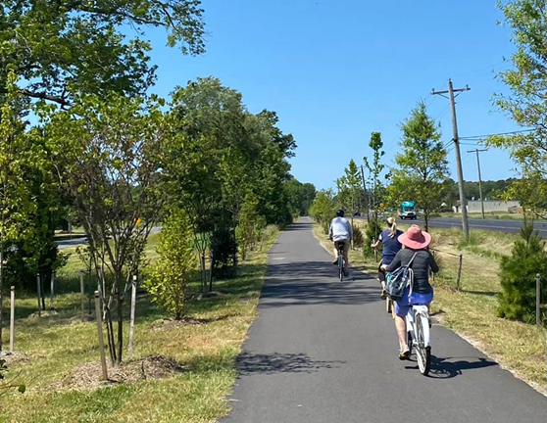
Positive Impacts of More Places to Walk & Bike Safely
Equitable Access to Recreation, Natural Resources, Services, Shopping, and JOBS! J-1 students & residents
Economic -- Increase in tourism, long stays, greater spending. Queen Anne Cross County trail reported 20,000 users in the first year - more than half from outside the county. Outer Banks NC and GAP Trail studies show new business starts & relocation, and increased employment, property values/tax revenues. $800K per mile, $121M per year is the estimated economic impact of MD to PA GAP Trail.
Health-- Reduced levels of obesity, high blood pressure, diabetes, & improved mental health result from regular moderate activity. AARP Livability score ranks a walkable community as top desired feature for people to age in place. If it’s safe when you’re 80, it’s safe for an 8 year old!
Environment-- Reduces congestion. Ability to combine trail projects with water and utility projects, preserves open space and existing rights of way (ROW). OP trails use some utility easements. More are possible.
Eastern Shore communities around us are building trails and promoting active tourism. New rail trails - Crisfield to Westover, Cambridge Downtown, Easton to St Michaels, Kent Narrows, Salisbury.
Source: www.sehinc.com/news/why-your-community-should-invest-bicycle-and-pedestrian-infrastructure

Slide 12
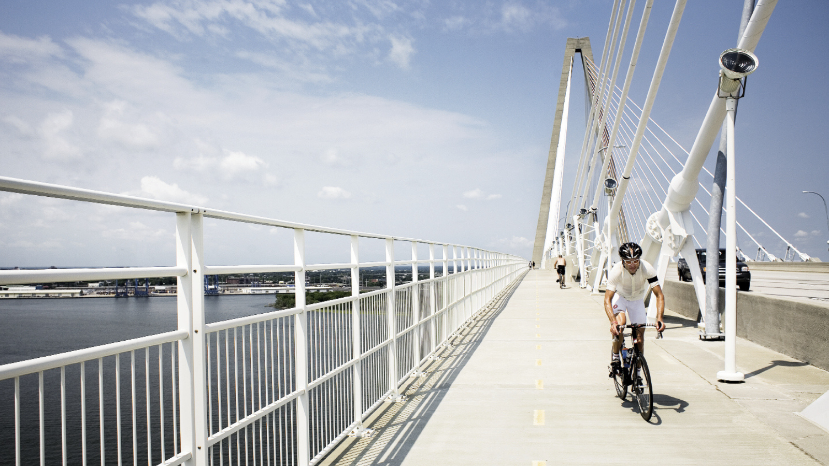
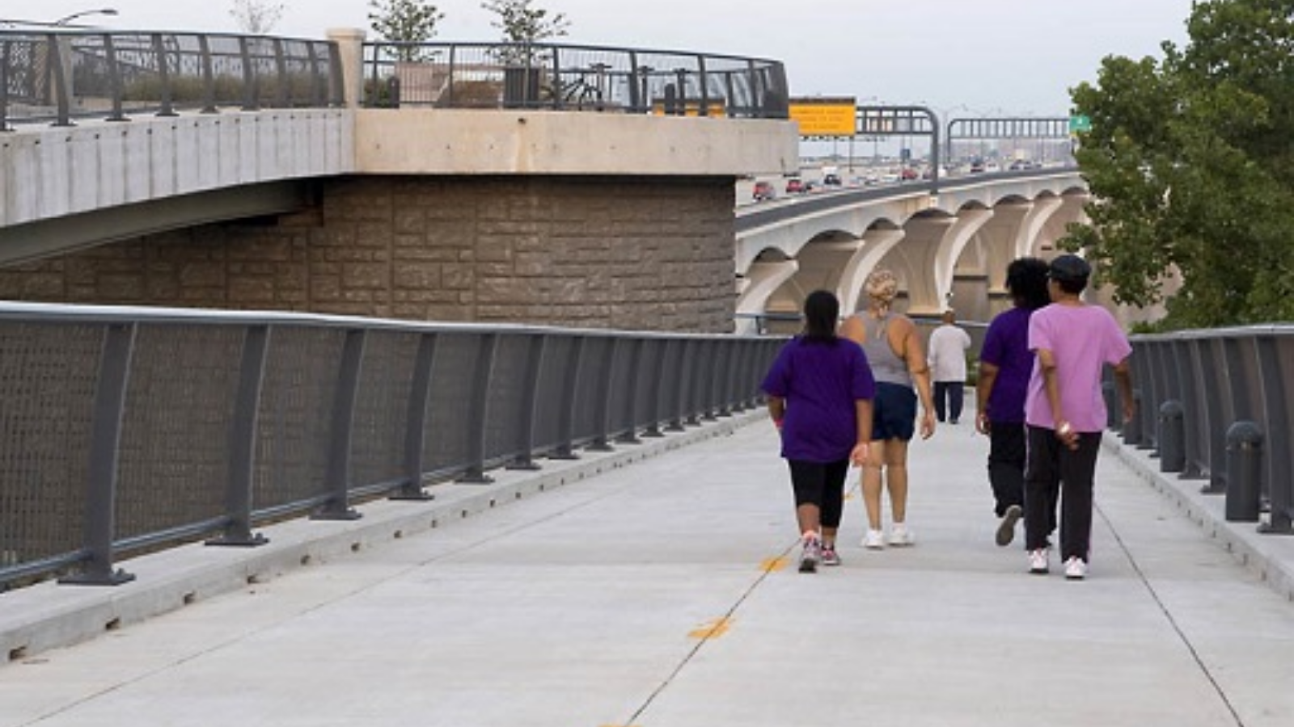
Federal and State Laws Require Bike and Walk Access on Bridge Replacement or Redesign
Maryland State Highway Administration Design Guidelines Chapter 7.1 All newly constructed and reconstructed bridges shall accommodate bicycle and pedestrian access where appropriate and feasible to do so. It is SHA’s policy to provide sidewalks and shoulders on both sides of bridges where bicyclists and pedestrians are permitted to operate.
1/14/2022 U.S. Department of Transportation (US DOT) issued guidance in the Bridge Investment Program. Under the law anytime a state replaces or rehabilitates any highway bridge deck they must include biking and walking access. Federal money is available for planning & building. $18.4 million was awarded to 23 states this month!

Slide 13
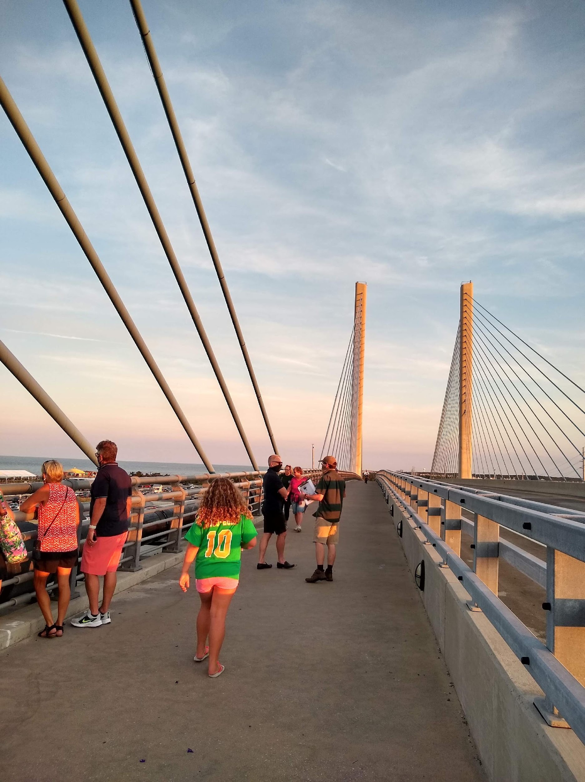
Many bridge crossings have separate lanes for safe walking and biking
Check out this Gallery at http://pedestrian.org/topics/interstate-row-gallery.htm
Mario Cuomo Bridge (Tappanzee) over Hudson River in NY has 800-2000 users daily, equal number of walkers & bikers. 6 overlook stops.
Woodrow Wilson Bridge between Virginia & Maryland on I-495 - estimated 5,000 walkers a month, equal # of visitors/residents
San Francisco Golden Gate Bridge – estimates 250 bikes and more than 100 walkers cross each HOUR!
Indian River Inlet Bridge in Delaware – 12-foot-wide path heavily used year-round. OP resident Laura Scharle leads guided walks each year. Check out her web site Delmarva Trails and Waterways.
What is your favorite?

Slide 14
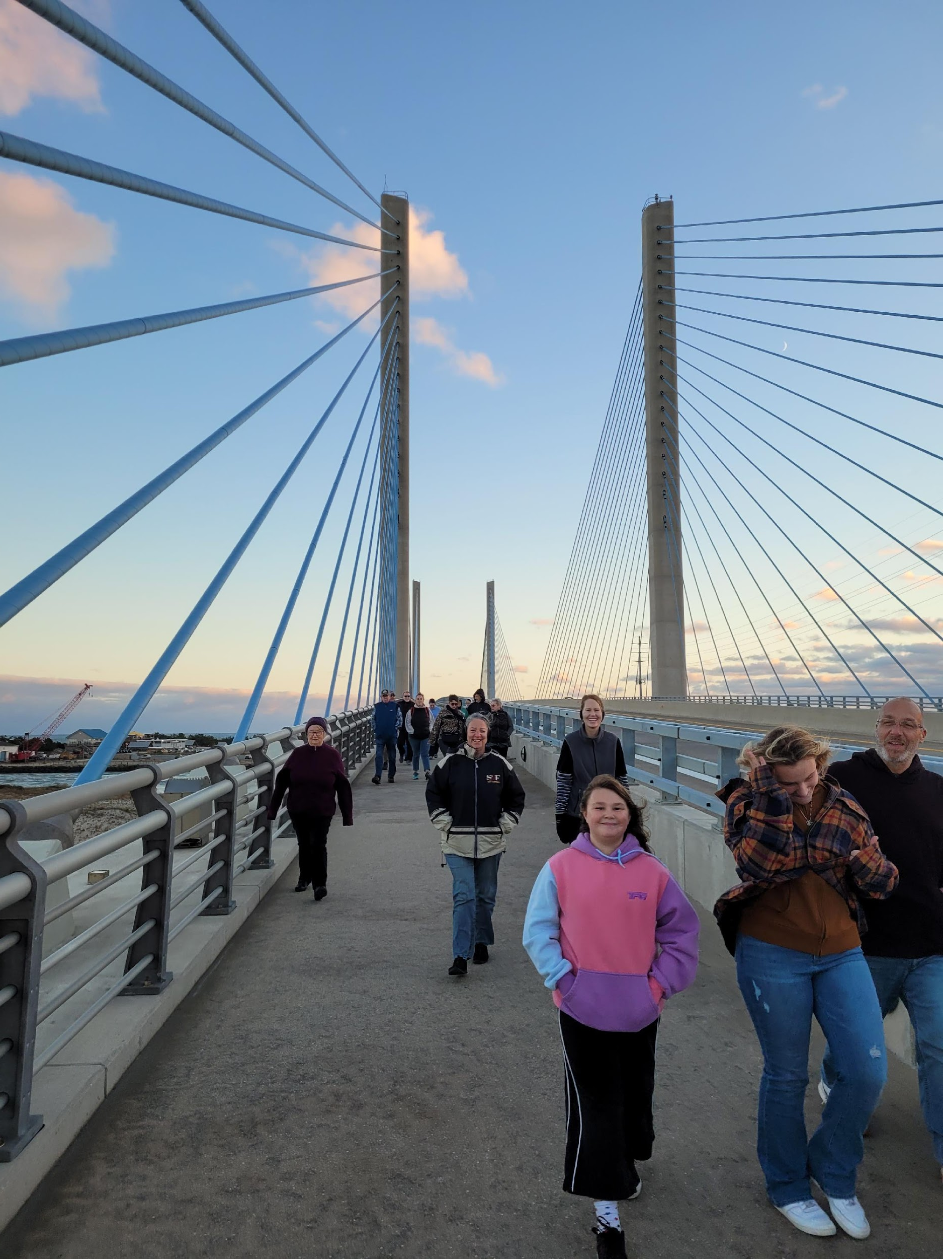
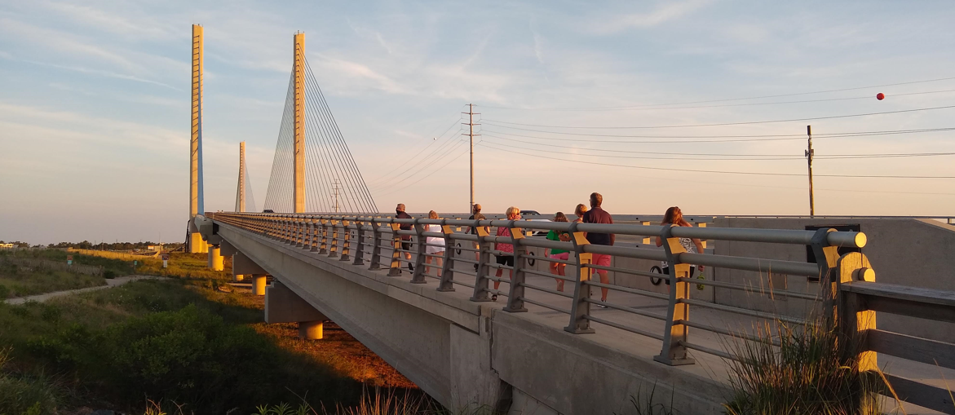
Charles W. Cullen (Indian River Inlet) Bridge
Bikeway plans were included from beginning designs in 2002; open for traffic in 2012
Provides safe pedestrian access between state park amenities
State park leads guided bridge walks (total 300-500 ppl/year)
Inaugural Sun, Moon, Bridge event (April 2021) saw 2500+ people walking the bridge
Provides safe access for several 5Ks and triathlons each year

Slide 15
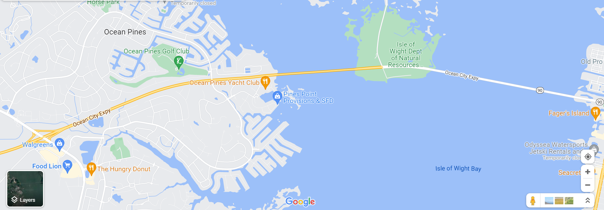
How did other Communities Advocate and Plan for Bike and Pedestrian Accommodations?
Engaged with Transportation Planners and Elected Officials early & often to make their voices heard!
Created and maintained walk/bike trails between bridge access points and activity centers (red lines)
Utilized existing trails/paths for access and planned how to connect them in bridge design (red line along 90)
OPA staff/board/volunteers can improve bike/walkability of community in and around 90. Work w/state, county, OC, and property owners to connect North & South Ocean Pines and provide future access to Route 90 Corridor.

Slide 16
Smart MDOT Engineers can design path & access points if they believe it is a priority. Let’s tell them!
ALL CONCEPTS
SHOW OPTION
FOR SEPARATED BIKE/WALK
PATH -4 lane options are most likely to allow for shared used path.

Slide 17
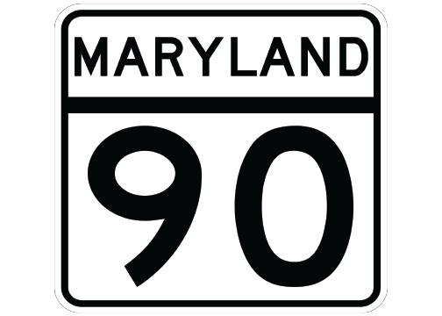
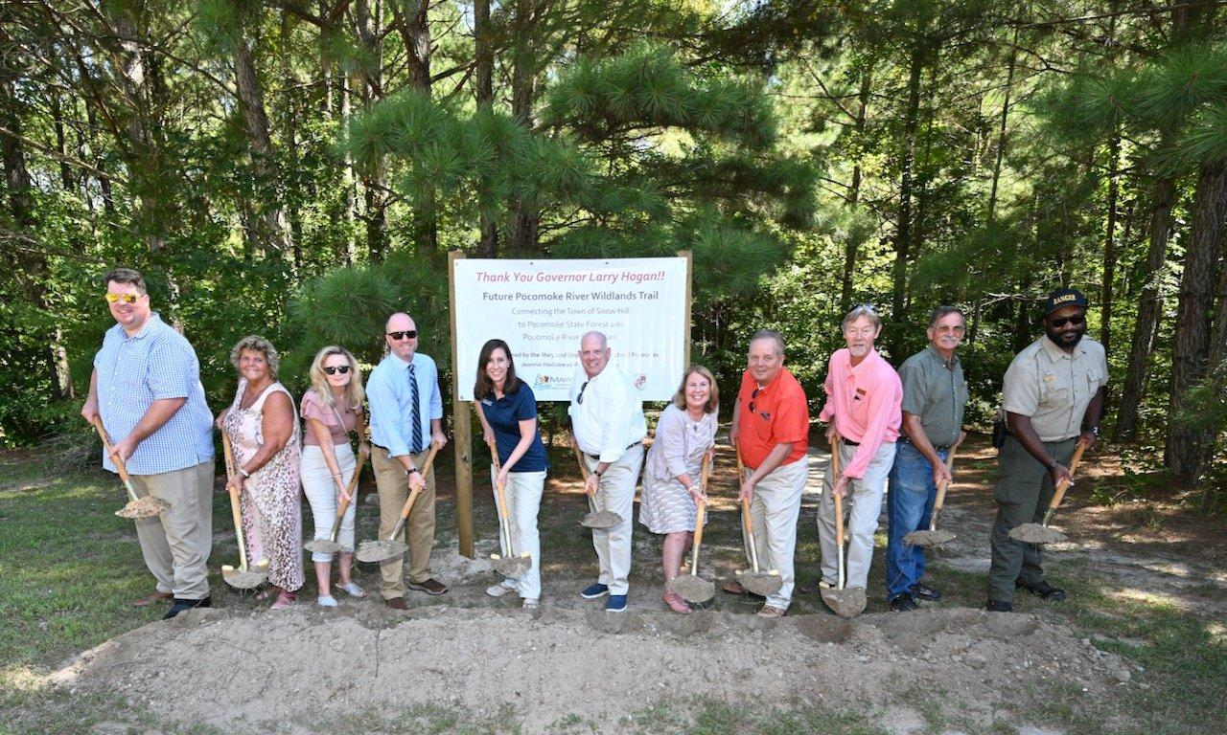
WHAT CAN Ocean Pines Association DO?
Review the Project Plans and potential designs and provide input on the survey before Nov. 30.
Draft a letter outlining priorities and concerns like Bike/Ped shared used path; safe access ramps, and passage under 90 at the Golf Course Crossing.
Form a work group staff, Board member(s), and residents to improve OP walkability/bikeability including the Route 90 project. Address resident concerns and ideas in survey responses.
Budget for staff and/or consulting assistance to develop plan to make Ocean Pines a more walkable/bikeable/liveable community.
Write to State and Local Representatives to tell them that safe connections and shared use paths are important to Ocean Pines.

Slide 18
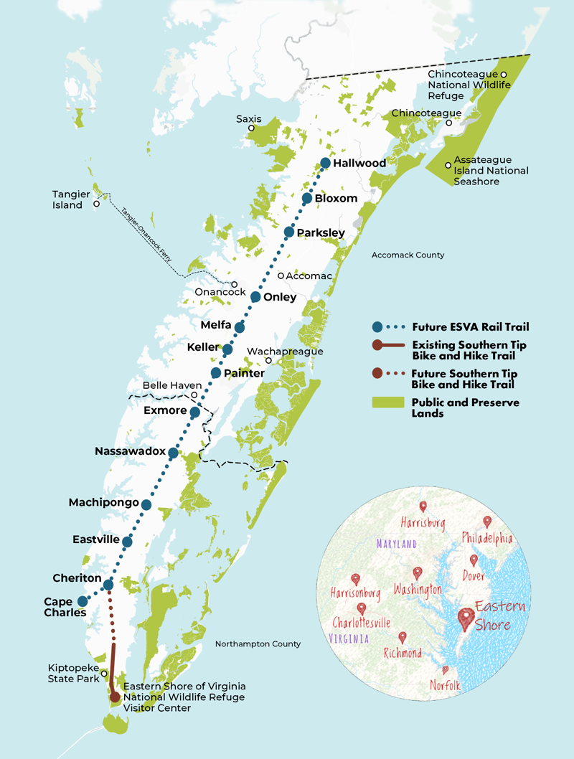
Look what our neighbors are doing! Eastern Shore of Virginia Rail Trail 49 miles -Cape Charles to Hallwood
“Railbanking” authorized under the National Trails Act preserves a corridor that would have been abandoned and lost to public use.
Ensures the right-of-way will remain in place for potential future rail operations and utility needs.
Driven by success of other railtrails: Virginia Capital Trail has estimated $5M annual impact. Town of Abingdon sees $25M tourism impact from Virginia Creeper Trail.
BayCoast Rail/Box Car Express Execs involved in planning asked “Why stop at the MD line? Let’s Bring trail to Pocomoke City.” see red line

Slide 19
WANT TO GET INVOLVED?
Follow us on Facebook. Share pictures of your rides, walks, and related events. www.facebook.com/WoCoBikePed
Be a safe walker and biker. Wear reflective gear and helmet on bikes, observe traffic laws. Share the road!
Volunteer to help with community rides, Youth Bike Safety, the Maryland Coast Bike Ride, outreach efforts.
Help make our community and Worcester County a safe place to walk and bike – whether you’re 8 or 80!
Email: wcbikepedsafety@gmail.com
Thank you!

Slide 20
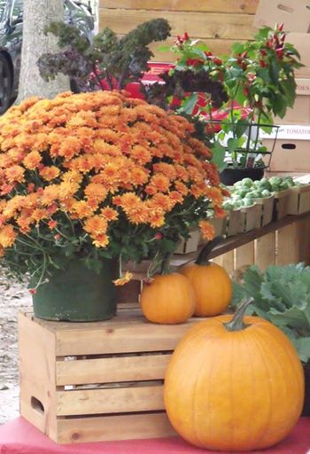
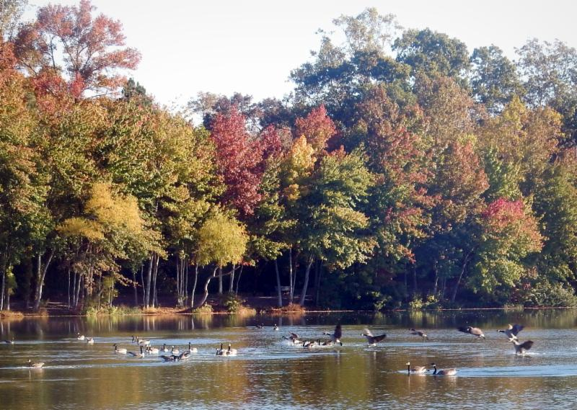
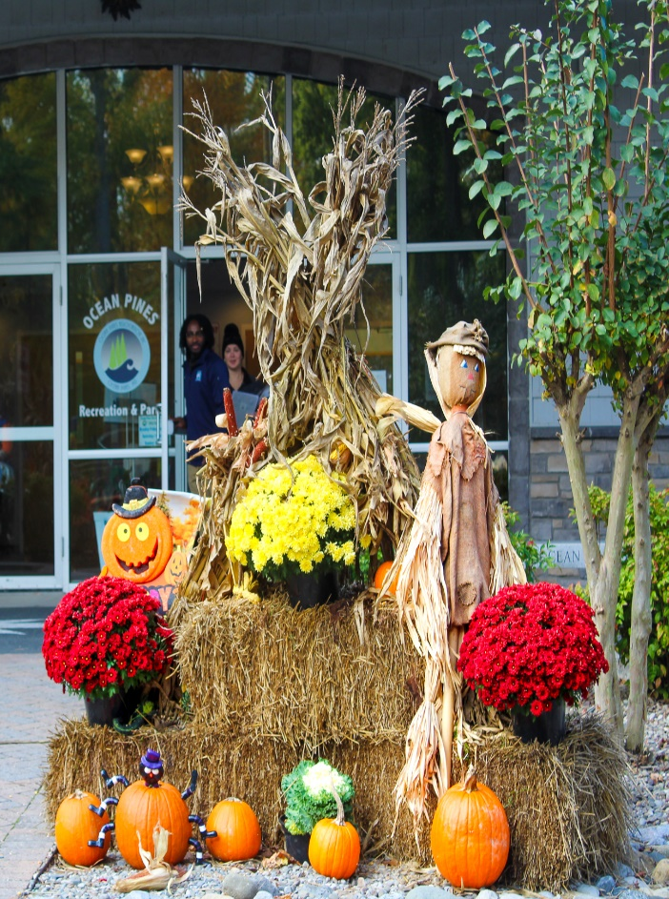
GM Leadership Report – John Viola

Slide 21
Initiatives
Drainage
OPVFD Work Group
Roads
Open Positions
North Gate Bridge
Racquet Sports
Surveys

Slide 22
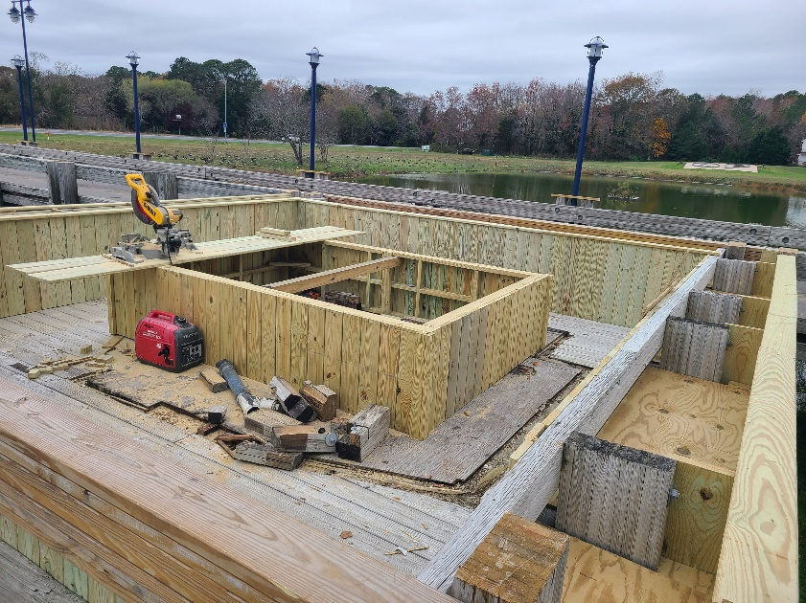
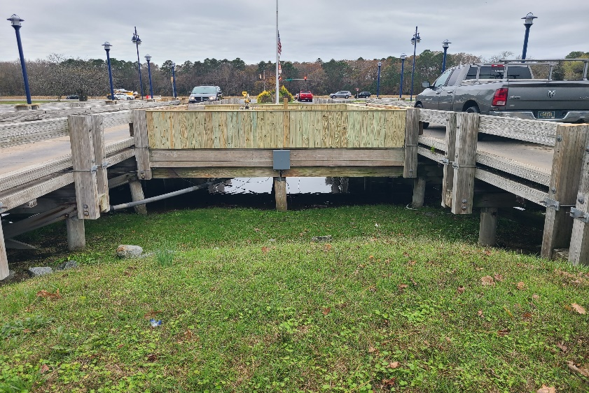
North Gate Bridge
North Gate Bridge:
Raised Flower Box
Estimated Cost <$5,000
Timeframe - November/December
Outside Wall Trim Finish
Estimated Cost $10,000 - $15,000
Timeframe – Spring
North side pond – Fountain
Estimated Cost $8,000
Timeframe - Spring

Slide 23
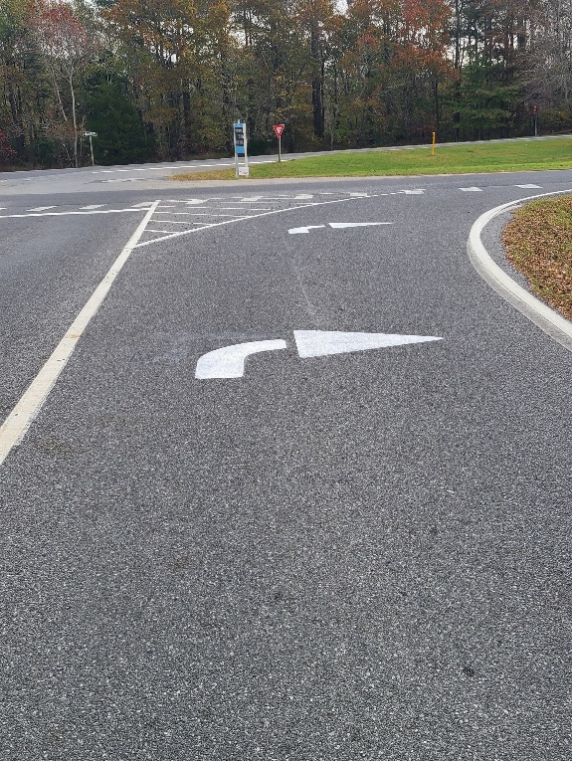
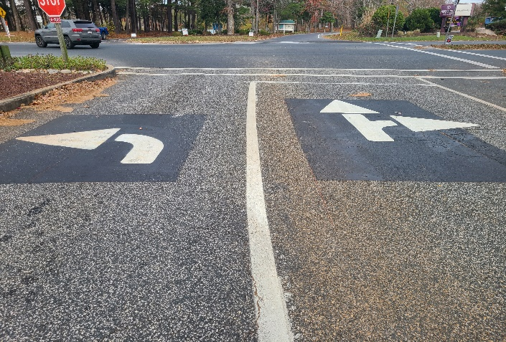
Roads
Paving
Approximately 3 miles of roads to be completed: Barnacle Court, Beach Court, Birdnest Drive, Fosse Grange, Garrett Drive, Ivanhoe Court, Liberty Bell Court, Little John Court, Moonshell Drive, Rabbit Run Lane, Surfers Way, Watergreen Lane, and Willow Way
Paving began on November 17th
Estimated completion 1st week in December,
weather permitting
Approved cost is $363,122.90
Arrows and Crosswalks
Miles Moffit is currently painting the arrows, cross walks,
and stop bars
Estimated cost < $5,000
Estimated completion 2 – 3 weeks

Slide 24
Drainage
Secondary Pipes
Water’s Edge Pipe
$8,850
Completed September 30, 2022
Clubhouse Pipe
$8,850
Completed October 28, 2022
Birdsnest Pipe
Estimate of $15,000
Late fall, early winter

Slide 25
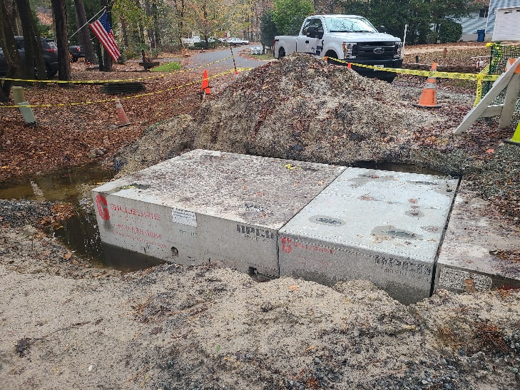
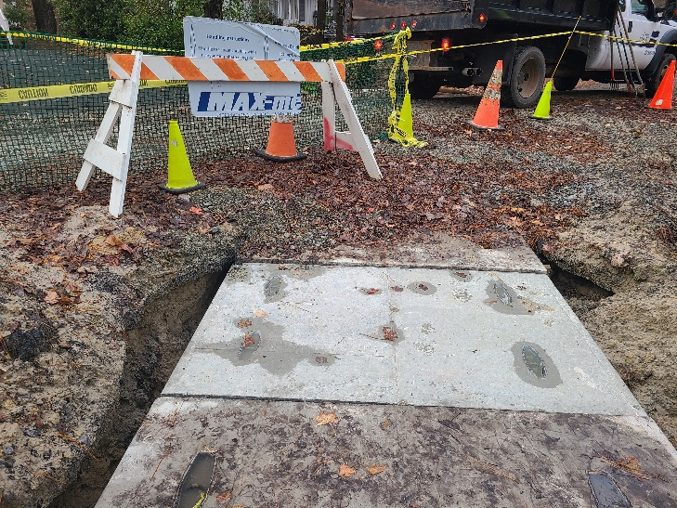
Drainage cont.
Pinehurst
Approved Cost $12,236
Completed
Sandyhook
Approved Cost $12,236
Completed
Beaconhill
Approved Cost $13,676
Concrete completed November 18th
Blacktop to be completed week after Thanksgiving

Slide 26
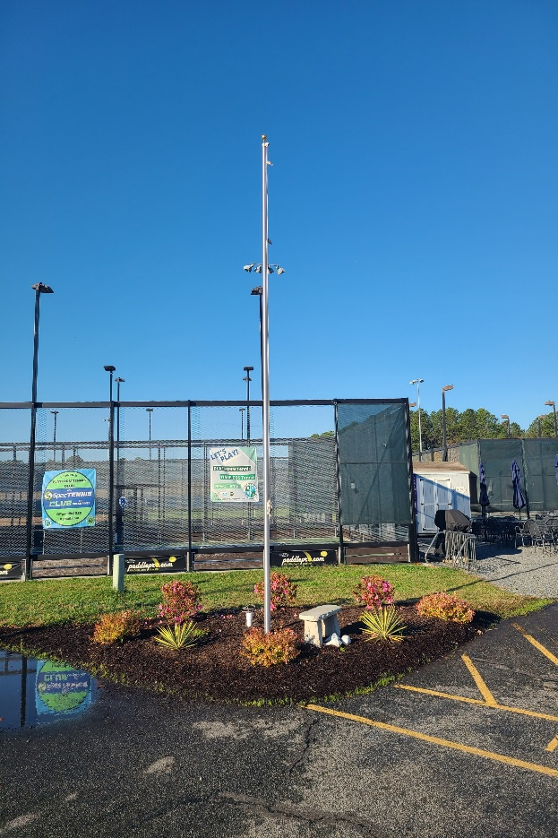
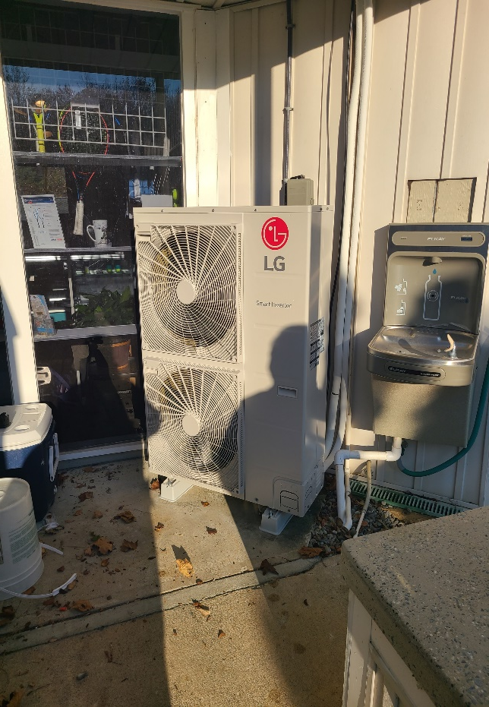
Racquet Sports
Flagpole with lights
Cost: $2,500
Completed in 09/2022
HVAC
Cost: $6,500
Completed 11/18/22

Slide 27
Open Positions
Police
Two recruits ready for the academy in January
Salaries are now comparable within the area per Chief Ehrisman
Aquatics
Recently hired two lifeguards and 2 swim instructors
Reaching out to local swim teams/clubs and will hire and train starting at age 15
Public Works
Making progress on hiring
Several people interviewed and background checks are pending

Slide 28
OPVFD Work Group
Issued RFP for consultant (feasibility study) on 9/26/22 to seven firms/individuals
Questions and responses accepted through 10/14/22
Proposals due 10/31/22
Team needs more time to evaluate
Team recommendation is for another 30 days to come back to the Board at next Board Meeting on 12/17/22

Slide 29
Surveys
Planning Committee chair
Golf (191 responses)
Racquet Sports (229 responses)
Recreation and Parks (300 responses)
Aquatics (259 responses)
Overall customer service satisfaction levels have been strong:
Golf: 4.03 out of 5
Racquet: 3.25 out of 5
Recreation and Parks: 3.99 out of 5
Aquatics: 3.76 out of 5
The full results of each survey (generally around 10 questions) were summed up for the GM and sent to the department head and appropriate committee chair.

Slide 30
Surveys cont.
Results were also posted to oceanpines.org.
Surveys were run for about three weeks and were communicated on the website, social media, the e-blast, press releases, and through posted signs at each amenity with QR codes.
The communications survey, as of Thursday, has about 100 responses in the first four days. Overall satisfaction with OPA communications is currently 3.97 out of 5.

Slide 31
Financials

Slide 32
Financial Change Month of October 2022
October (In 000’s)
 | Budget | Current Year | Favor/ (Unfavor) vs. Budget
Net Revenues | $503 | $555 | $52
Expenses | 1,082 | 1,057 | 25
Net Operating | ($579) | ($502) | $77

Slide 33
Financial Change Year-to-Date October 2022
YTD October 2022 (In 000’s)
 | Budget | Current Year | Favor/ (Unfavor) vs. Budget
Net Revenues | $12,397 | $13,248 | $851
Expenses | 7,844 | 7,872 | (28)
Net Operating | $4,553 | $5,376 | $823

Slide 34
Month of October Favor/(Unfavorable) vs. Budget (in 000’s)
Department/Amenity | Favorable/ (Unfavorable)
Police | 25
Recreation & Parks | 24
Pickleball | 15
Admin/GM Office/Finance/PR&Marketing | 10
Clubhouse Grille | 7
Aquatics | 6
Beach Parking | 5
Yacht Club | (18)
Public Works, Gen Maint, CPI | (8)
Other Net (Marinas, Beach Club, Tennis, Platform Tennis) | 11
TOTAL | $77

Slide 35
Year-to-Date October Favor/(Unfavorable) vs. Budget (in 000’s)
Department/Amenity | Favorable/(Unfavorable)
Golf Ops & Maintenance | 183
Aquatics | 126
Public Works, Gen Maint, CPI | 113
Beach Club | 88
Yacht Club | 83
Police | 55
Rec & Parks | 50
Racquet Sports | 43
Marinas | 37
Beach Parking | 23
Admin/GM Office/Finance/PR&Marketing | 16
Clubhouse Grille | 6
TOTAL | $823

Slide 36
Unaudited Reserves October 2022 ($ Millions)
 | GeneralReplace | Bulkheads | Roads | Drainage | New Capital | Total
4/30/22 Balance | $4.8 | $0.5 | $0.0 | $0.7 | $0.1 | $6.1
Contributions/ Interest | 1.8 | 1.1 | 0.7 | - | 0.2 | 3.8
Casino Funds | - | - | 0.4 | 0.1 | - | 0.5
Transfer (Spend) | (0.6) | (0.3) | - | (0.5) | (0.2) | (1.6)
10/31/22 Balance | $6.0 | $1.3 | $1.1 | $0.3 | $0.1 | $8.8

Slide 37
Reserves Year-End Unaudited Estimate (in ooo’s)
 | Beginning Balance |  |  | Unaudited EST Balance
 | 4/30/22 | Additions | Expenditures | 4/30/2023
Major Maintenance & Replacement:
Marina Fuel Lines/Pumps/C Deck |  |  | (500)
Golf Maint. Mowers/Sprayer |  |  | (180)
Police Vehicles |  |  | (146)
Admin Building Renovation |  |  | (125)
Aquatics Furniture, Equipment |  |  | (100)
Public Works Utility Vehicle |  |  | (75)
North Gate Bridge |  |  | (75)
Court Renovations |  |  | (75)
Other |  |  | (100)
Total | 4,769 | 1,925 | (1,376) | 5,318
Bulkheads & Waterways | 536 | 1,085 | (1,170) | 451
Roads | 5 | 1,060 | (365) | 700
Drainage | 687 | 110 | (550) | 247
New Capital | 150 | 215 | (335) | 30
TOTAL 4/30/23 ESTIMATE | 6,147 | 4,395 | (3,796) | 6,746

Slide 38
Treasurer’s Report Monica Rakowski

Slide 39
Cash & Short-Term Investments
Activity for Month of October
As of October 31, 2022, the Association had approx. ~ $16.7M in cash
Cash increased ~ $0.9M from the same time period last year
Cash decreased ~($0.7M) from September 2022
$11.1M invested in CDAR’s
Remaining $5.6M in Insured Cash Sweep, Money Market and Other Operating Accounts
Note: With Interest Rates continuing to increase in the marketplace, there will be an upward trend of interest income realized within the Reserve Accounts in the coming months

Slide 40
Public Comments
Members wishing to make comments must state their name and address.

Slide 41
Capital Requests None

Slide 42
CPI Violations None

Slide 43
Unfinished Business None

Slide 44
New Business
Motion to approve OPA partnering with the Gavin Knupp Foundation to create an annual Gavin Knupp Award – Colette Horn
Discussion on new “Vote” signs – Stephen Jacobs
Discussion on submitting a letter of endorsement from the Board in support of the efforts by the Worcester County Bike and Pedestrian Coalition regarding the proposed Route 90 project – Doug Parks

Slide 45
Appointments
Frank Brown – Chair – Golf Committee
Amy Hasson – 1st Term – Aquatics Committee
Vivian Koroknay– 1st Term – Aquatics Committee
Thomas Ottenwaelder – 1st Term – Recreation & Parks Committee
Linda Yurche – 1st Term – Communications Committee

Slide 46
Adjournment

