Slide 1
Board of Directors Meeting
October 16, 2021

Slide 2
Approval of Agenda

Slide 3
Approval of Minutes July 21, 2021 – Regular Meeting July 30, 2021 – Special Meeting July 30, 2021 – Closed Meeting September 7, 2021 – Special Meeting September 7, 2021 – Closed Meeting
N

Slide 4
President’s Remarks Larry Perrone

Slide 5
Community Survey Update – Colette Horn

Slide 6
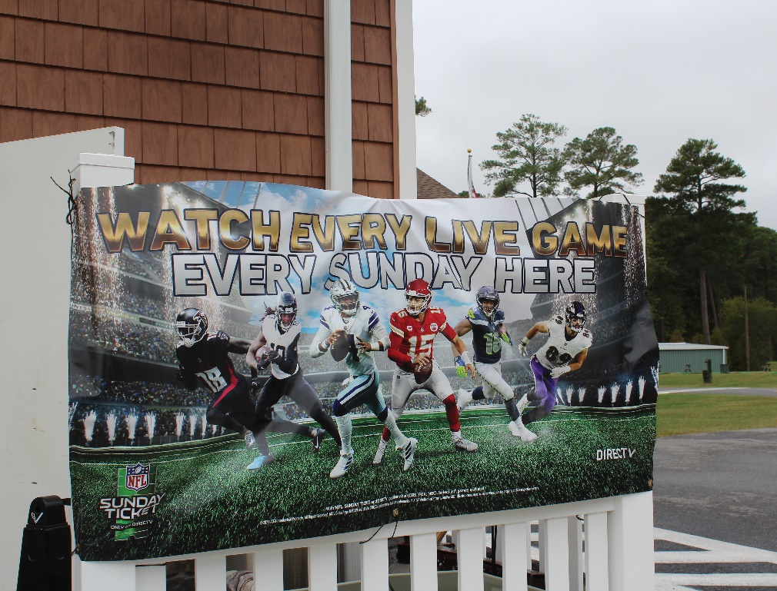
GM Leadership Report John Viola

Slide 7
GM Report
Initiatives
Clubhouse Railing
DMA “Lite” Study
Bainbridge Pond
Bulkheads
Northstar
Proposed Pickleball Court
Manklin Creek Road
Clubhouse Meeting Room Interior Doors

Slide 8
Clubhouse Railing
Clubhouse F&B Manager – Judy

Slide 9
Northstar
Overall system stability of modules in play has been trending in right direction
Tickets outstanding with Northstar team reduced significantly since the beginning of the summer
Thorough testing plan completed last week by entire team of Northstar users (version 6.4.7)
Plan to go live with version 6.4.9 in early November (waiting on Northstar team for “Release Notes”)

Slide 10
Proposed Pickleball Court
Permits are still with the State of Maryland. There are 3 issues we are working on with Vista-
Check possibly Typo on sheet 2
68 sq. ft. of mitigation maybe required
Changing bioswale which may eliminate nontidal wetland impacts.
Mitigation - It could be on site at Tennis or we will pick another location to do the mitigation if no room on the site.
Bio swale is landscape elements designed to remove silt and pollution from surface runoff water instead of piping.

Slide 11
Clubhouse Meeting Room Interior Doors
The new doorway to the banquet / meeting room-
They would match the main entrance to the country club
It would be all glass, will not distract from the view when entering the building
There will be double doors to enter the room
They will cut down on noise and distractions when the room is being used
They will not impede the use of the restrooms by the bar area or the golf pro shop
Public Works will do the framing
The cost of the doors is $7,978.65

Slide 12
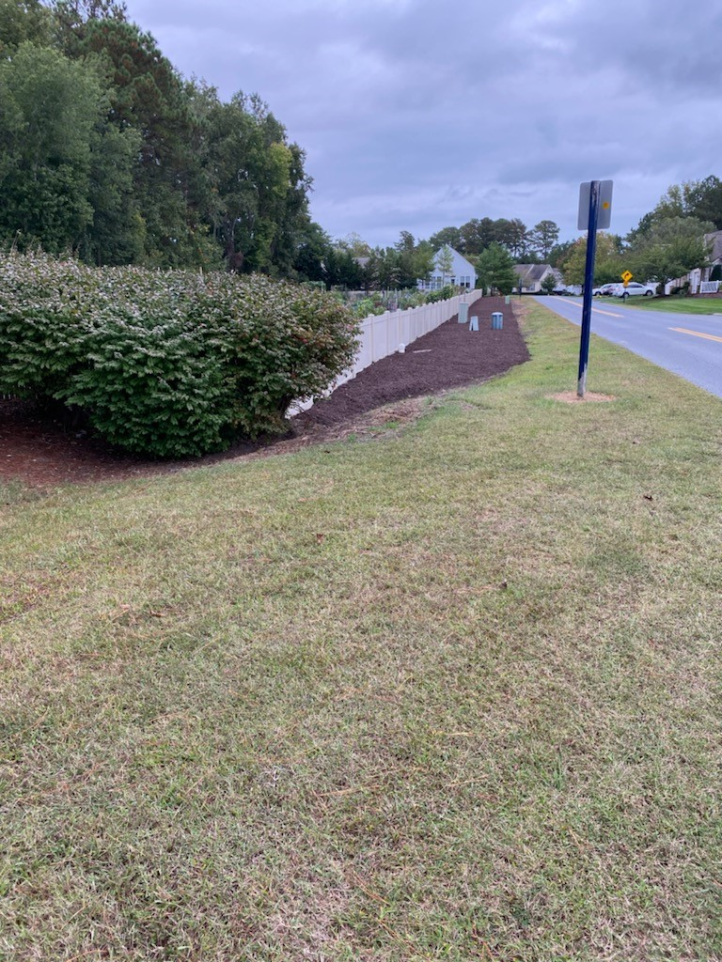
Manklin Creek Road Maintenance
BEFORE
AFTER

Slide 13
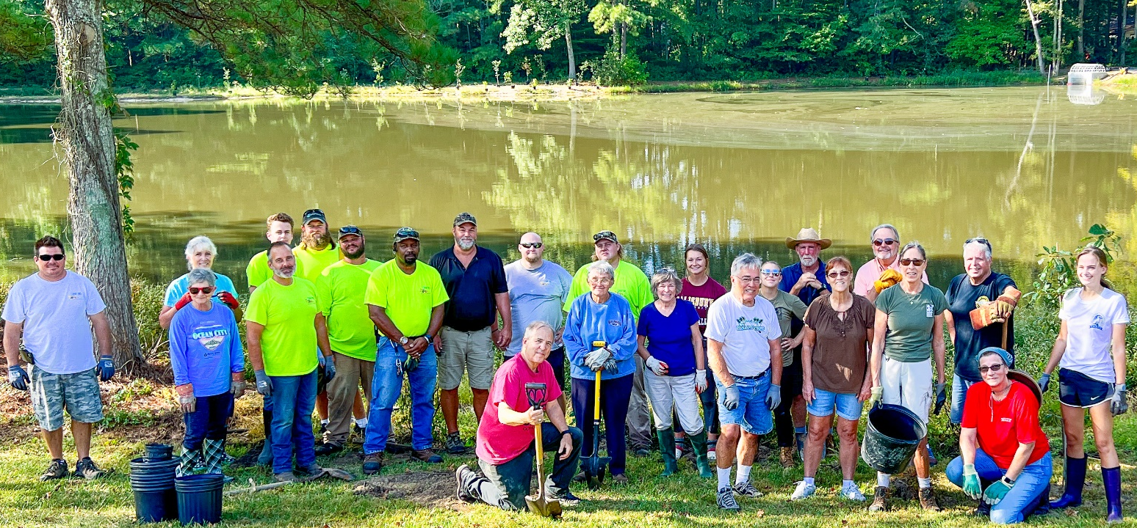
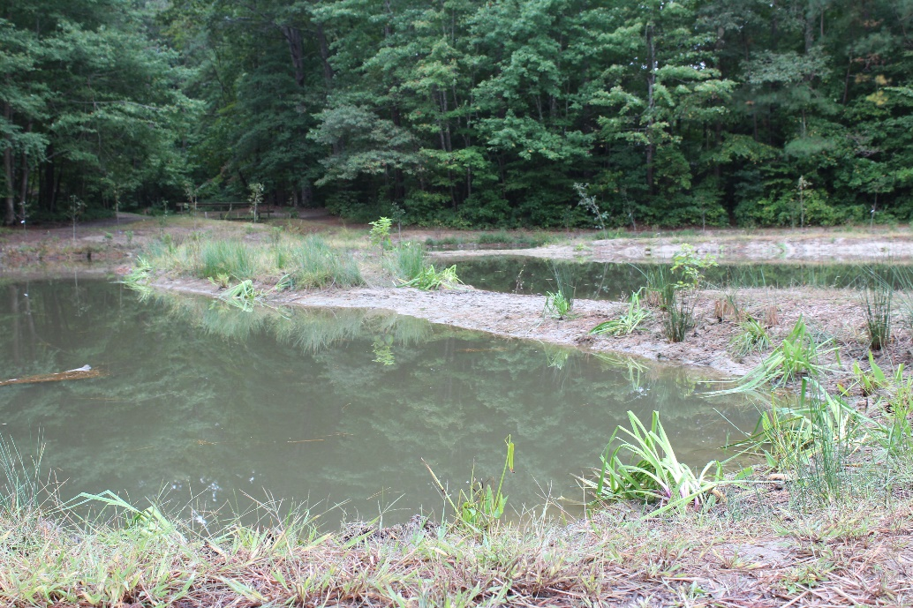
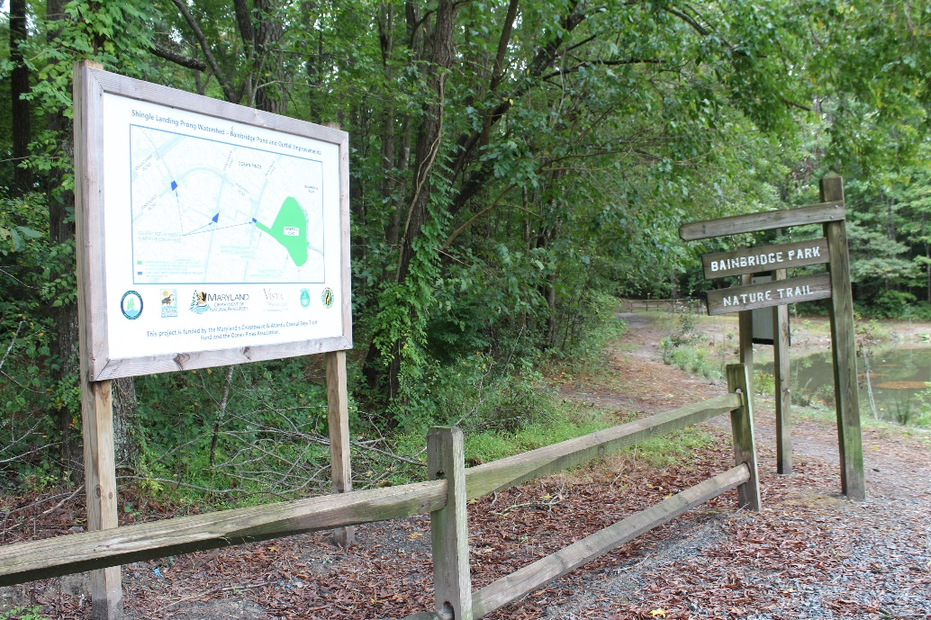
Bainbridge Pond

Slide 14
DMA “Lite” Study
Objective
To update the DMA study dated 9/5/2018
The reserve study is a very good exercise and a beneficial tool to be utilized for budgets, planning, analysis and other financial and management decisions.
Listed as a key objective for the current fiscal year.
All department heads have reviewed and made adjustments with DMA and me.
I have assigned the lead for this initiative to Linda Martin.

Slide 15
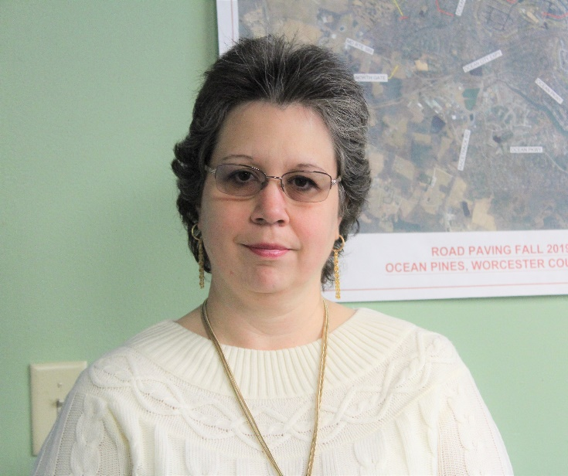
Linda Martin
Returned to Ocean Pines in October 2020 as Office Manager, Previously with Ocean Pines from 2006-2017 as the CPI/Public Works Office Coordinator
Has held financial-related and customer service positions in retail, medical and community-based organizations
Majored in Accounting
Has been leading an effort to update a study of Ocean Pines’ replacement reserves
Handles customer service inquiries to info@oceanpines.org.

Slide 16
DMA “Lite” Study
Progress To Date
First draft of reserve study received from DMA in July. Reviewed by Department Heads for any changes and resubmitted back to DMA in August.
Final draft of reserve study received by DMA at end of September. Copies were made and distributed to Budget and Finance Committee.
Next Steps
Budget and Finance Committee currently reviewing study and will submit questions prior to the working session.
Working session with Budget and Finance Committee/DMA tentatively scheduled for the first week of November. The working session will be open to the public, with date, time and location to be announced soon.
Presentation to Board now scheduled at the November meeting.
Cost
$16,590.00.
90% paid so far, 10% due when final study is delivered (after working session).

Slide 17
CPI Violation Dashboard SEPTEMBER
Violations
As of 8/31/21 | New Violations | Closed Violations | As of 9/30/21
87 | 29 | 48 | 68
Legal Cases
As of 8/31/21 | New Violations to Legal | Closed Violations in Legal | As of 9/30/21
55 | 6 | 21 | 40

Slide 18
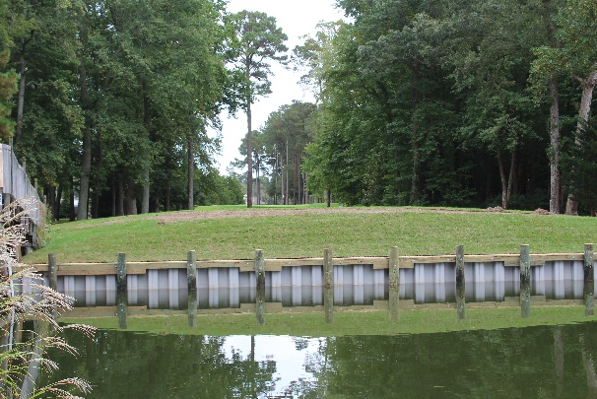
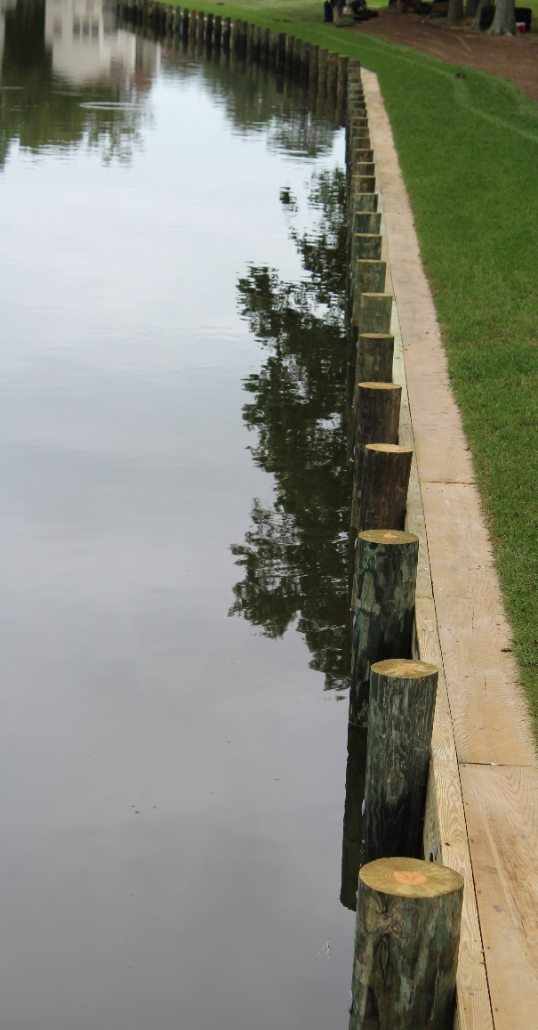
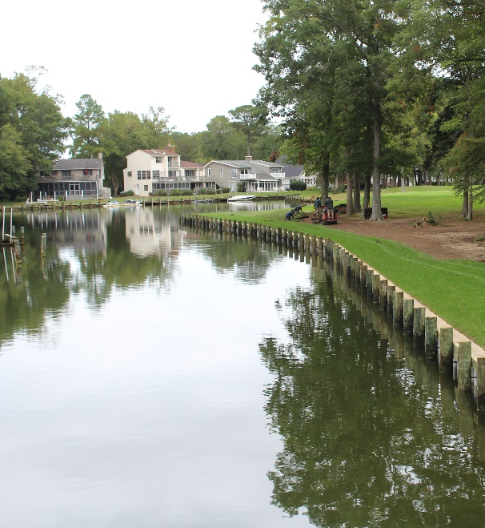
Golf Course Bulkheads
Work began August 16th
Finished October 8th
Total cost was $200,035
Board Approved at the July 21st Meeting

Slide 19
Financial Change month of AUGUST 2021
August (In 000’s)
 | Budget | Current Year | Favor/ (Unfavor) vs. Budget
Net Revenues | $1,427 | $1,565 | $138
Expenses + New Capital | 1,347 | 1,330 | 17
Net Operating | $80 | $235 | $155

Slide 20
Financial Change YEAR-TO-DATE AUGUST 2021
YTD August 2021 (In 000’s)
 | Budget | Current Year | Favor/ (Unfavor) vs. Budget
Net Revenues | $10,758 | $11,627 | $869
Expenses | 5,126 | 4,873 | 253
Net Operating | $5,632 | $6,754 | $1,122

Slide 21
Detail for the Month of AUGUST Favor/(Unfavorable) Vs. Budget (in 000’s)
Department/Amenity | Favorable/(Unfavorable)
Yacht Club | $53.2
Aquatics | 41.6
Public Works/General Maint./CPI | 36.6
Police | 18.4
Golf Ops + Maintenance | 12.1
New Capital | (4.8)
Other Net (Marinas, Racquet, Parking, Clubhouse Grille, Admin) | (1.8)
TOTAL | $155.3

Slide 22
Detail for year-to-date august Favor/(Unfavorable) Vs. Budget (in 000’s)
Department/Amenity | Favorable/(Unfavorable)
Yacht Club | $261.3
Golf Ops + Maintenance | $221.8
Aquatics | 188.4
Public Works/General Maint/CPI | 163.5
Beach Club | 64.4
Police | 54.5
Clubhouse Grille | 49.1
Admin, Finance, GM, PR/Mktng | 48.9
Beach Parking | 48.1
Racquet Sports | 31.4
New Capital | (4.8)
Other Net (Marinas, Rec & Parks) | (4.1)
TOTAL | $1,122.5

Slide 23
“flash” estimate for month of SEPTEMBER 2021 (in 000’s)
Department/Amenity | Favorable/(Unfavorable)
Public Works/General Maint/CPI | $50.7
Marinas | 44.6
Police | 23.2
Golf Ops + Maintenance | 22.5
Aquatics | 12.5
Beach Parking | 9.0
Rec & Parks | 6.7
Beach Club | 6.3
Other Net (Admin, GM, Finance, Marketing, Racquet Sports, Yacht Club, Clubhouse Grille) | 1.1
TOTAL | $176.6

Slide 24
Treasurer’s Report - Doug Parks

Slide 27
Cash & Short-Term Investments
Activity for Month of August
Overall Laddered Investment Rate of Return on CDAR’s for August Approx. 0.85%
As of August 31, 2021, the Association had approx. $16.8 million in cash
Approx. $9.5 million invested in CDAR’s, fully FDIC insured
Approx. $7.3 million in Money Market, and other operating accounts, fully insured

Slide 28
Unaudited Reserves august 2021 ($Millions)
 | GeneralReplace | Bulkheads | Roads | Drainage | New Capital | Total
4/30/21 Balance | $3.9 | $1.0 | $0.2 | $0.5 | $0.1 | $5.7
Contributions/ Interest | 1.6 | 1.1 | - | - | 0.2 | 2.9
Casino Funds + Grant Income | - | - | - | 0.4 | - | 0.4
Transfer (Spend) | (0.2) | (0.5) | (0.2) | (0.3) | - | (1.2)
8/31/21 Balance | $5.3 | $1.6 | $- | $0.6 | $0.3 | $7.8

Slide 29
Reserves year-end unaudited estimate (in ooo’s)
 | Beginning Balance |  |  | Unaudited EST Balance
 | 4/30/21 | Additions | Expenditures | 4/30/2022
Major Maintenance & Replacement:
Public Works – Fleet Vehicles |  |  | (302)
Aquatics (Furniture, Roof, Equip) |  |  | (75)
Police Vehicles |  |  | (80)
Golf Maintenance Tri-plex Mower |  |  | (49)
Public Works Boom Mower |  |  | (36)
Golf Ops (Ball Dispenser/Washer) |  |  | (14)
Yacht Club Kitchen Equipment |  |  | (20)
Racquet (Lighting,Fountains) |  |  | (10)
Other |  |  | (50)
Total | 3,853 | 1,685 | (636) | 4,902
Bulkheads & Waterways | 1,010 | 1,070 | (1,368) | 712
Roads | 216 | 3 | (209) | 10
Drainage | 469 | 835 | (800) | 504
New Capital | 102 | 183 | (190) | 95
TOTAL 4/30/22 ESTIMATE | 5,650 | 3,776 | (3,200) | 6,223

Slide 30
Public Comments

Slide 31
PURCHASE REQUESTS-
None

Slide 32
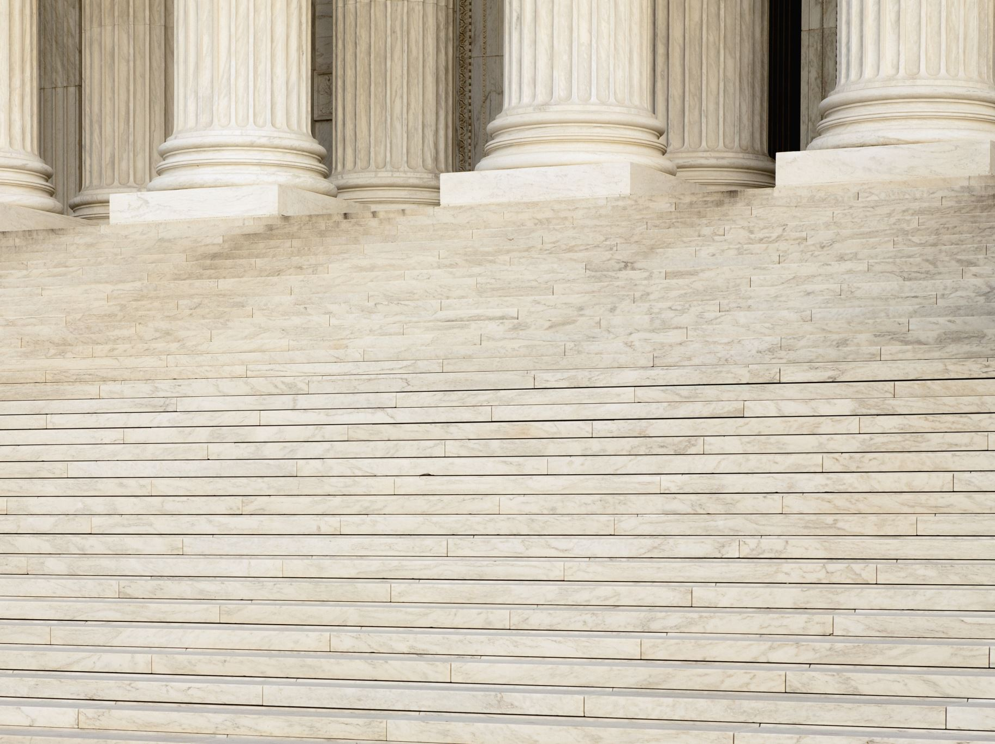
CPI Violations- None

Slide 33
Unfinished Business Second Reading – Resolution C-03 – Doug Parks
Second Reading – Resolution F-02 – Doug Parks
Second Reading – Resolution F-03 – Doug Parks

Slide 34
New Business MOTION: To approve revisions to the OPA employee policies on sick and safe leave – Colette Horn MOTION: To approve a Policy Providing for employees to gift sick and safe leave time to co-workers in need to go into effect on May 1, 2022. - Colette Horn

Slide 35
Appointments Jim Trummel – 3rd Term – By-Laws & Resolutions Robert Hillegass – 3rd Term - By-Laws & Resolutions Stephen Jacobs – 1st Term - By-Laws & Resolutions Steve Habeger – Temporary extension – Elections Mark B. Heintz – Temporary extension – Elections John Latham – 1st Term – Marine Sharon Santacroce – 2nd Term – Environment & Natural Assets Debbie Bennington – 1 year Extension - Communications

Slide 36
Adjournment

