Slide 1
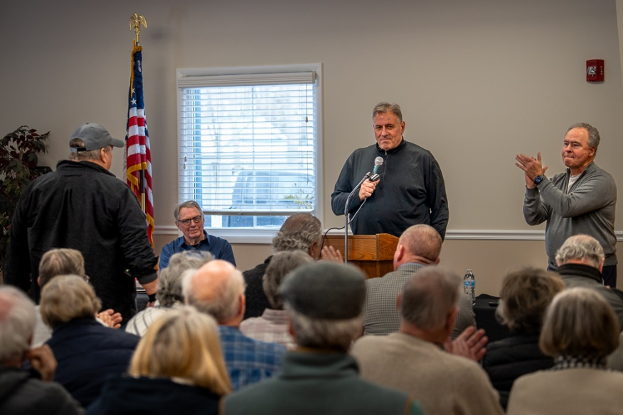
GM Leadership Report – John Viola
January 25, 2025

Slide 2
Touch of Italy
Maintenance
PWC Slips
Initiatives
Racquet Sports Building
Firehouse Building
Bridge (4th Tee Box)
Driving Range Building
Bocce Ball Courts
Budget
Snow Removal
Digital Signs
Metrics

Slide 3
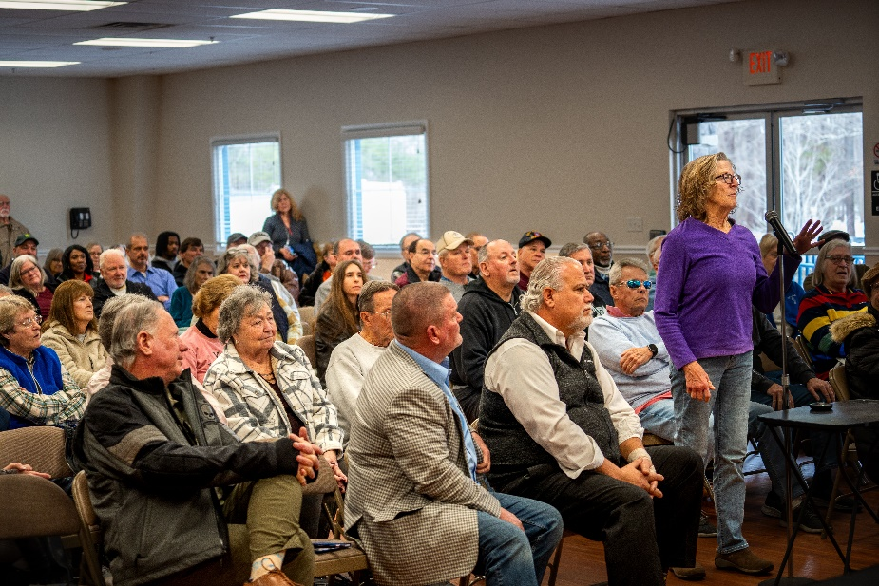
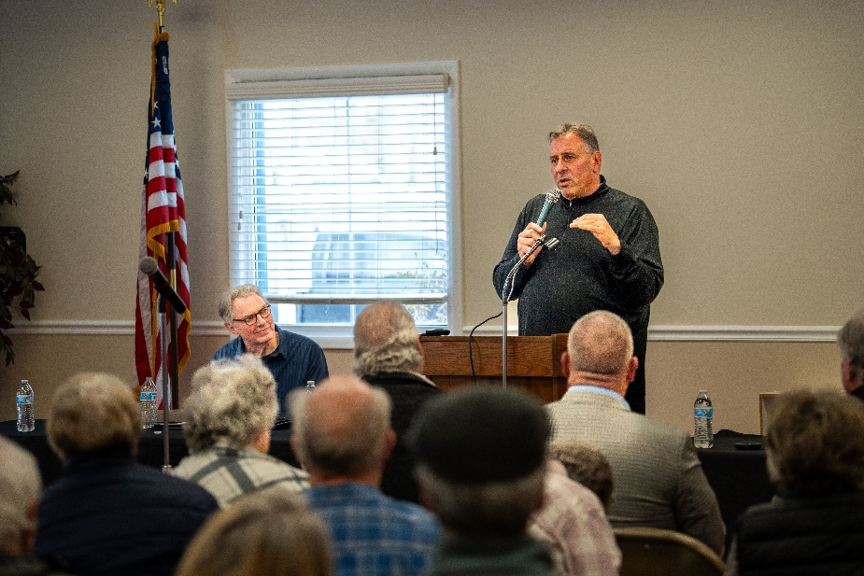
Touch of Italy
5-year lease agreement approved by Board and signed on January 8, 2025
Contract to begin May 1, 2025
Management of Yacht Club, Clubhouse, & Beach Club
Town Hall held on January 16, 2025

Slide 4
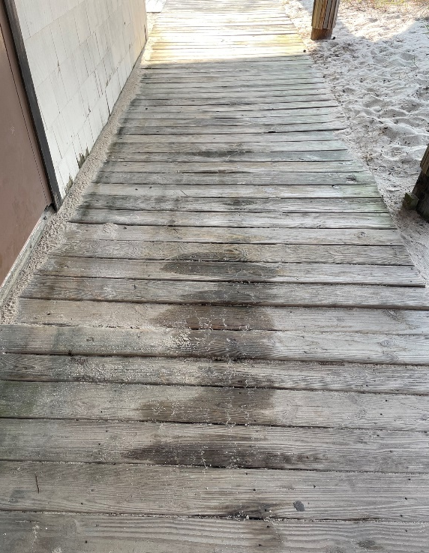
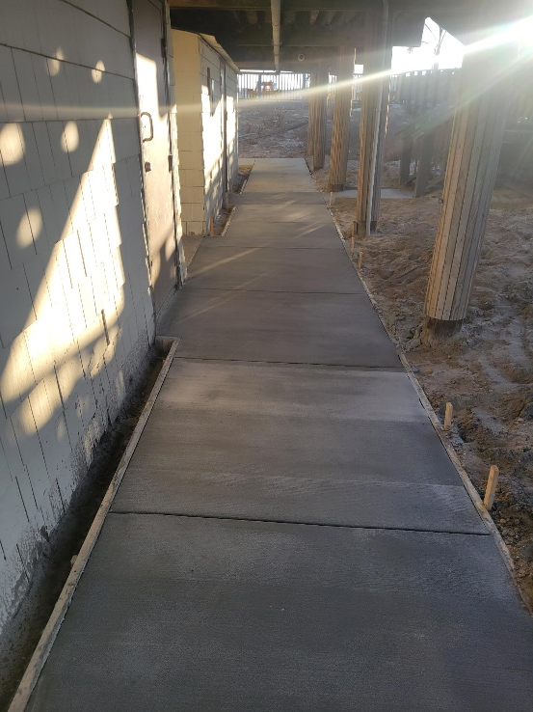
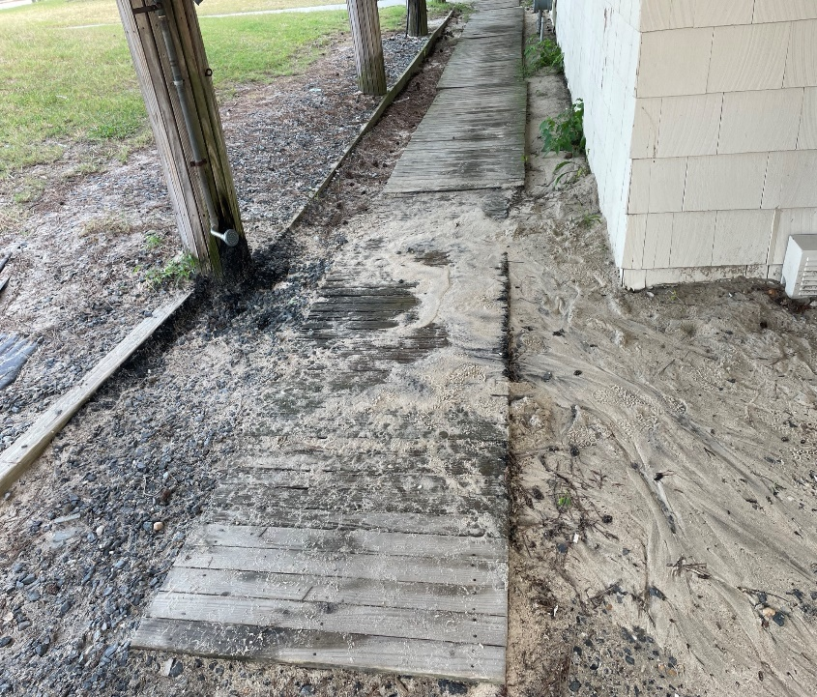
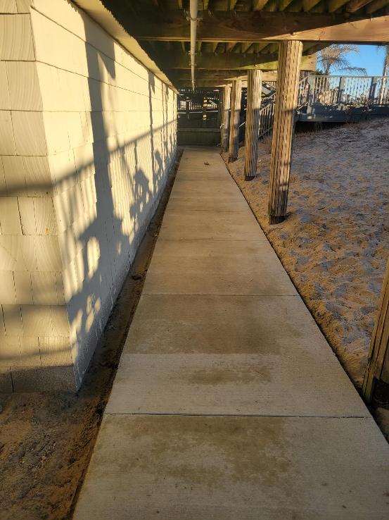
Maintenance
BEFORE
AFTER
Wood walkway replaced with sidewalk around Beach Club building to address drainage and safety issues
Work done by outside contractor
Total cost: $4,500

Slide 5
Maintenance
BEFORE
AFTER
Recreation Director reviewed and reported separation in gym floor
Annual maintenance item
Work done in-house by Public Works

Slide 6
PWC Slips
“One of a kind great experience to keep our personal water craft (PWC) at our Swim & Racquet Club overlooking the bay” (quote by Nobie Violante)
Details:
6 floating pwc slips approved
Planned implementation – May 1st
Cost (material and installation): ~$20,000
Call or email Ruth Ann Meyer for information on the slips

Slide 7
Initiatives
Racquet Sports Building
Status: green
Timeline: weather permitting, to begin week of 1/27
Firehouse Building
Status: green
Timeline: 4th quarter 2025 – 1st quarter 2027
Bridge (4th tee box)
Status: green
Timeline: new decking and rails to begin week of 2/3
Cost: $40,000
Driving Range Building
Status: completed
Bocce Ball Courts
Status: in beginning stages of design and cost estimates
Timeline: if approved, to be completed by Memorial Day

Slide 8
Director of Business Administration – Linda Martin

Slide 9
FY 2025/2026 Budget
Town Hall to be held on February 5th beginning at 11:00 a.m. in the Clubhouse Meeting Room
Addressing public safety, maintenance, and infrastructure (Fire Department)
FMLI, medical costs, and liability insurance increases
Pricing study conducted

Slide 10
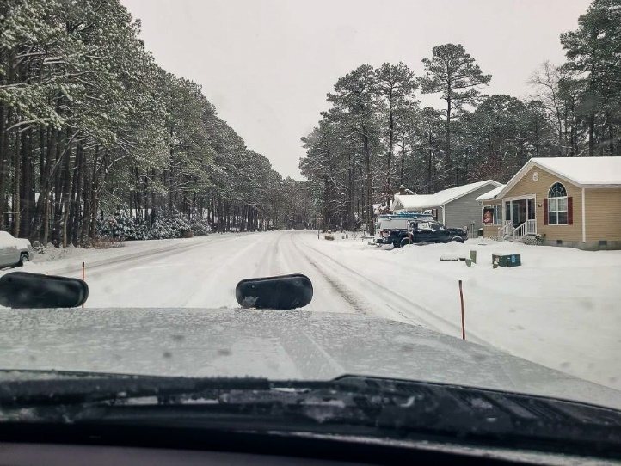
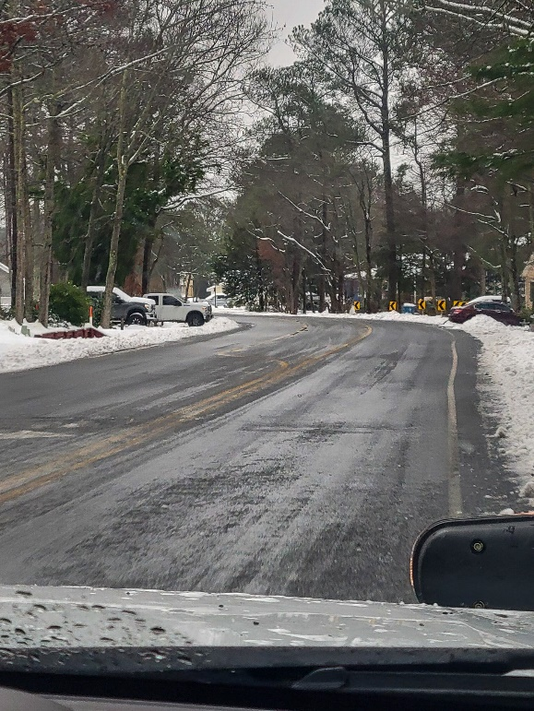
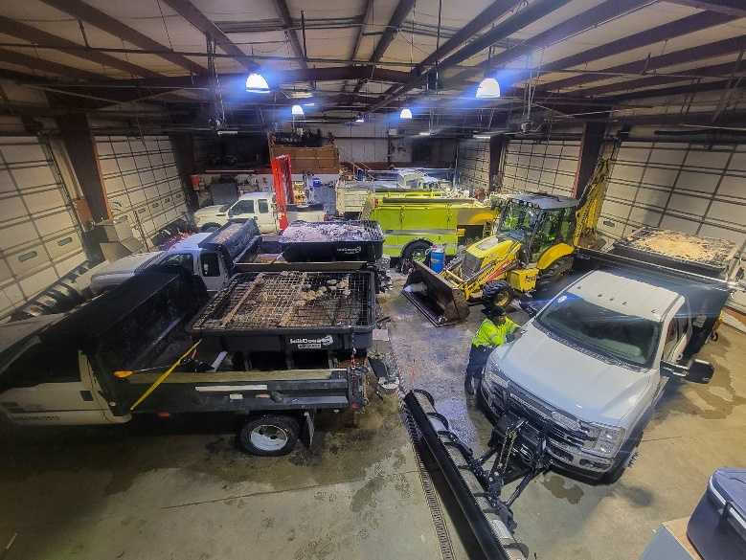
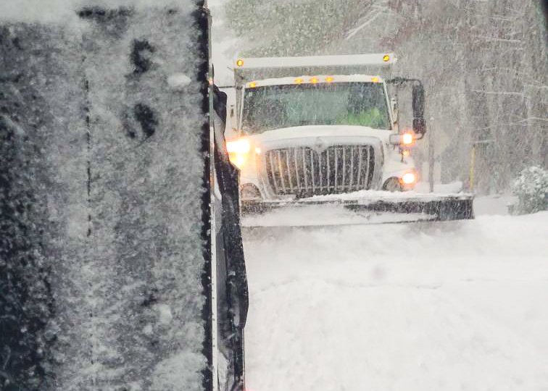
Snow Removal
Snow storms: January 6th, January 11th, and January 21st
$10,000 budget for snow removal
Total cost including labor (overtime), contractor for mailbox pad cleaning, and salt for roads: $27,519

Slide 11
Digital Signs
Location of signs approved by Worcester County on January 21st
Per approval, once signs are installed remaining median signs need to be removed (directional signage and sectional signage can remain), along with removal of an temporary signage
4 additional signs to be installed:
Manklin Creek Road
Cathell Road
Yacht Club entrance
Community Center
All 4 signs are in stock and Phillips Signs along with assistance from Public Works will install when weather improves

Slide 12
CPI Violation Dashboard December
Violations
As of 12/1/24 | New Violations | Closed Violations | As of 12/31/24
299 | 179 | 176 | 302
179 violations initiated in December: 25 maintenance/trash/debris; 11 no permit; 4 signs; 139 miscellaneous
Miscellaneous violations includes permit expiration, trailers, unregistered/junk vehicles, vehicle parking, and wire/metal fencing
176 violations complied out; 302 remain open
67 maintenance/trash/debris; 55 no permit; 14 signs; 166 miscellaneous
70 of 302 violations still open are in legal

Slide 13
Work Orders December
Open Work Orders as of 12/1/24 | New Work Orders | Closed Work Orders | Open Work Orders as of 12/31/24
79 | 48 | 85 | 42
48 work orders initiated in December: 1 bulkhead; 11 drainage; 5 grounds/landscaping; 4 roads; 1 sign; 26 general maintenance
Majority still open in drainage (29):
10 – over 30 days; 9 – over 60 days
Average 1-4 work orders a day to complete depending upon severity

Slide 14
Customer Service Dashboard (from info@oceanpines.org) December
Type | # Received – Dec.
Amenities | 10
CPI | 10
Drainage | 0
General | 19
Public Works | 4
TOTAL | 43

Slide 15
Financials

Slide 16
MONTH OF DECEMBER 2024 FINANCIAL RESULTS

Slide 17
DECEMBER 2024 YTD FINANCIAL RESULTS

Slide 18
UNAUDITED RESERVE SUMMARY DECEMBER 2024 ($ MILLIONS)
 | General Replace | Bulkheads | Roads | Drainage | New Capital | Total
4/30/24 Balance | $5.5 | $0.3 | $0.8 | $0.4 | $0.1 | $7.1
Contributions/ Interest | 2.0 | 1.1 | 0.1 | 0.1 | - | 3.3
Casino Funds | - | - | 0.3 | 0.1 | - | 0.4
Transfer (Spend) | (2.0) | (0.6) | - | (0.3) | - | (2.9)
12/31/24 Balance | $5.5 | $0.8 | $1.2 | $0.3 | $0.1 | $7.9

Slide 19
Treasurer’s Report - Monica Rakowski

Slide 20
Cash & Short-Term Investments
Month of December
As of December 31, 2024, the Association had Approximately (~) $15.1M in Cash
Cash Decreased ~ ($0.6)M from the Same Time Period Last Year
Cash Decreased ~ ($1.0M) from November 2024
$8.7M Invested in CDAR’s
$54K in Interest Income Recognized for the Month
Remaining $6.4M in Insured Cash Sweep, Treasury Bills, Money Market and Other Operating Accounts (Diversified Between 2 Local Banks)

