Slide 1
Board of Directors Meeting
December 19, 2020

Slide 2
Approval of Agenda

Slide 3
Approval of Minutes November 18, 2020 – Regular Meeting November 18-19, 2020 – Closed Meeting

Slide 4
President’s Remarks Larry Perrone

Slide 5
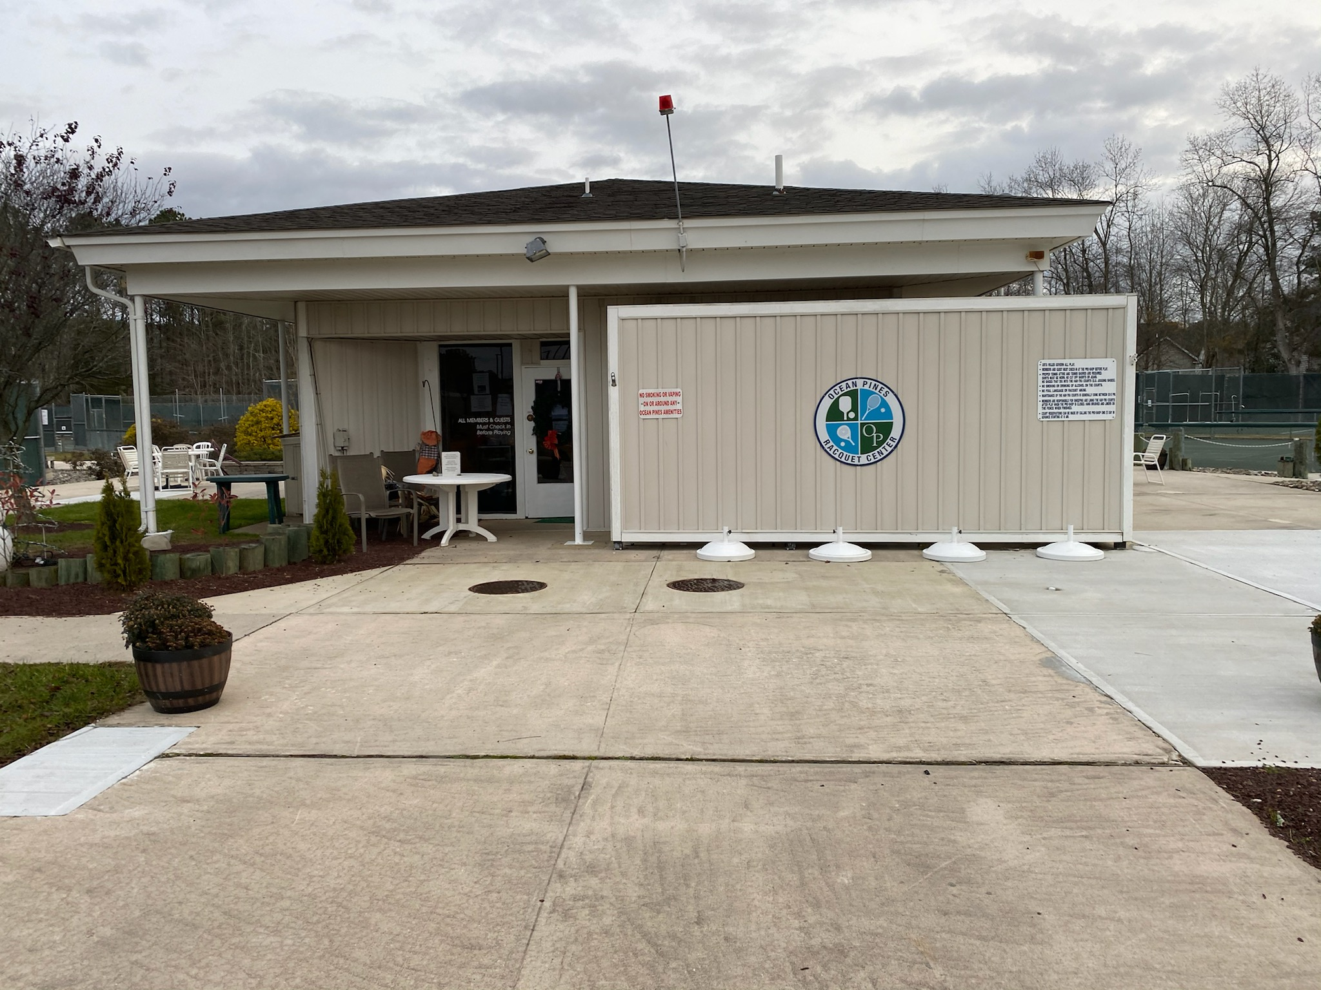
GM team Report John Viola

Slide 6
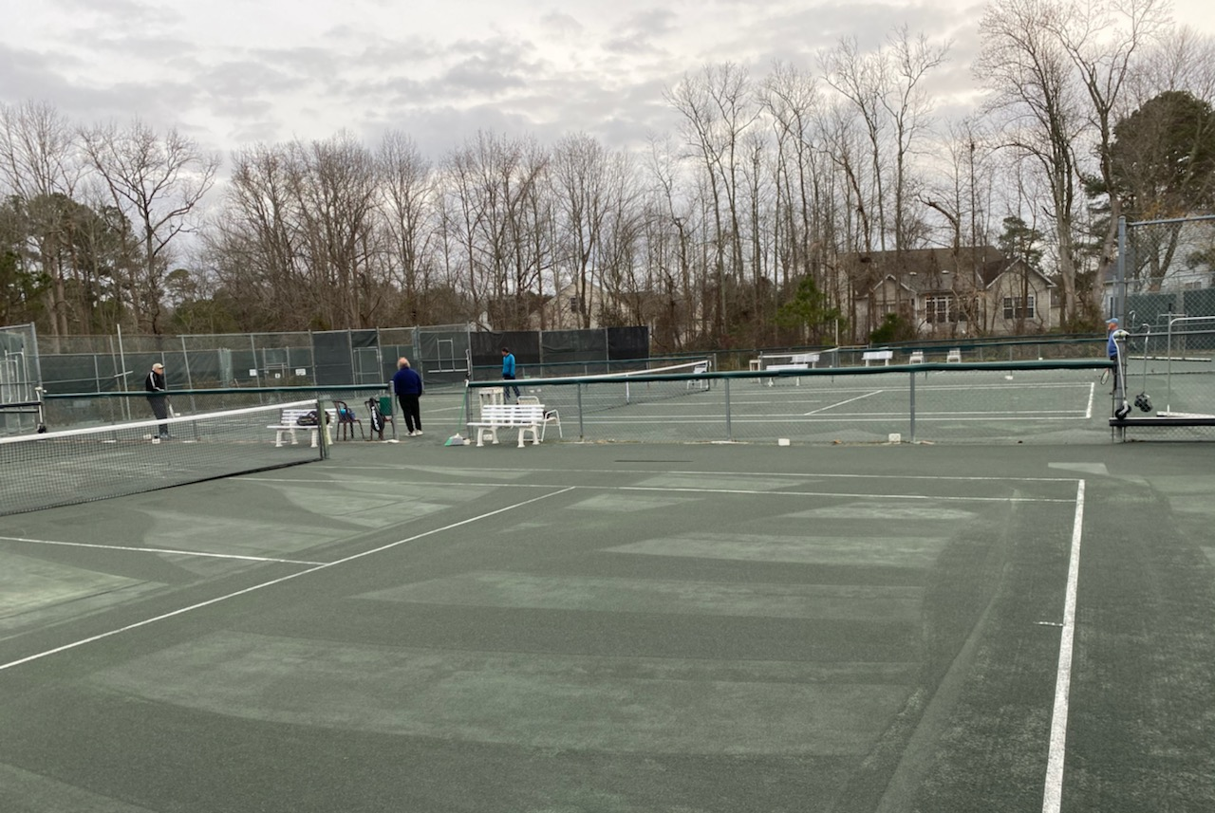

Slide 8
GM TEAM REPORT
Received guidance from b & f in September time period
Prepare “bottom up”
Department heads input
I had the team review initiatives with b & f over the last several months for guidance and to communicate what we were “looking at”
Proposed Budgets “working documents” were available for distribution to B & f and Board on Friday December 18th as per commitment
There are challenges, variable, options that need to be (vetted) discussed independently vs. imbedded in the work papers.
Covid-19 initiatives, rising salary and benefit costs and PPP favorability have been highlighted

Slide 9
GM TEAM REPORT (continued)
FY 2020-2021 Forecast
 | Administration | $1,037,000
 | Aquatics | (270,000)
 | Beach Parking | (202,000)
 | General Maintenance | (144,000)
 | Marinas | 63,000
 | Public Works | 81,000
 | Other | 85,000
 | Operating Profit | $ 650,000 Favorable

Slide 10
GM TEAM REPORT (continued)
Forecast FY 2020-2021
Forecast | $ 650,000
PPP | (1,150,000)
PPP | (275,000)
ACA | (125,000)
Loss w/o PPP | $(900,000)

Slide 11
GM TEAM REPORT (continued)
The Following Items Were Key Items As We Addressed And Prepared The Preliminary Proposed Budget:
Operating Departments And Drainage Reserve:
 | Drainage - Pipes
 | Salaries, medical benefits, liability insurance
 | Aquatics
 | Beach Parking
 | Bulkheads (General)
 | Positions
 | Fire/EMS
 | Other
 | Depreciation
 | Estimated Favorability

Slide 12
GM TEAM REPORT (continued)
Initiatives:
 | Bainbridge Drainage
 | T-Docks
 | Racquet Courts
 | Mailboxes
 | Boat Ramp Gates
 | Kayak Storage
 | Recreation Pier
Covid Adjustment:
 | Aquatics
 | Beach Parking
 | Yacht Club
 | Golf
 | Beach Club
 | Recreation & Parks

Slide 13
GM TEAM REPORT (continued)
Completed Reviews and recommendations to the Board for;
Waste Services
Accounting Services
Storm, Saturday, Dec. 5th
5.7 inches of rain reported by Public Works
Public Works crews were sent out all day. Police were called and responded
Started Ocean Pines Academy and Board Onboarding Initiatives
Leader and Team designated
Outline and timeline prepared and approved
Video and/or in-person meetings to be addressed
Next steps, meet with the Departments
Racquet sports
Fence
Allocated increased resources to software and drainage

Slide 14
software
Needs High Degree of Customization – All departments are evaluating the extent, cost and timeframe of any enhancements needed by the software company so that they can be prioritized and scheduled.
F&B – The software system has been deployed at the Clubhouse Grille and is being evaluated for future implementations at other F&B venues. Test bed is being deployed to simulate and evaluate future F&B venues as well.
General – We have been experiencing random unreliability on a fairly regular basis. We are working with the software company to isolate the causes of these problems by creating an audit log which will include pertinent details of each incident. This will allow the software company to have a better chance of narrowing down the root causes of these problems.
Support – We’re also trying to establish the reasons that the support is inconsistent. Timely responses and appropriately skilled technicians are key to acceptable uptime and we’ve not been able to establish a consistent level of either. The software company has come up with the following:
Weekly update calls to go over open items instead of Bi-Weekly
Support Leader will attend every other meeting to be sure staff is following priorities.
Support Leader will also address these concerns privately with his team, not only at meetings.
Open Items list will be overseen by Support Leader for ongoing status between meetings.
Additional Open Items recently added (Public Works) will be addressed by Support Leader immediately.

Slide 15
CPI Violation Dashboard NOVEMber
Violations
As of 10/31/20 | New Violations | Closed Violations | As of 11/30/20
116 | 13 | 44 | 85
Legal Cases
As of 10/31/20 | New Violations to Legal | Closed Violations by Legal | As of 11/30/20
43 | 18 | 4 | 57

Slide 16
WORK ORDERS NOVEMBER
Open Work Orders as of 10/31/20 | New Work Orders | Closed Work Orders | Open Work Orders as of 11/30/20
44 | 67 | 53 | 58

Slide 17
Financial Change month of OCTOBER 2020
October (In Thousands)
 | Budget | Current Year | Favor/ (Unfavor) vs. Budget
Net Revenues | $470 | $495 | $25
Expenses | 1,216 | 1,107 | 109
Net Operating | ($ 746) | ($ 612) | $134

Slide 18
Financial Change ytd ocToBER 2020
October YTD (In Thousands)
 | Budget | Current Year | Favor/ (Unfavor) vs. Budget
Net Revenues | $11,702 | $11,949 | $247
Expenses | 7,353 | 6,333 | 1,020
Net Operating | $4,349 | $5,616 | $1,267

Slide 19
Detail for the Month of octoBER Favor/(Unfavorable) Vs. Budget
Public Works/General Maint/CPI | $79.5
Recreation & Parks | 30.7
Golf Ops & Maintenance | 16.9
Finance | 15.1
Clubhouse Grille | 14.1
Beach Parking | 10.7
Marinas | 7.6
Yacht Club | (33.8)
Aquatics | (6.1)
Other (Net) | (0.7)
Net Operating | $134.0

Slide 20
Detail for october ytd Favor/(Unfavorable) Vs. Budget
General Admin. | $982.0
Public Works/Gen Maintenance/CPI | 391.4
Yacht Club | 79.6
Finance | 58.7
Marinas | 56.8
Clubhouse Grille | 41.8
Public Relations | 30.4
Police | 29.6
GM’s Office | 13.0
Golf Ops & Maintenance | 8.2
Aquatics | (217.6)
Beach Parking | (177.8)
Racquet Sports | (20.8)
Recreation & Parks | (8.4)
Net Operating | $1,266.9

Slide 21
Month of NOVEMBER 2020 flash
November Estimate (In Thousands)
 | Budget | Current Year | Favor/ (Unfavor) vs. Budget
Net Revenues | $262 | $290 | $28
Expenses | 975 | 915 | 60
Net Operating | ($713) | ($625) | $88

Slide 22
Treasurer’s Report - Doug Parks

Slide 23
Cash & Short-Term Investments
Activity for Month of October
Overall Laddered Investment Rate of Return on CDAR’s for October Approx. 1.0%
As of October 31, 2020, the Association had approx. $12.5 million in cash
Approx. $7.1 million invested in CDAR’s, fully FDIC insured
Approx. $5.4 million in Money Market and other operating accounts, fully insured

Slide 25
Unaudited Reserves OCTOBER 2020 ($Millions)
 | GeneralReplace | Bulkheads | Roads | Drainage | New Capital | Total
4/30/20 Balance | $3.5 | $1.6 | $0 | $0.5 | $0 | $5.6
Assessments/ Interest | 1.8 | 0.9 | - | - | 0.2 | 2.9
Casino Funds | - | - | 0.3 | - | - | 0.3
Transfer (Spend) | (1.1) | (0.6) | (0.1) | (0.05) | (0.1) | (1.9)
10/31/20 Balance | $4.2 | $1.9 | $0.2 | $0.5 | $0.1 | $6.9

Slide 26
Reserves 4/30/21 unaudited estimate (in thousands)
 | Beginning Balance |  |  | Projected Balance
 | 4/30/2020 | Additions | Expenditures | 4/30/2021
Major Maintenance & Replacement:
Police Renovation |  |  | (608)
Northstar |  |  | (75)
Admin Siding-Roof |  |  | (73)
Aquatics (Splash Pads, etc) |  |  | (50)
Yacht Club + Beach Club |  |  | (40)
Racquet Sports Sidewalks |  |  | (65)
Tractor for Ditch Maintenance |  |  | (150)
Rough Mower |  |  | (67)
Police Vehicle |  |  | (40)
Playground Equipment/Other |  |  | (150)
Total | 3,481 | 1,825 | (1,318) | 3,988
Bulkheads & Waterways | 1,653 | 900 | (1,784) | 769
Roads | 0 | 330 | (110) | 220
Drainage | 506 | 5 | (511) | -
New Capital | 0 | 167 | (72) | 95
TOTAL 4/30/21 | 5,640 | 3,227 | (3,795) | 5,072

Slide 27
Public Comments

Slide 28
Capital Purchase Requests none

Slide 29
CPI Violations- 5 White Cap Lane (roof maintenance) 5 White Cap Lane (house number) 18 Harbormist Circle (roof maintenance) 4 Moby Dick Dr. (roof maintenance) 28 Birdnest Dr. (roof maintenance) 62 Falconbridge Rd. (roof maintenance) 61 Falconbridge Rd. (roof maintenance) 23 Falconbridge Rd. (roof maintenance) 21 Falconbridge Rd. (roof maintenance) 42 Bramblewood Dr. (roof maintenance & house number) 1 Maid Marion Lane (roof maintenance) 9 Chestnut Way (roof maintenance)
These violations were with the Attorney, his recommendation was to present to the Board, per Resolution M-01, para. 2 & 7, and Section 14.A. of the Declaration of Restrictions requires a 2/3 Board approval vote is required for OPA to enter a property to perform maintenance violation repairs.

Slide 30
unfinished Business Second Reading – Resolution C-14 – Camilla Rogers Board Work Group Updates – Larry Perrone

Slide 31
new Business Motion – Approve Trash Removal Contract – Larry Perrone Motion – To Approve Accounting Firm – Doug Parks Motion – HR Policies – Colette Horn Discussion – Jenkins Point Project – Larry Perrone

Slide 32
Appointments - none

Slide 33
Adjournment To Closed Session

